Slide 1
Low Impact Development
Planning, Design, and Construction for Compliance with
MRP Provision C.3
Dan Cloak, Principal
Dan Cloak Environmental Consulting
June 12, 2014

Slide 2

Motivations
Compliance
Mandate
Client support
Acceptance of costs
Structure
Schedule
Accountability
Project Quality
Enthusiasm
Interest
Energy
Synergies
Opportunities
Elegance

Slide 3
Objectives for Today
Bring you up to date on the ongoing
evolution of C.3 requirements
Provide a refresher on LID design for
C.3 compliance
Discuss common problems and issues with
project design and identify workable solutions
Share feedback

Slide 4
Time | Topic
12:45 | Check In
1:00 | Introductions
1:10 | LID Principles and Objectives
1:25 | C.3 Background and Update
1:45 | LID Site Design and Bioretention Design—Conceptual Level
2:30 | BREAK
2:40 | Issues Frequently Discussed
3:30 | BREAK
3:40 | Bioretention Design Details
4:15 | Construction of Bioretention Facilities
4:25 | Operation and Maintenance of Bioretention Facilities
4:35 | Topics for Future Workshops and Wrap Up
4:45 | Adjourn

Slide 5
Principles & Objectives
LID Planning, Design, and Construction

Slide 6
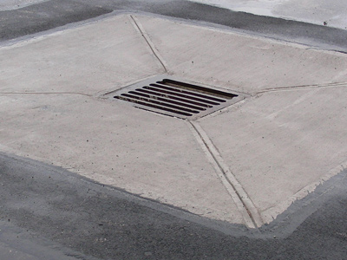
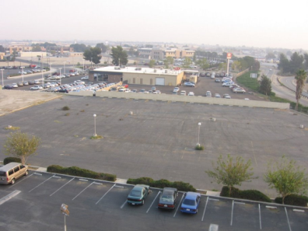
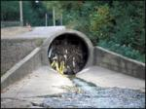
Conventional Urban Drainage
Impervious surfaces:
roofs and pavement
Catch basins and
piped drainage
“Collect and
convey” design
objective

Slide 7
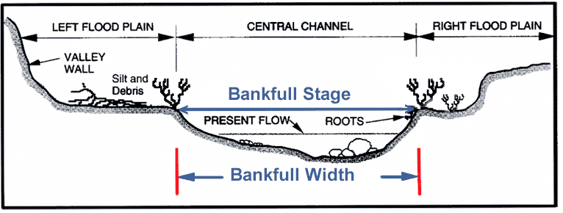
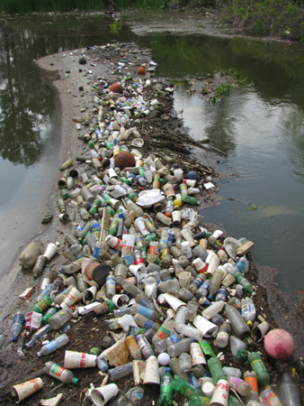
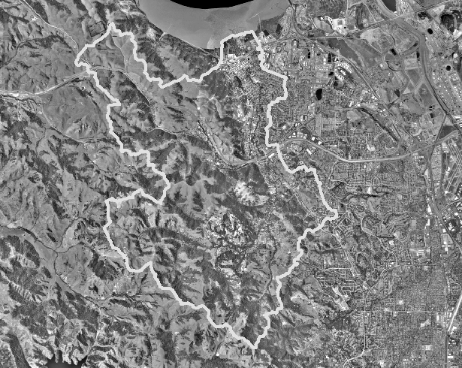
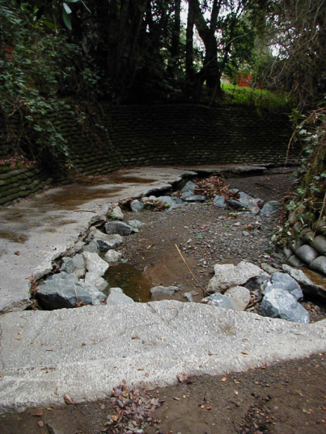
Drainage Impacts
Site Scale | Watershed and Stream Scale
Higher peak flows | Flooding and scouring of stream beds
Lower time of concentration | Flash flows
Runoff from small storms | Discharge when runoff did not previously occur
Increased runoff durations | Stream erosion at moderate stream flow rates
Greater runoff volumes | Higher pollutant loading
Greater runoff energy | Conveys trash and gross pollutants to streams
Decreased infiltration | Lower and less frequent stream base flow
Dry weather discharges | High pollutant concentrations during low flows
Notes:
The pictures relate to items #1, #4, and #6 in the table.

Slide 8
LID Design Objectives
Watershed and Stream Scale | Site scale
Reduce peak flows | Detain runoff on site
Increase time of concentration | Slow runoff from leaving site
No runoff from small storms | Infiltrate, evapotranspirate and reuse
Reduce duration of moderate flows | Let runoff seep away very slowly
Reduce runoff volume | Infiltrate and reuse where possible
Reduce runoff energy | Detain and slow flows
Increase groundwater storage and stream base flows | Facilitate infiltration
Reduce pollutants in runoff | Detain and filter runoff
Protect against spills and dumping | Disconnect drainage and filter runoff

Slide 9
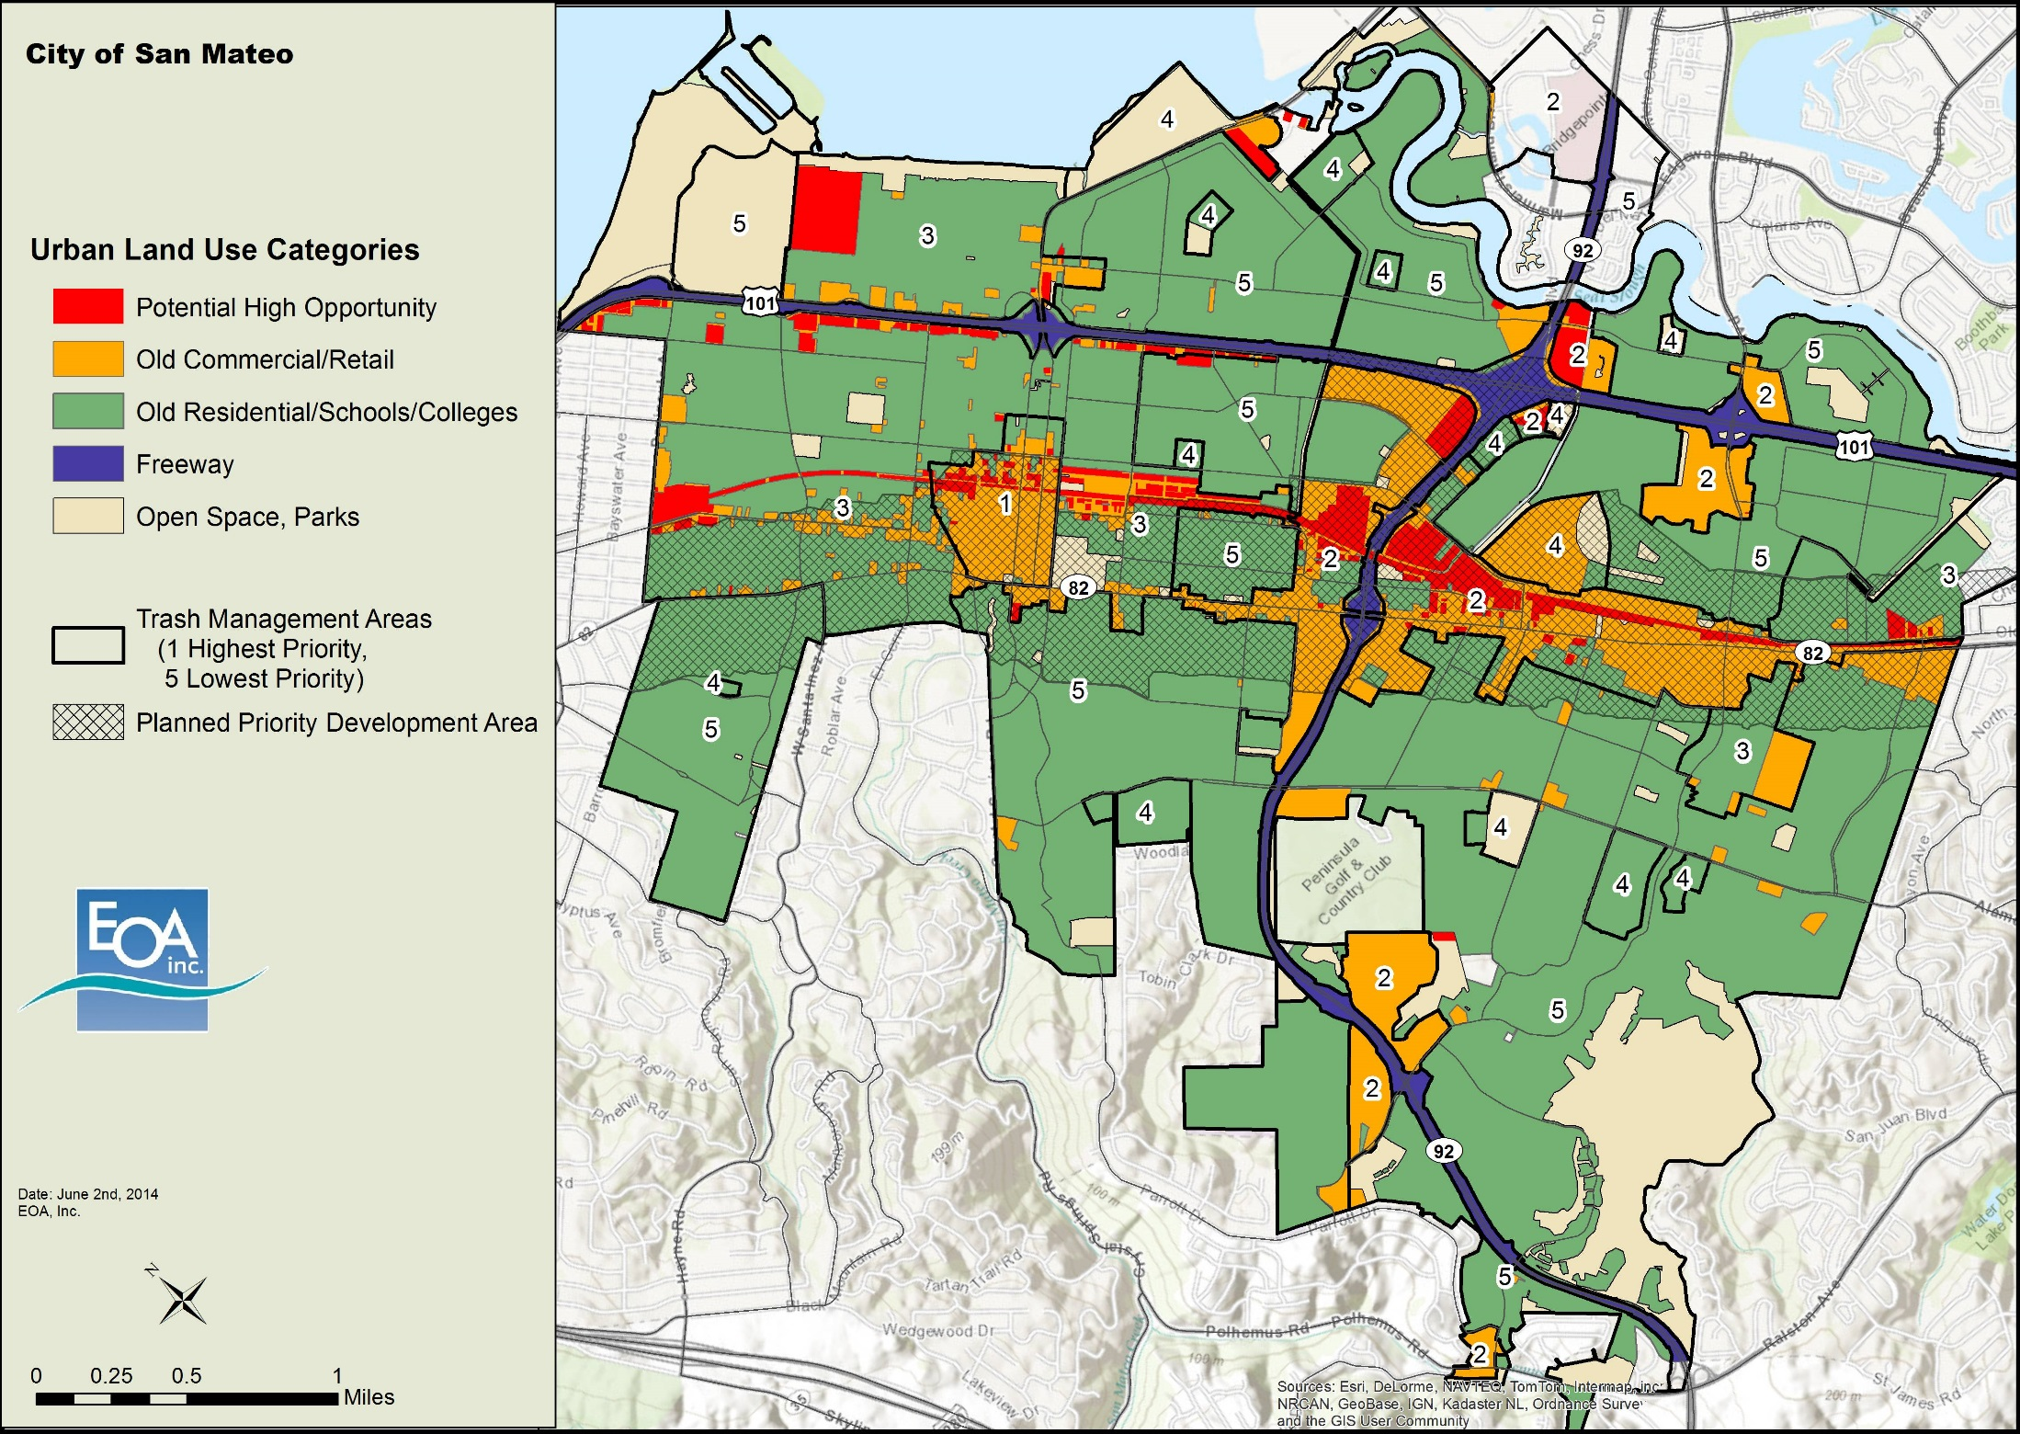
Green Infrastructure

Slide 10

Public ROW and Drainage

Slide 11
C.3 Background & Update
LID Planning, Design, and Construction

Slide 12
C.3 Regulatory History
1987 | Congress adds Section 402(p) to Clean Water Act
1990 | USEPA regulations require states to issue stormwater NPDES permits to large municipalities
1990 | Regional Water Board issues first Bay Area stormwater NPDES permits
2000 | State Water Resources Control Board “Bellflower decision” confirms municipalities must require new developments to treat runoff

Slide 13
C.3 Regulatory History
2003 | Regional Water Board adds Provision C.3 to stormwater permit for Contra Costa municipalities
2005 | C.3 implementation begins for projects creating or replacing an acre or more of impervious area
2006 | Water Board adopts Contra Costa’s Hydrograph Modification Management Plan and requirements take effect. C.3 threshold for treatment requirements drops from one acre to 10,000 square feet of impervious area
Notes:
Discuss purpose and approach of Guidebook – promoting conversation between applicant and reviewer. Framework for using the flexibility and resolving ambiguities within the Permit. Where ambiguities come from (some unintentional, some negotiated).

Slide 14
C.3 Regulatory History
2009 | Municipal Regional Permit adopted, including LID requirements. Threshold for some land uses lowered to 5,000 SF of impervious area. Contra Costa develops current HMP sizing factors and calculator.
2011 | MRP amended, including “Special Projects” categories. LID requirements take effect, including feasibility tests for infiltration and harvesting/reuse.
2013 | Municipal permittees assessed implementation of feasibility tests and recommended allowing bioretention as a first choice for LID treatment.

Slide 15
Where Are We Now?
LID treatment is required
  Runoff may be reduced or dispersed as detailed in the Stormwater C.3 Guidebook
  Bioretention is LID and may be used without a feasibility test
Bioretention facilities must meet specific design criteria
  12" gravel storage layer underneath entire area,
  with underdrain at the top
  Vault-based filters or tree-well-type biofilters may be used only on “Special Projects,”
  Only for a portion of impervious area (table of “credits” on p. 60)
  Document infeasibility of 100% bioretention
Hydromodification Management requirements apply to projects with ≥ 1 acre impervious area created/replaced

Slide 16
Outdated

Slide 17
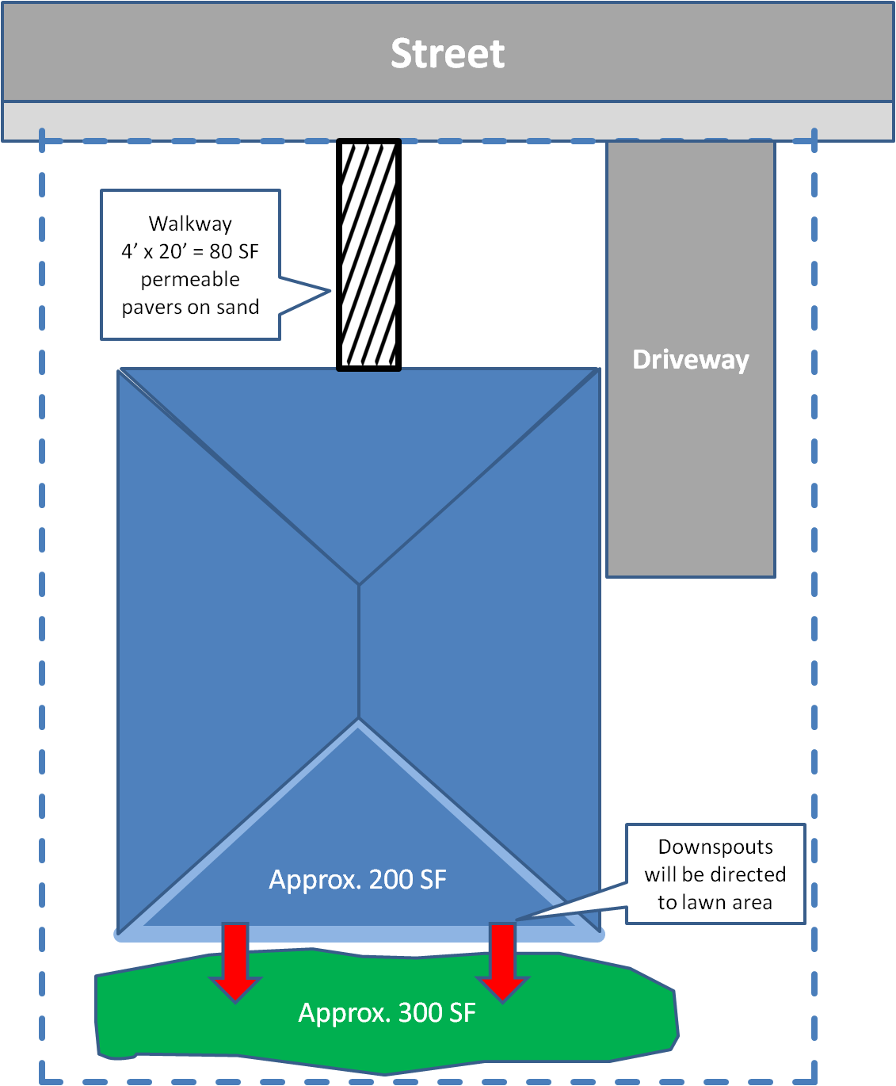
Small Projects
Projects that create or replace between 2,500 and 10,000 SF of impervious surface
Effective Dec. 1, 2012
Use template on CCCWP website

Slide 18
What’s Coming in MRP 2.0?
Focus on design standards for LID
  Bioretention
  Pervious Pavement
Updated hydromodification criteria
  New sizing factors for facilities
  Updated sizing calculator
Focus on operation and maintenance
Simplification and streamlining(?)

Slide 19
LID conceptual design and documentation
LID Planning, Design, and Construction

Slide 20
LID Design Process
Analyze Project for LID
Develop and Document LID Drainage Design
Specify LID Preliminary Design Details
Coordinate with Site Design and Landscape Design

Slide 21
Analyze Your Project for LID
Page
36
Optimize the site layout
Use pervious surfaces
Disperse runoff
Store runoff and use it later
Drain to bioretention or other facilities to retain, treat, and control flows

Slide 22
Optimize the Site Layout
Page
38
Define the development envelope
Minimize grading
Set back from creeks, wetlands, and riparian areas
Preserve significant trees

Slide 23
Optimize the Site Layout
Page
38
Limit roofs and paving
Preserve and use permeable soils
Detain and retain runoff throughout the site
Use drainage as a design element

Slide 24
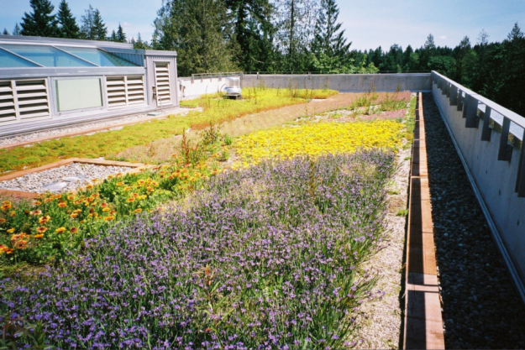
Use Pervious Surfaces
Page
38
Permeable pavements
Green roofs

Slide 25
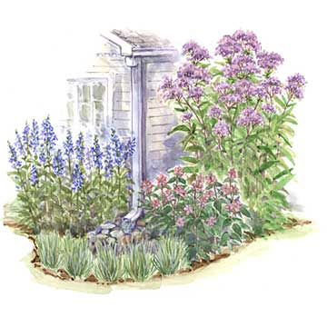
Disperse Runoff
Page
39

Slide 26
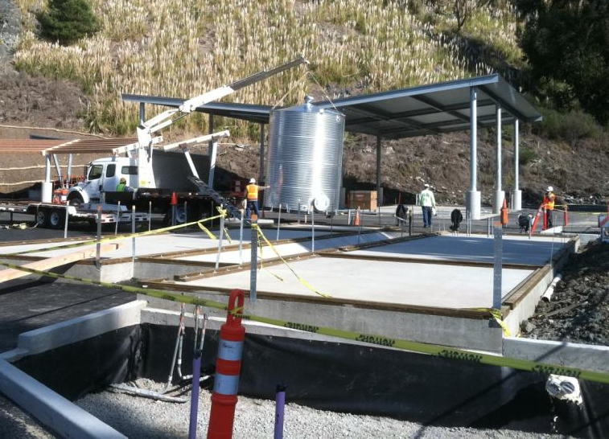
Harvesting and Use

Slide 27

Bioretention
evapotranspiration
flow control
orifice
losses
infiltration
Discharge
(biotreatment)

Slide 28
Bioretention Advantages
Filtration and pollutant sequestration
Biological processing and renewal
No mosquito problems
Mimic natural hydrology
Attractive landscape amenity
Potential use as park or playground
Low maintenance
Easy to inspect

Slide 29
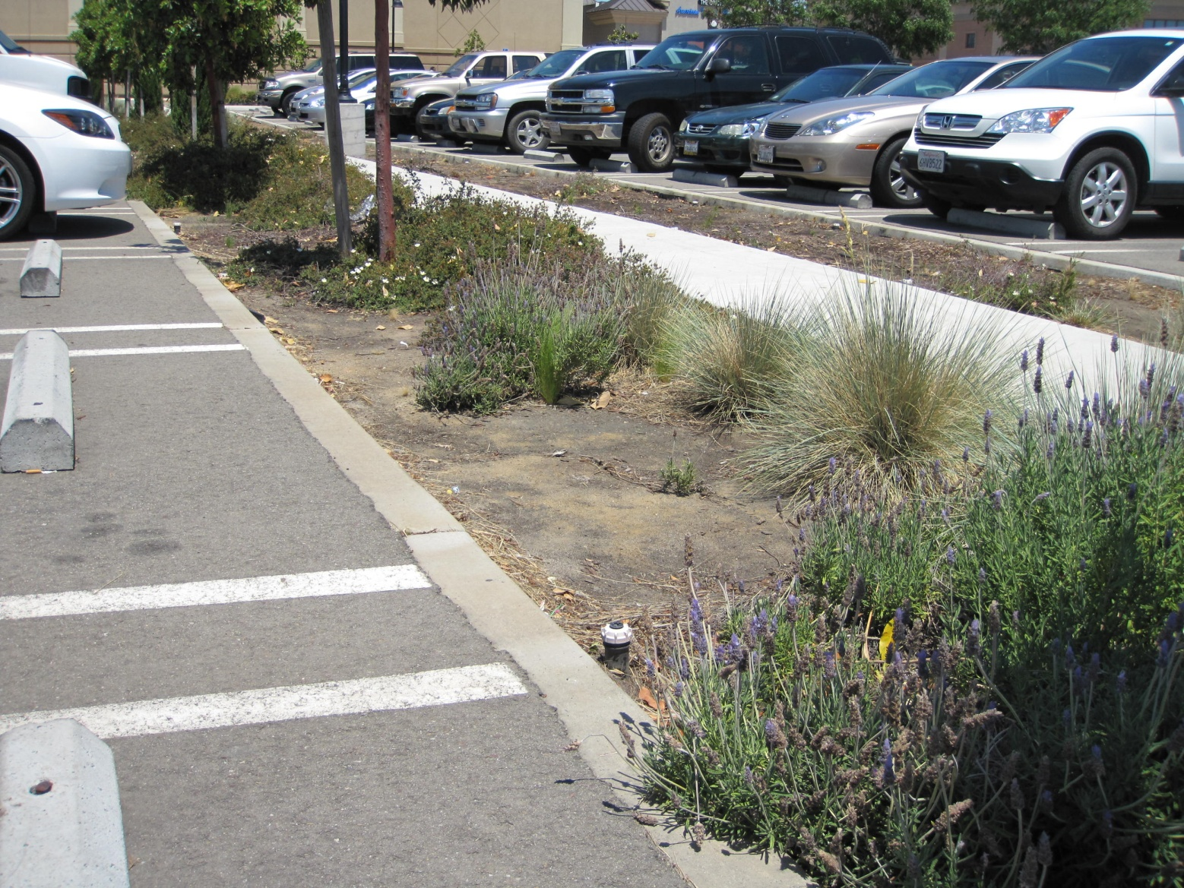
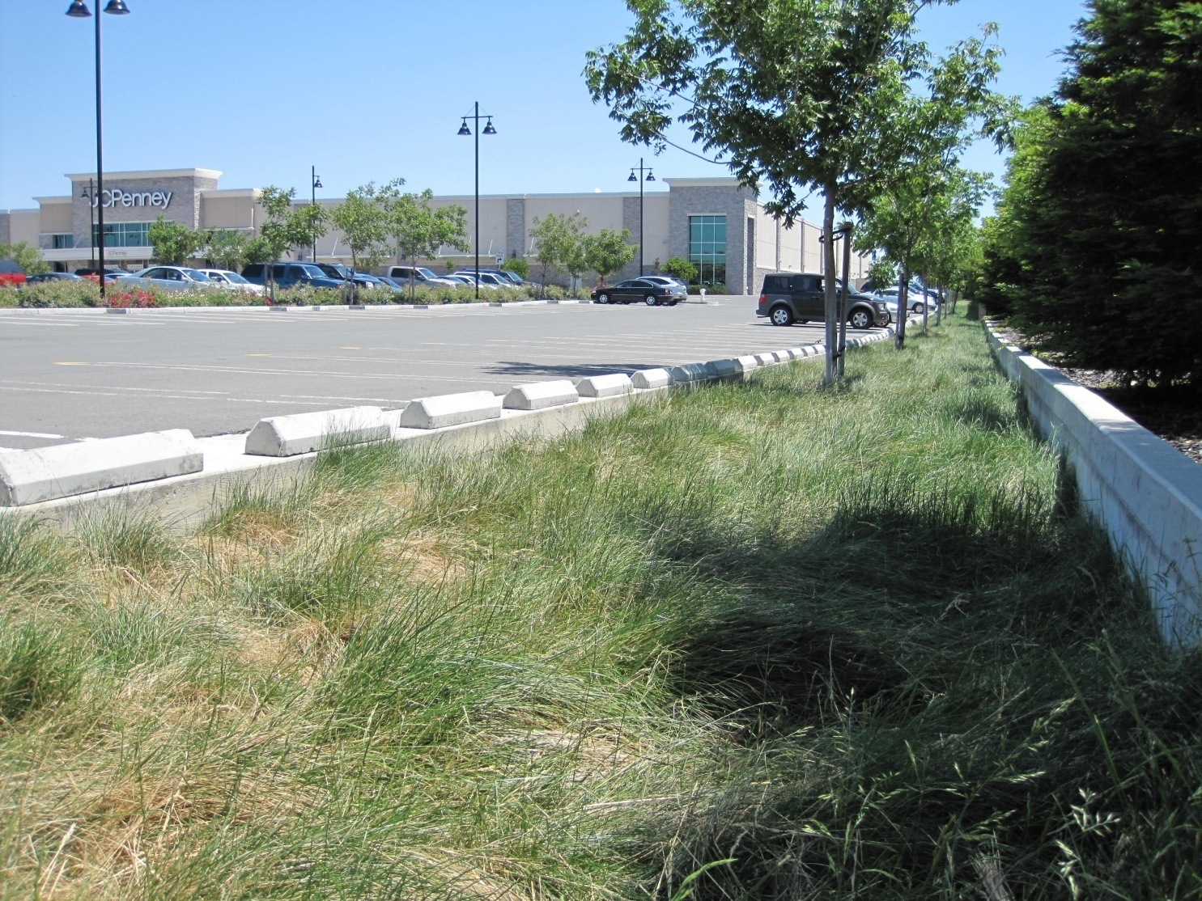
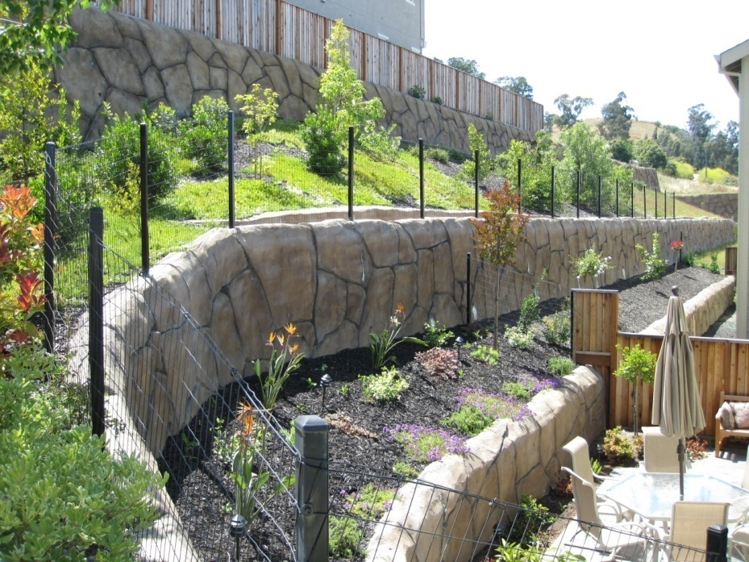
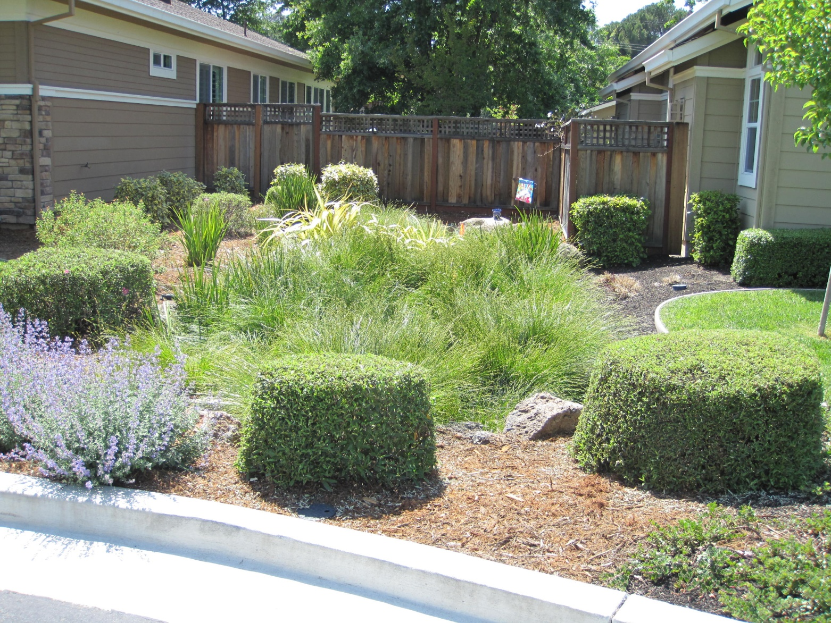
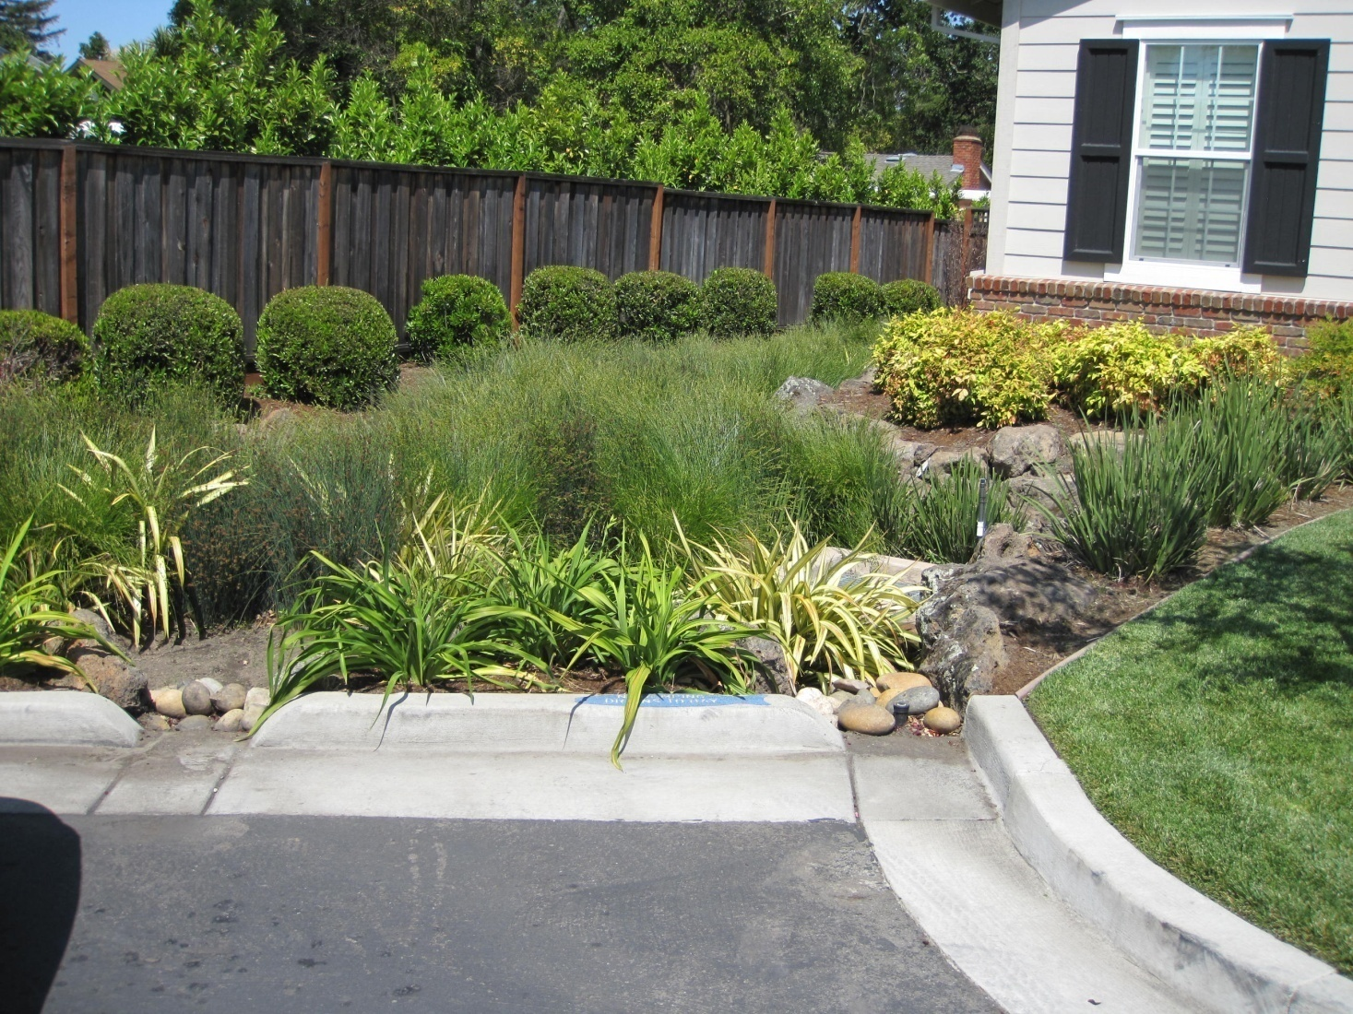
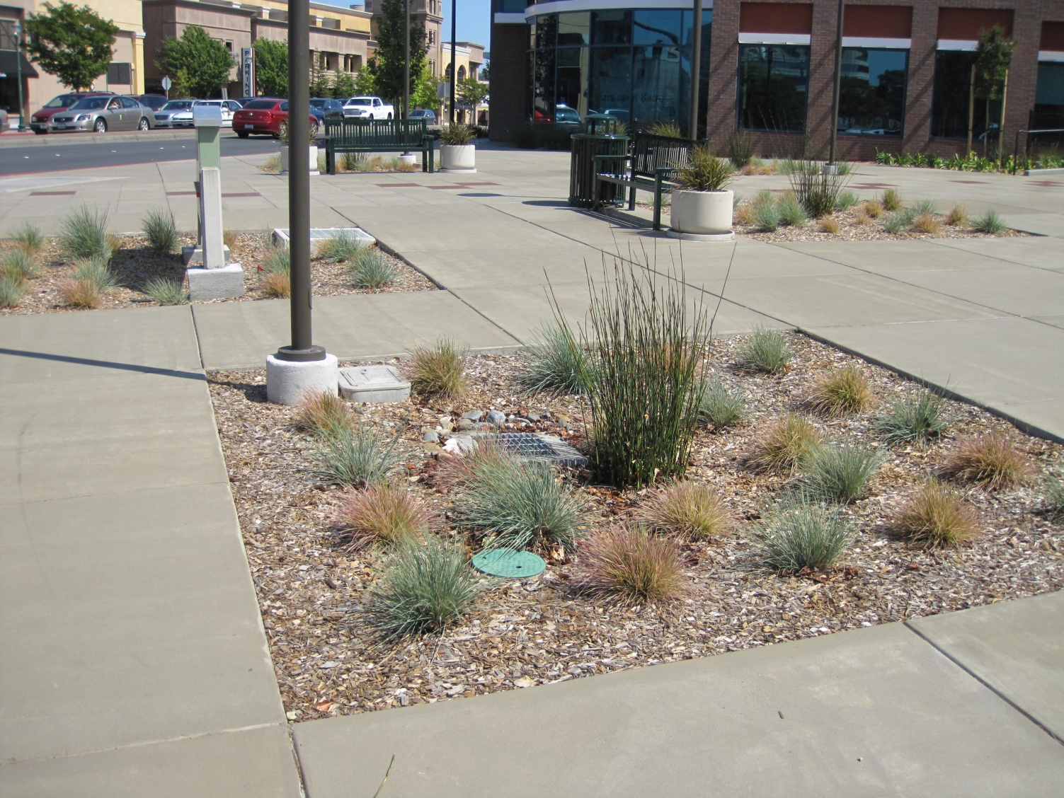
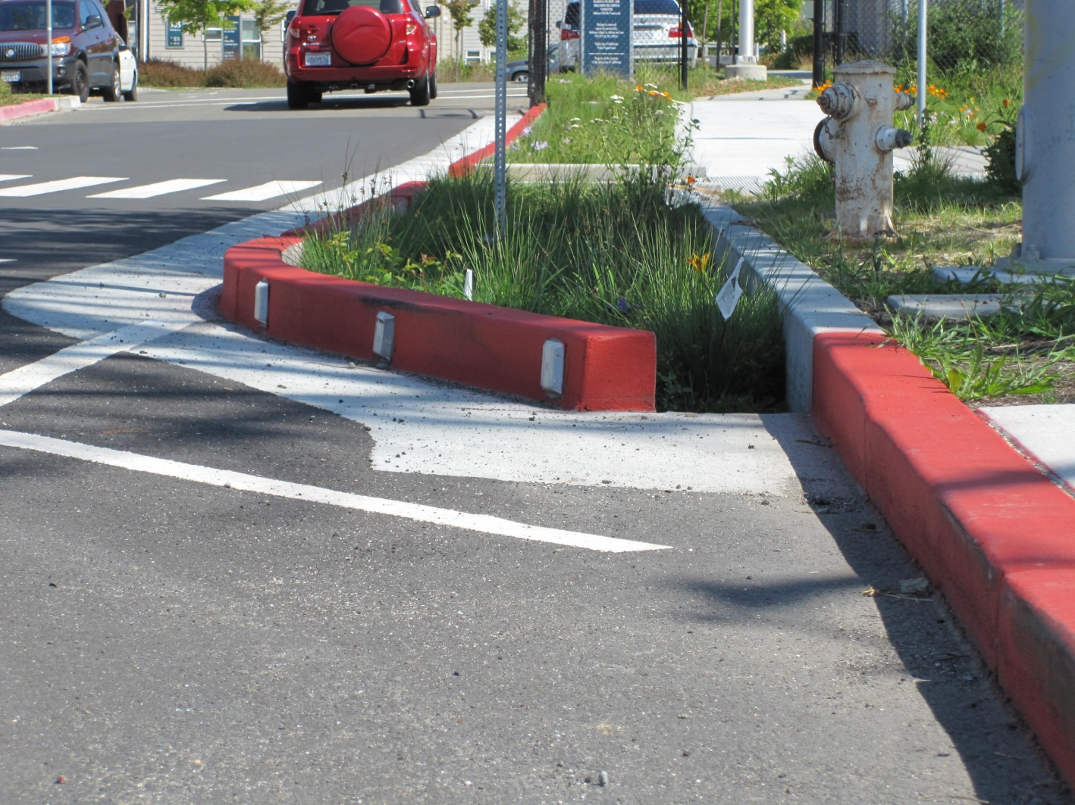
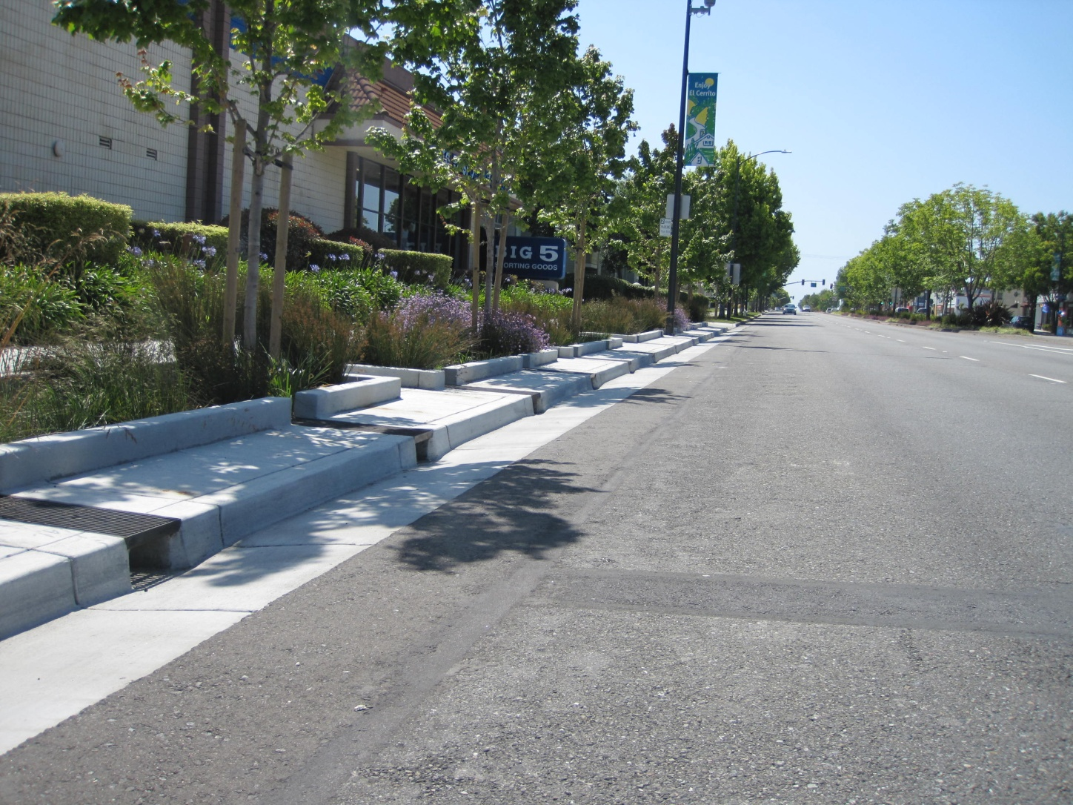
Bioretention

Slide 30
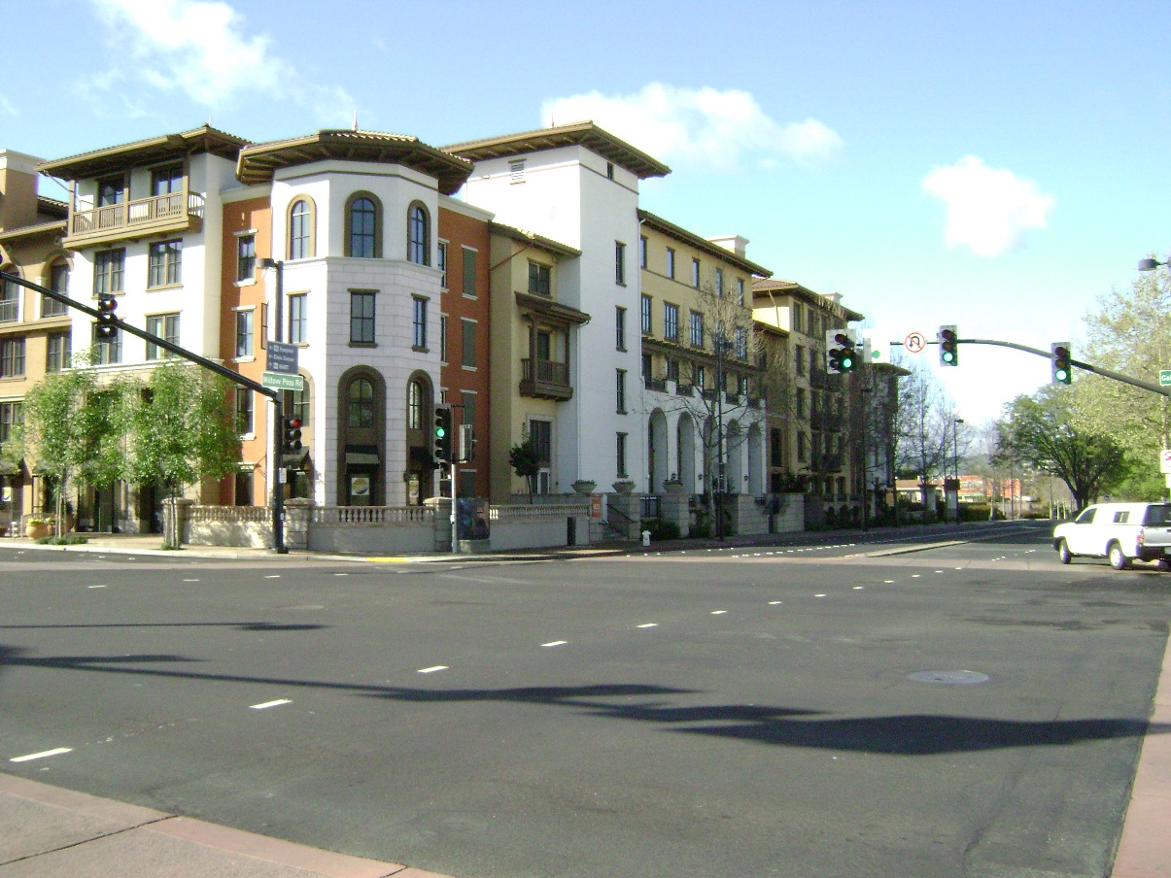
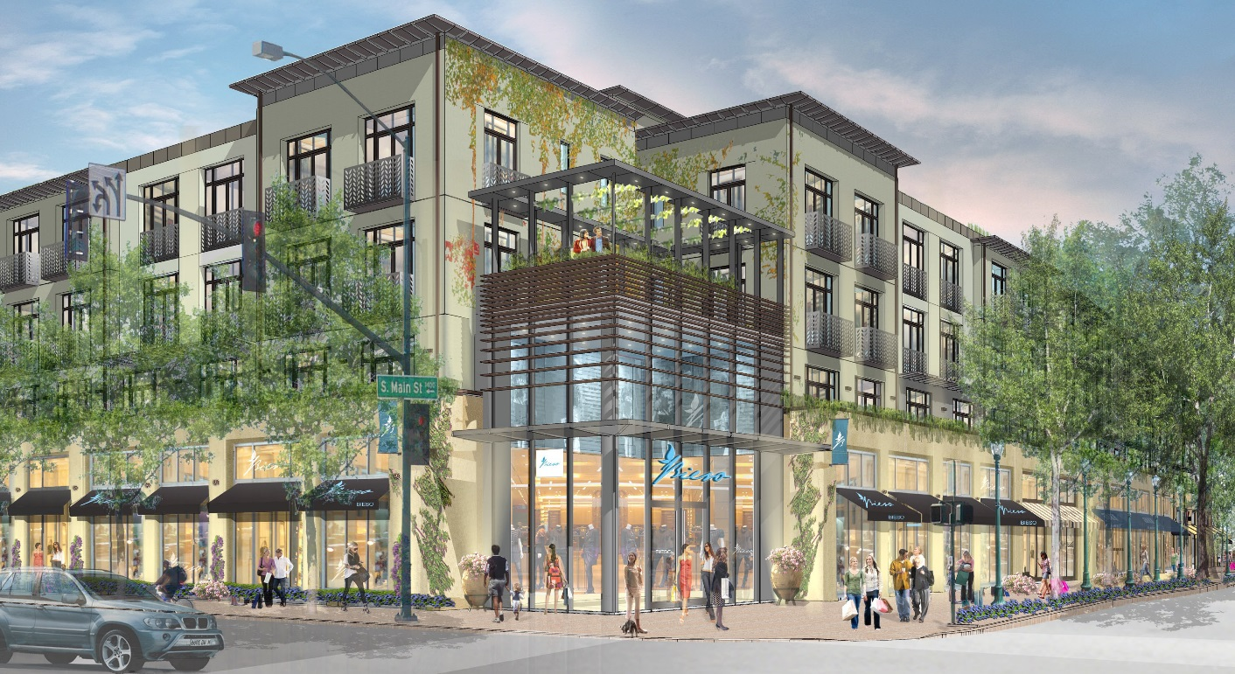
Special Projects

Slide 31
Special Projects
Page
60

Slide 32
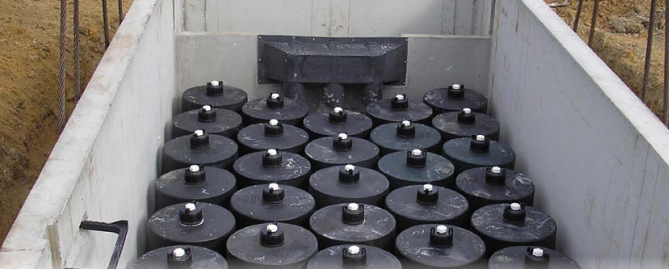
Special Projects - Criteria
Tree-box-type biofilters
  50 inches per hour surface loading rate
  Minimum 3.5 feet depth
  Supports a healthy tree or other vegetation
Vault-based media filters
  Surface loading rate of
  1 gpm/ft²
  Orifice to control flow to cartridges

Slide 33
Special Projects - Feasibility
Reporting requirement to assess the feasibility
of using 100% LID
Conditions for bioretention feasibility on Special Projects:
  Level area free of structures and utilities
    Large enough and suitable for landscaping
  Surface drainage or other route for runoff to reach the facility
  Connection from underdrain with sufficient head
Feasibility of offsite treatment
  Project proponent owns or controls suitable site, or
  Publicly operated mitigation program
Notes:
Add illustrative cross section of bioretention

Slide 34
Developing and Documenting a LID Design

Slide 35
LID Design Process
Analyze Project for LID
Develop and Document LID Drainage Design
Specify LID Preliminary Design Details
Coordinate with Site Design and Landscape Design

Slide 36
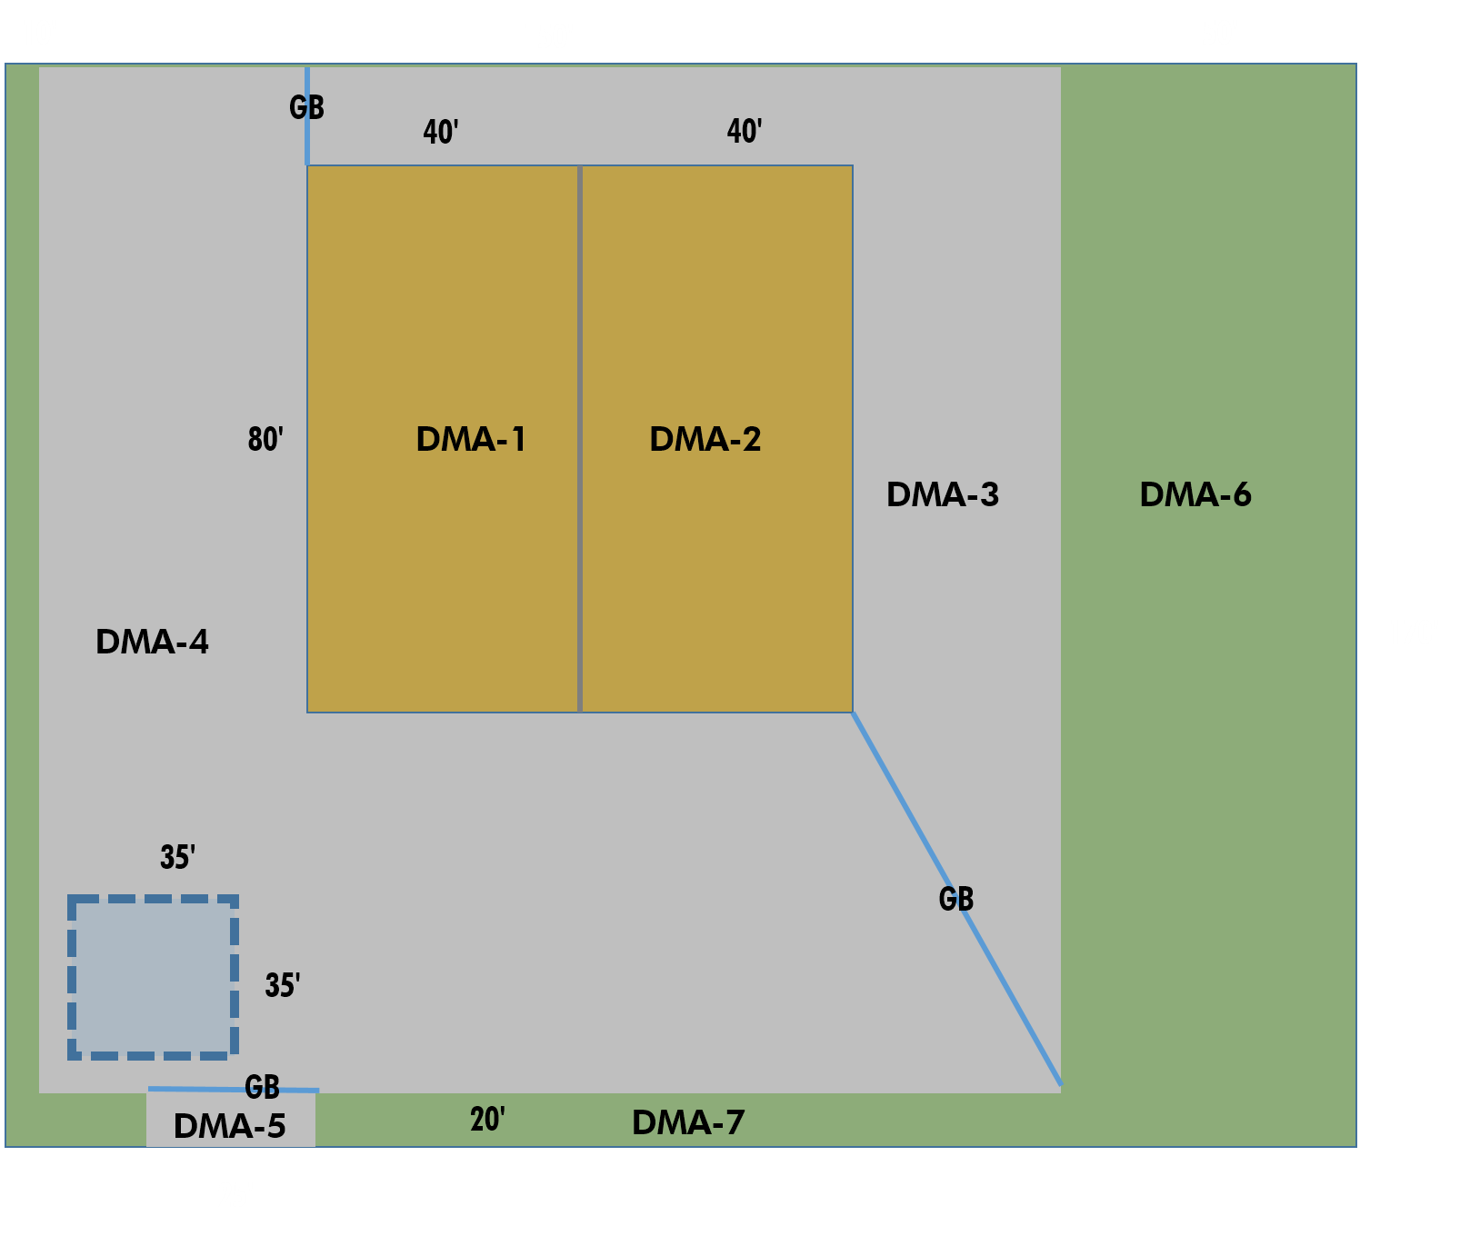
Drainage Management Areas
Follow roof ridges and grade breaks
Different DMA for each surface type

Slide 37
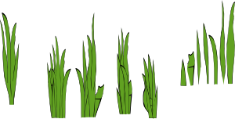

DMA Types
Page
4-2
Pervious DMAs
  Self-treating
  Self-retaining
Impervious DMAs
  Drains to
  self-retaining
    Max 2:1 ratio
    impervious:pervious
  Drains to LID facility
Use a curb to avoid run-on
from self-treating areas
To storm drain
Grade self-retaining areas
to drain inward. Set any area drains to pond 3"-4"

Slide 38
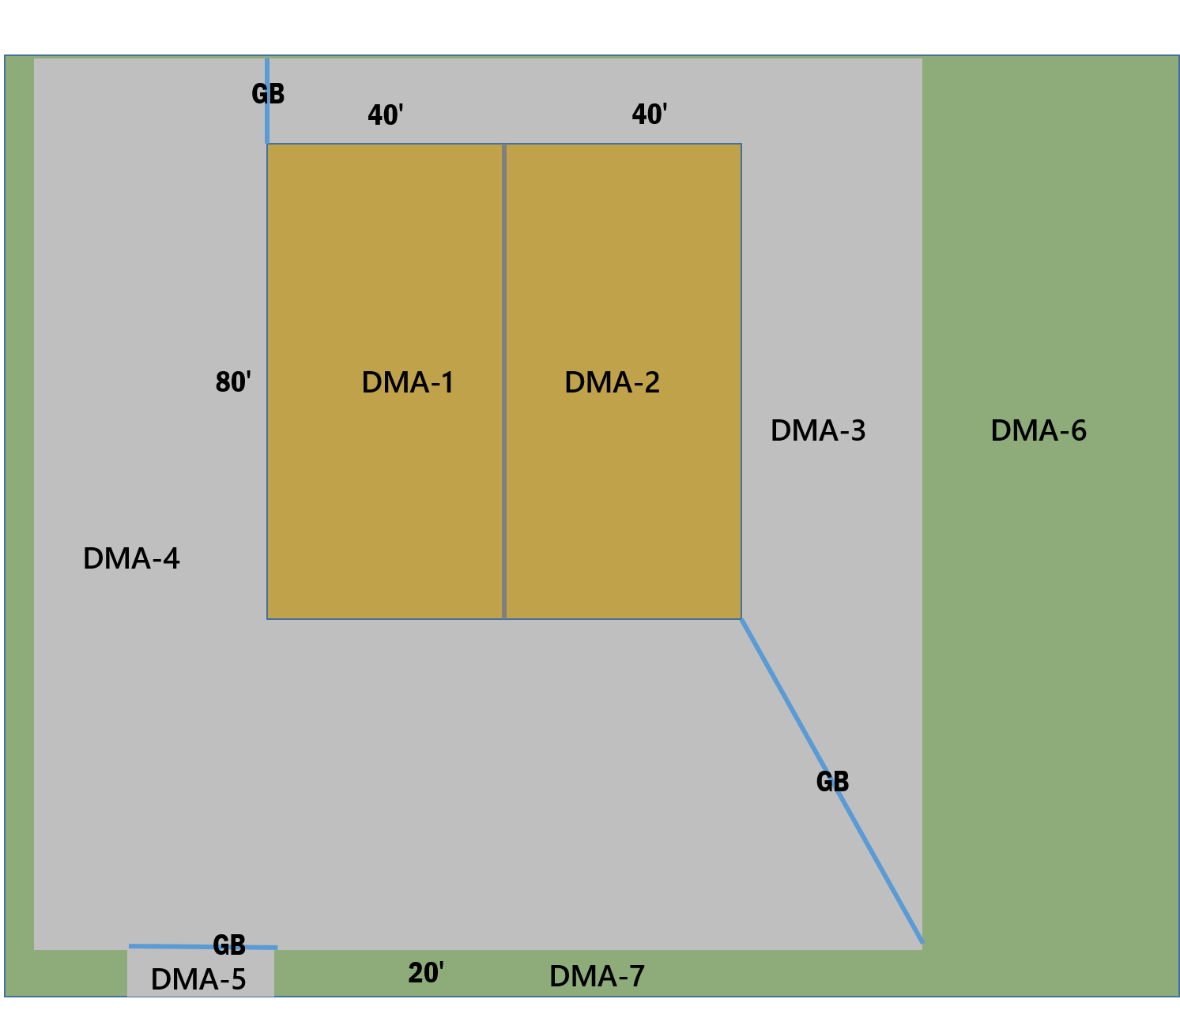
Example
DMA-1 | 3200
DMA-2 | 3200
DMA-3 | 3700
DMA-4 | 12400
DMA-5 | 500
DMA-6 | 8500
DMA-7 | 4200
Total | 35700

Slide 39
Sizing
DMA Name | DMA Area (SF) | Post-project surface type | DMA Runoff factor | DMA Area × runoff factor | Facility Name
DMA-1 | 3200 | Roof | 1.0 | 3200 | Facility Sizing factor | Minimum Facility Size | Proposed Facility Size
DMA-2 | 3200 | Roof | 1.0 | 3200
DMA-4 | 12400 | Paved | 1.0 | 12400
Total> |  |  |  | 18800 | 0.04 | 752 | 900
DMA-1 | 3200
DMA-2 | 3200
DMA-3 | 3700
DMA-4 | 12400
DMA-5 | 500
DMA-6 | 8500
DMA-7 | 4200
Total | 35700

Slide 40
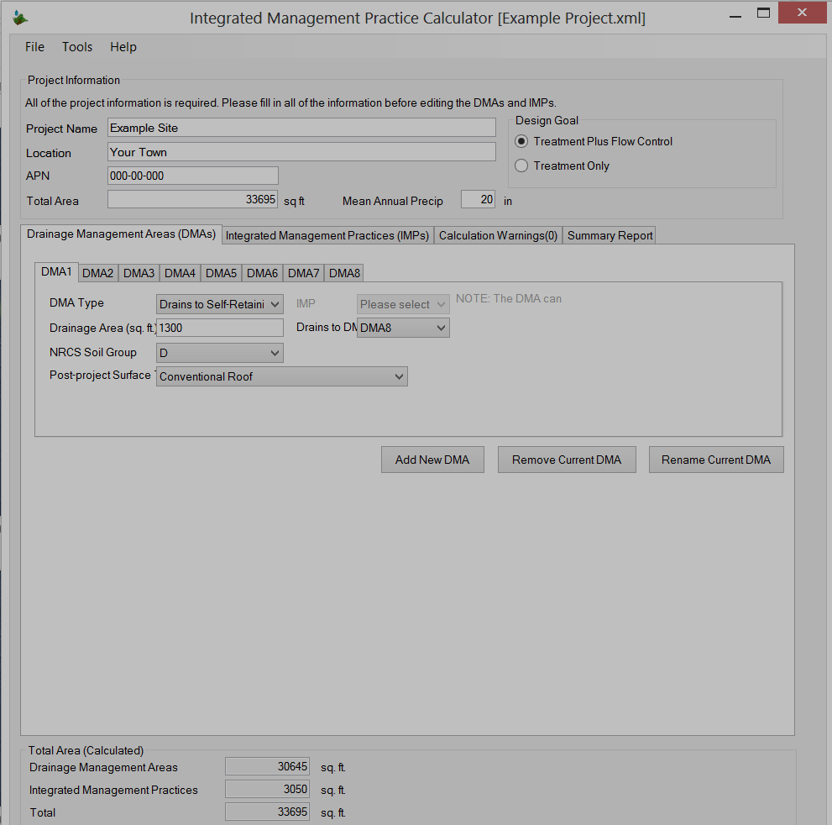
Sizing Calculator

Slide 41
Break

Slide 42
Issues Frequently Discussed
LID Planning, Design, and Construction

Slide 43
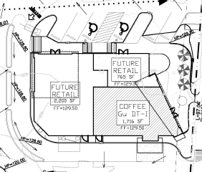
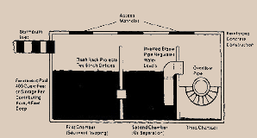
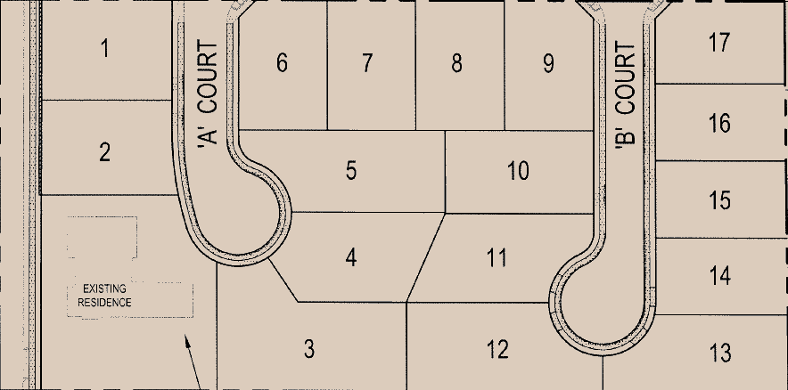
3 most common mistakes
Didn’t start early enough.
Planned to use less effective treatment facilities.
Postponed deciding who will operate and maintain treatment and flow-control facilities.

Slide 44
Applicability
Page
5
The whole of an action
  Consistent with CEQA definition
  No piecemealing
  Includes improvements on public ROW
Swimming pools
Pervious pavements
  Must meet criteria
Pavement reconstruction
  Did the drainage change?

Slide 45
The 50% Rule
Page
3
Criterion in previous
permit (2003-2009):
Project results in an
increase of or
replacement of 50% or
more of existing
development
OLD
NEW
Existing Development
MRP criterion: Project
results in alteration of
more than 50% of the
previously existing
development
OLD
NEW
Notes:
Perverse incentive to build on undeveloped portion of lot.

Slide 46
Development Review Process
Pre-Application
Meeting
Completed
Application
“Deemed
Complete”
Section
Review
Planning
Commission
Conditions of
Approval
CEQA
Review
Detailed
Design
Plan Set and
Permit
Application
Construction

Slide 47
Development Review Process
Discuss
design, O&M responsibility
Pre-Application
Meeting
Completed
Application
“Deemed
Complete”
Respond to questions and revise plan
Lay out the site and stormwater facilities
Prepare and submit a Stormwater Control Plan
Section
Review
Planning
Commission
Conditions of
Approval
CEQA
Review
Construct facilities. Submit Final O&M Plan prior to end of construction
Incorporate facilities in plans and specifications
Stormwater requirements are attached to COAs
Detailed
Design
Plan Set and
Permit
Application
Construction
Transfer Maintenance Responsibility
Notes:
Note some require, some don’t pre-application meeting.

Slide 48
Level of Detail
Page
25
“Plan and design your stormwater controls integrally with the site plan and landscaping for your project.”
Drainage Management Areas
  Grading and roof areas and slopes
Locations/sizes of stormwater facilities
Conceptual routing of drainage

Slide 49
Options for New Subdivisions
Pages
6-8
Total impervious area will not exceed threshold
Dispersal will work
Improvement plans showing treatment and flow-control facilities
  Commitment to construct facilities prior to sale
Improvement plans showing treatment and flow-control facilities
  Deed restriction or other legal instrument ensuring lot-by-lot implementation

Slide 50

Grandfathering
Page
6
Requirements of previous permit apply if:
Planning application deemed complete on or before 12/1/2011…
…so long as the applicant is diligently pursuing the project
  Submittal of supplemental information
  Plans or other required documents

Slide 51
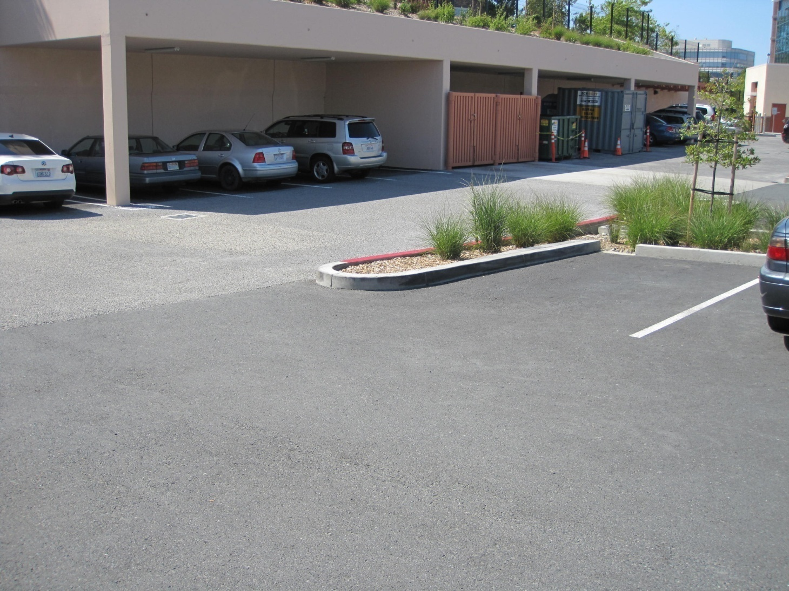
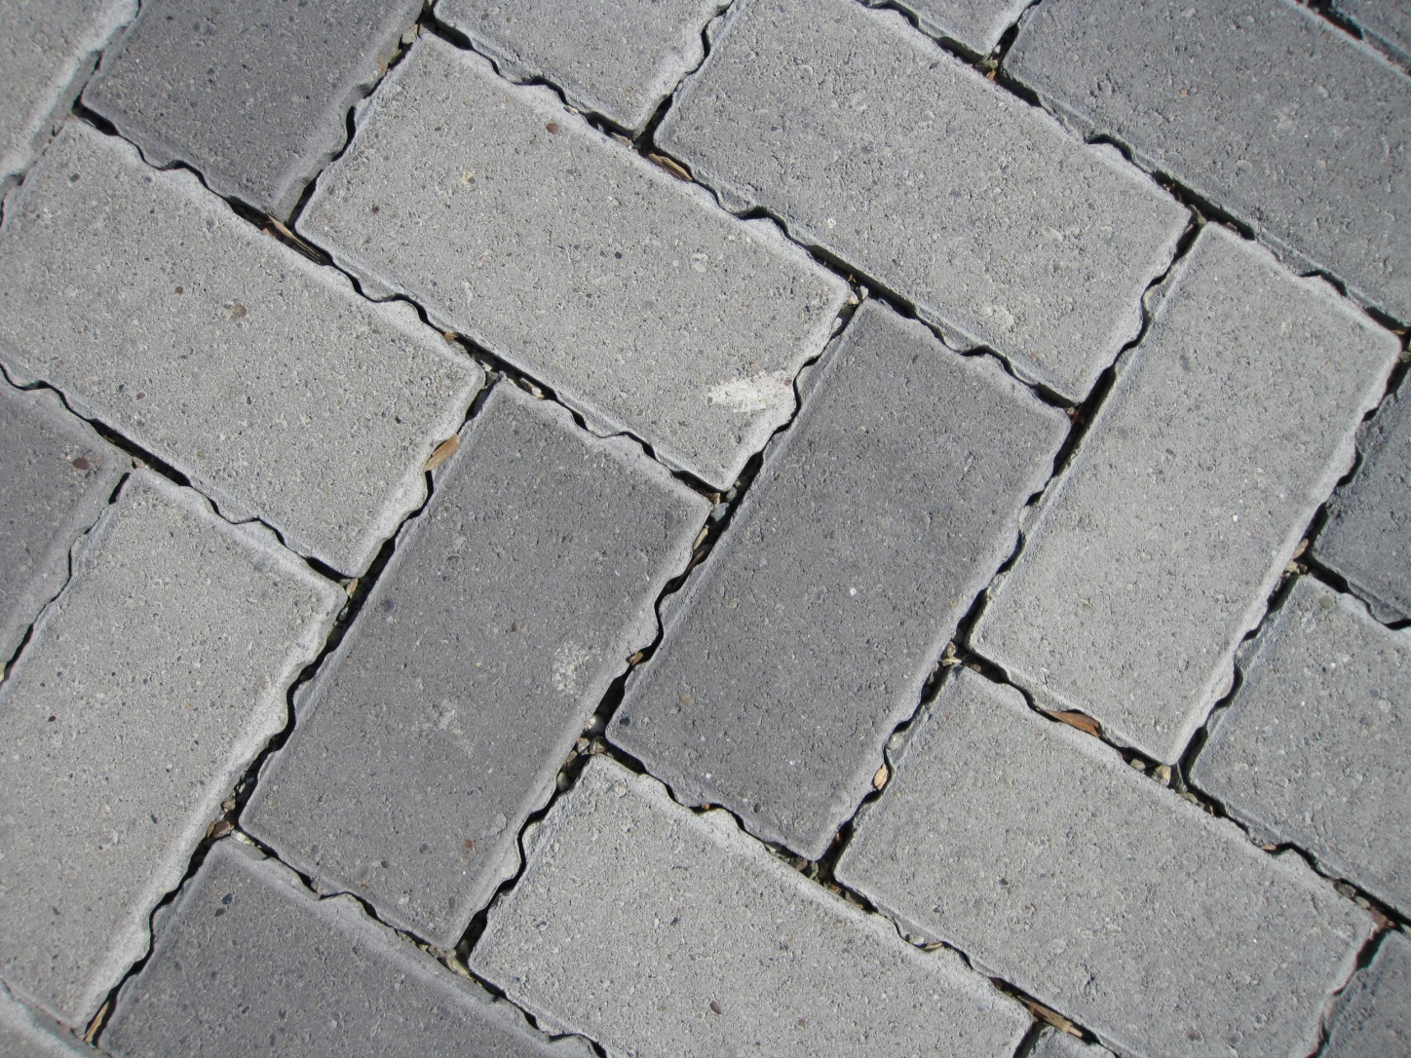
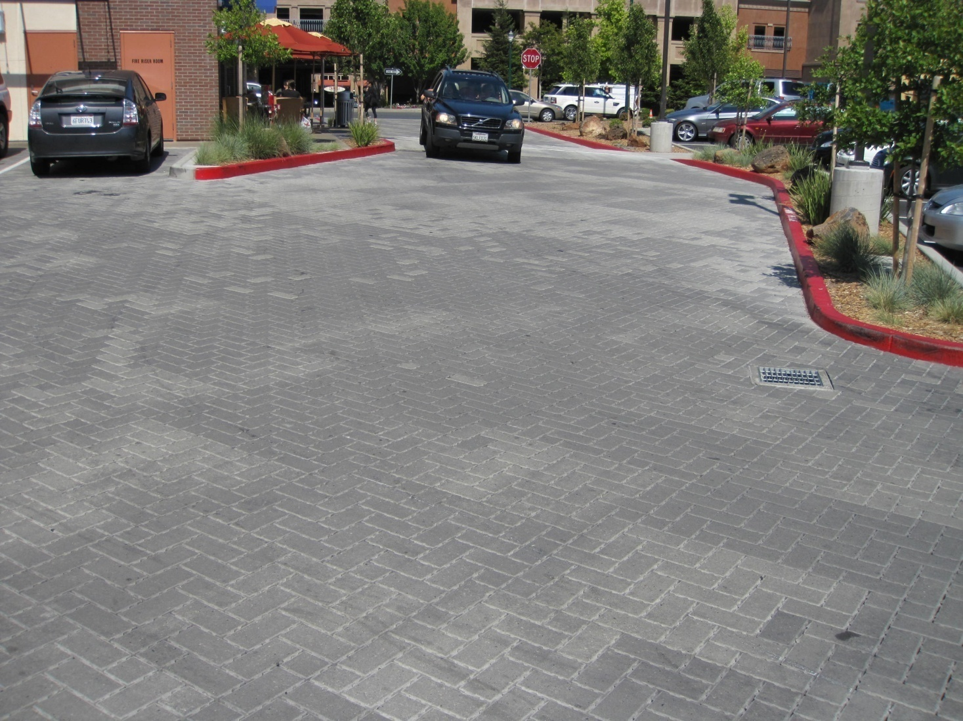
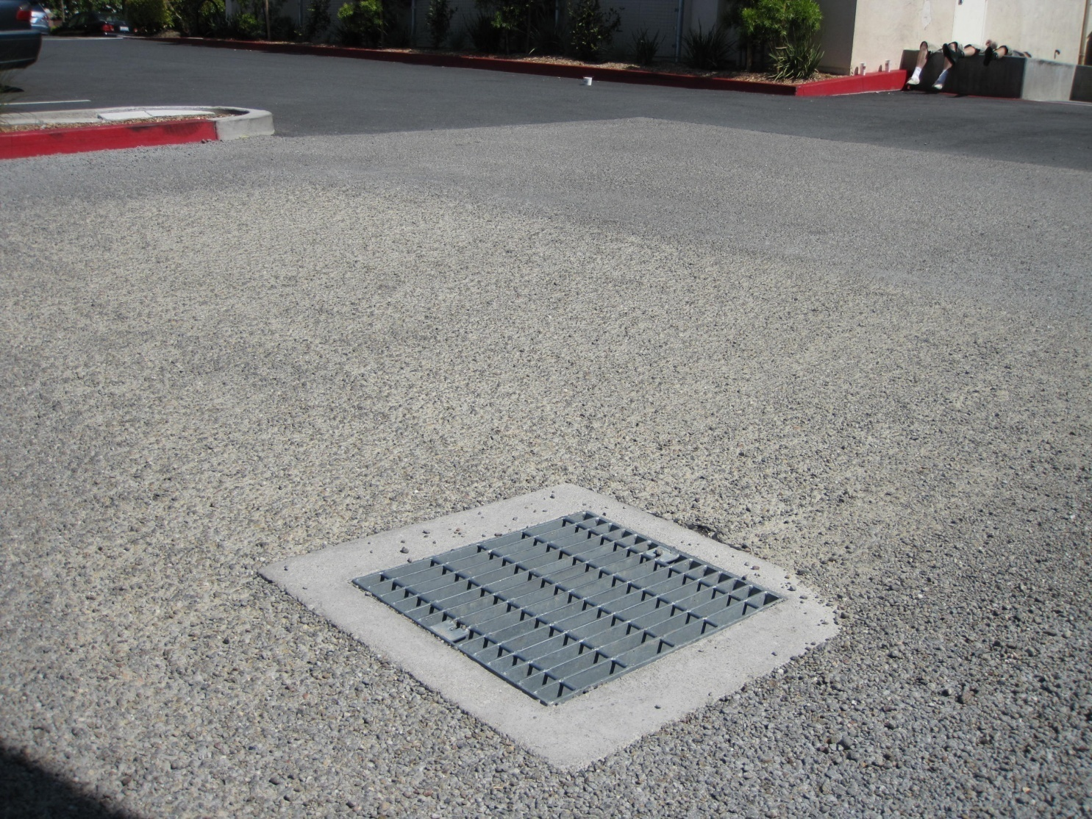
Pervious Pavement
Page
65

Slide 52
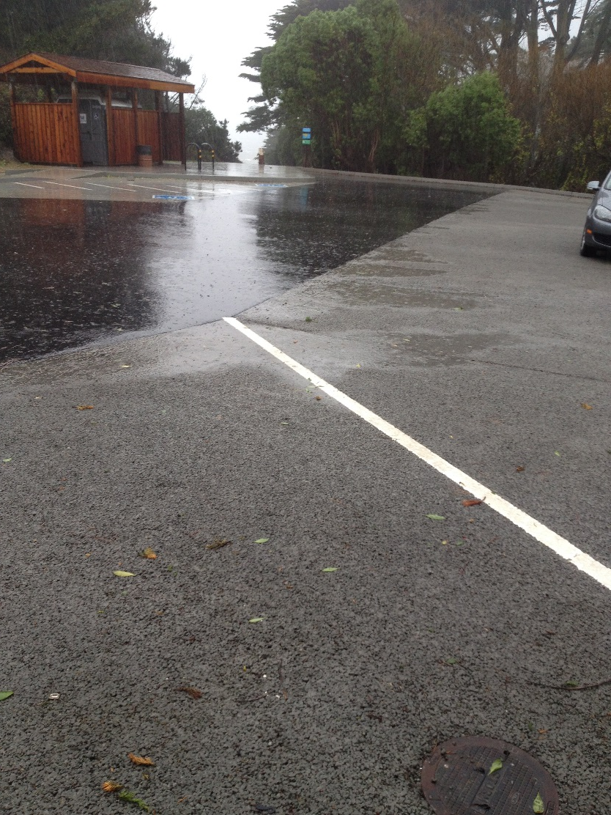
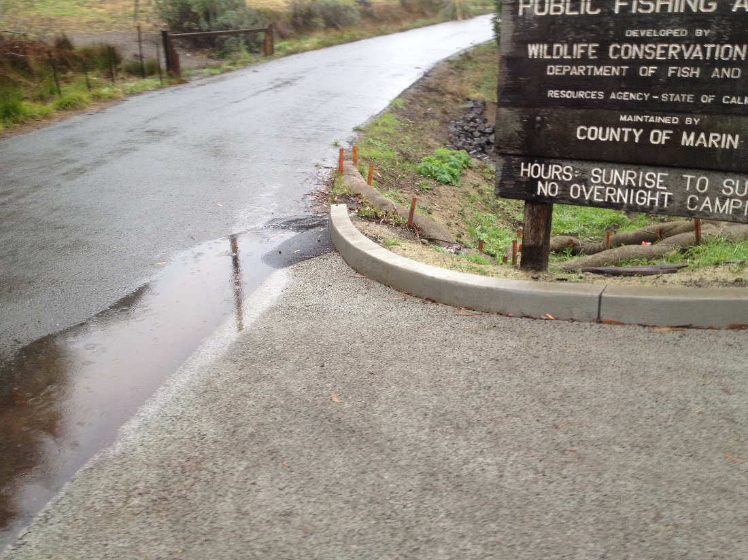
Issues With Pervious Pavement

Slide 53
Pervious Pavement
It’s for retention, not treatment
Only suitable where:
  Grades are flat
  Soils will drain
  Traffic is light
  Current property owner wants the aesthetic effect and/or cachet
  Future property owners will preserve it

Slide 54
Optimal size for bioretention?
½ Acre
4%
30 ft

Slide 55
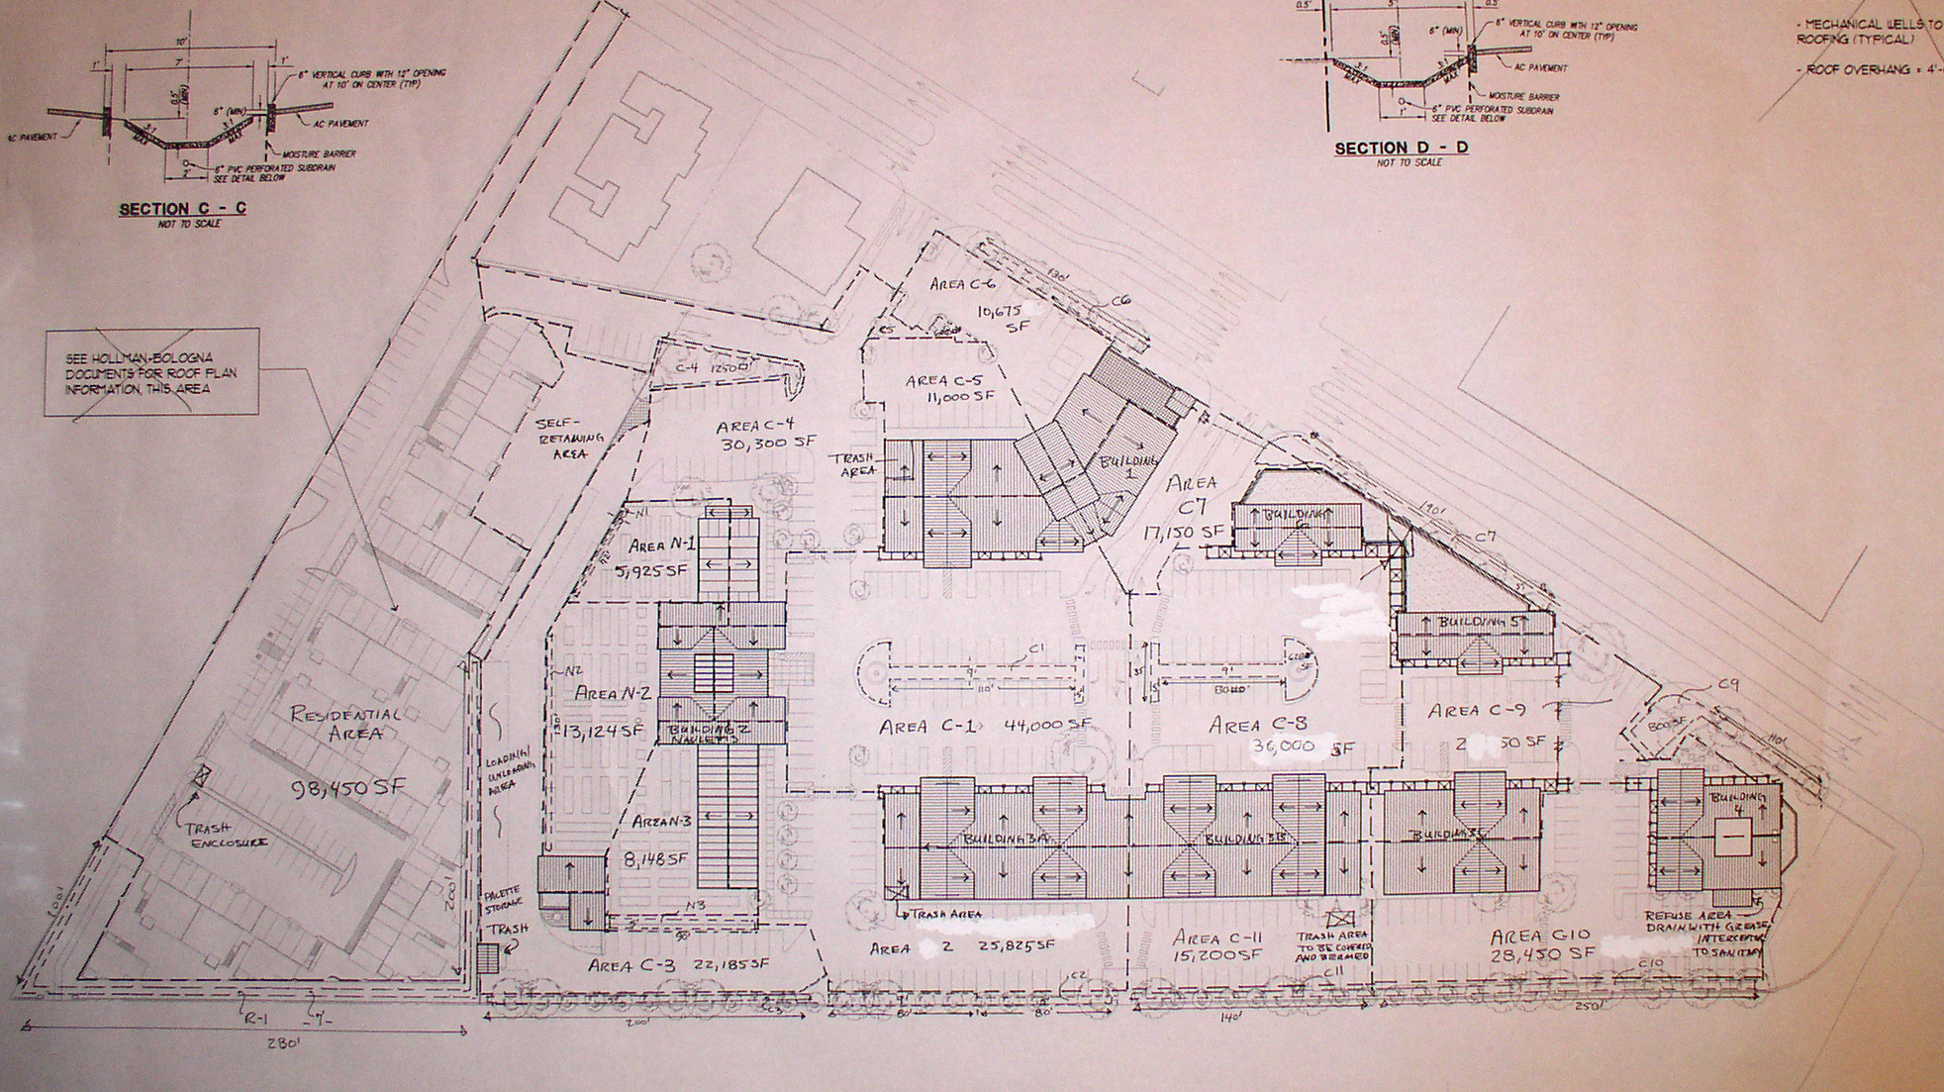
Best Planning for Parking Lots

Slide 56
Best Planning for Commercial

Slide 57
Best Planning for Subdivisions
Page
74
Direct a portion of roof runoff to yard
Direct remaining runoff to street
Drain street to a commonly owned bioretention facility
About 1 facility for each 6-10 lots

Slide 58
Small subdivision on flat site
Hydromodification management is required
Disperse/retain as much roof drainage as possible on each lot
No inlets – drain curb out to main street
Regrade if necessary, and tolerate a very slight slope
Bioretention top of soil layer is just below curb elevation—no side slopes

Slide 59
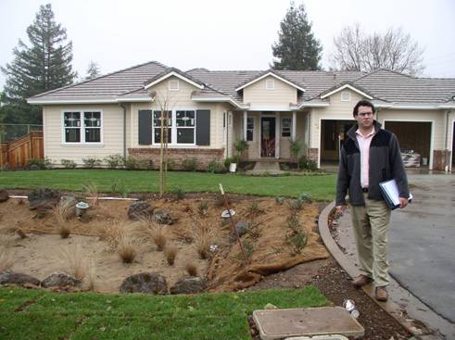
Don’t create pits

Slide 60
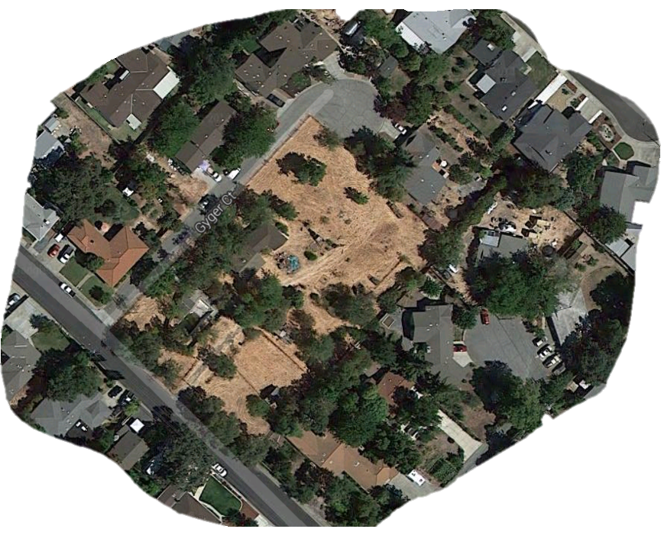
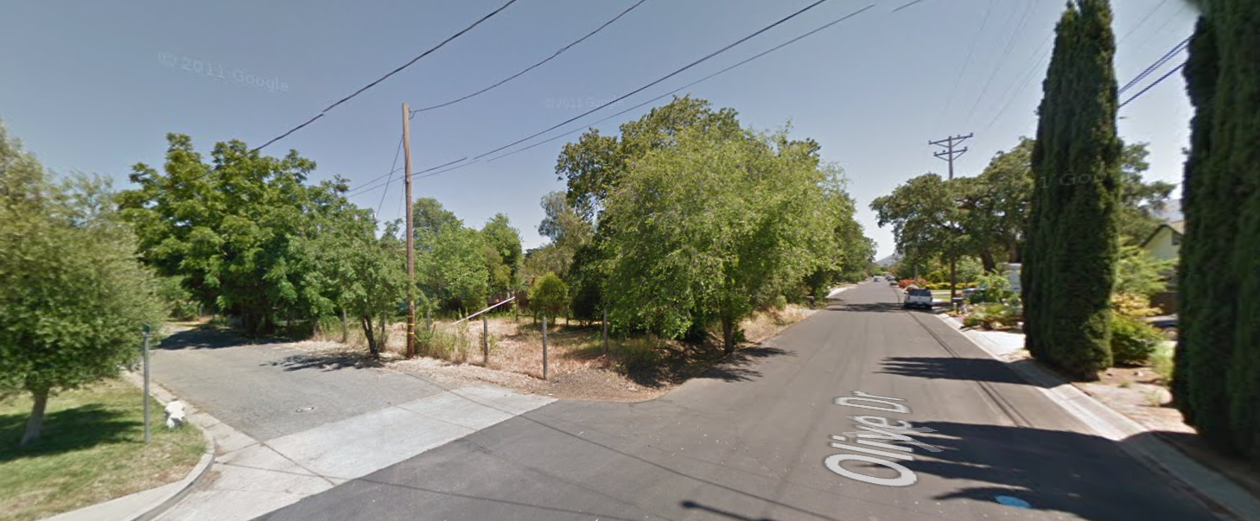
Public and Private Drainage

Slide 61
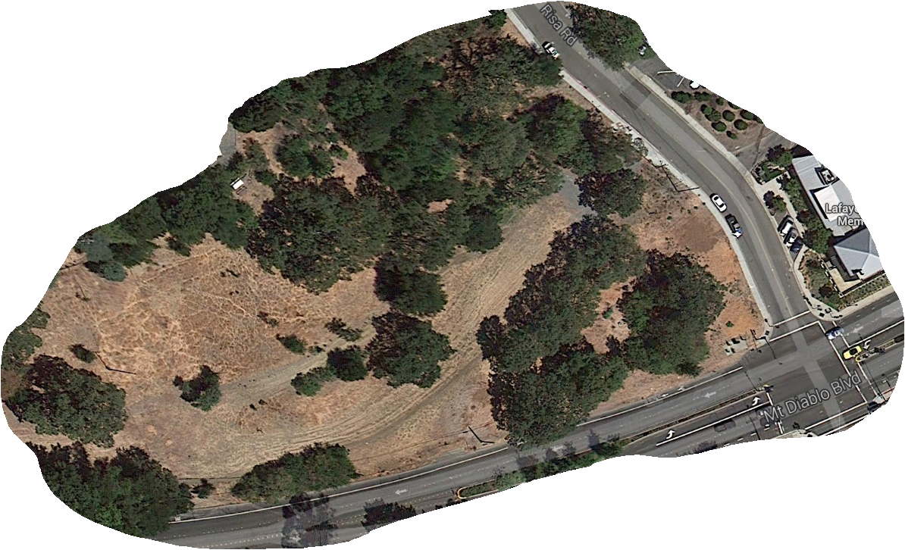
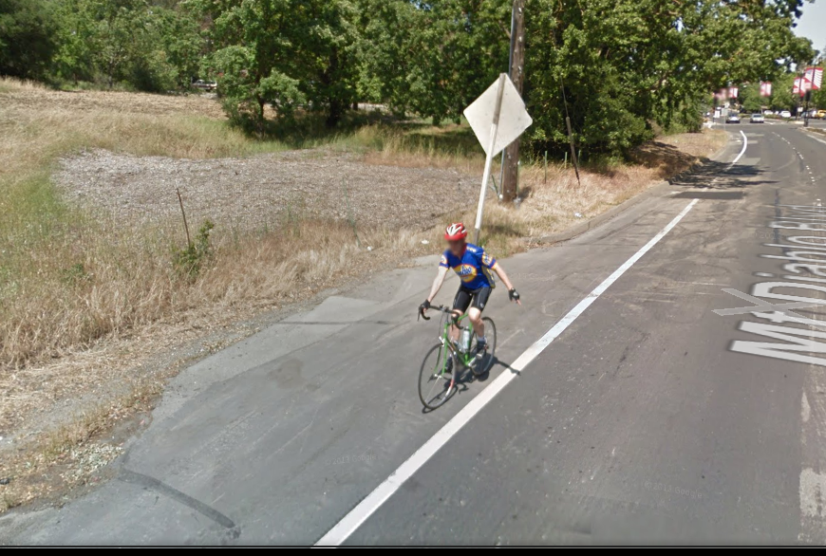
Substituting Impervious Area

Slide 62

Combining with Flood Control
Notes:
More work to do here

Slide 63
Flow Control & Redevelopment
Pre-Project
Impervious Area
Post-Project Impervious Area
Treatment only
Treatment + flow control

Slide 64

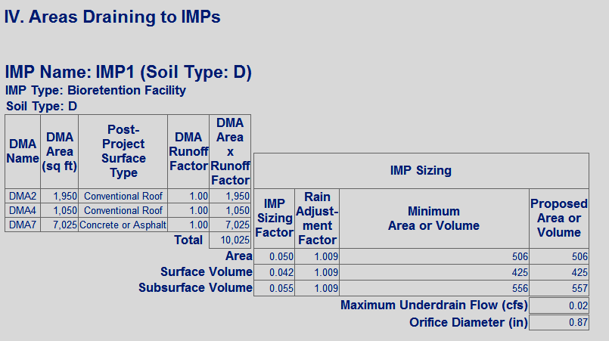
Achieving Required Volumes
Page
76
Bioretention Facility
Cross-section
Not to Scale
Overflow structure
Concrete drop inlet or manhole with frame. 24" min x 36“ if access required; atrium or beehive grate preferred, ¼ “ openings
Curb cut (or curb
inlet if needed
to ensure
runoff capture)
4" min. dia. SDR 35 or equiv.
sweep bend and cleanout
min. 2" above overflow level
Walls as needed to
establish constant
rim elevation around
perimeter of facility
Adjacent pavement
Cobbles or
splash block
Min. 6" or as
needed to achieve V₁
Top of Soil Layer TSL
Install all plantings to maintain
TSL at or below specified
elevation
3" max. mulch if
specified in landscape
plans
Male threaded pipe end with cap center-drilled to specified orifice dia. (Omit cap for treatment-only facilities.)
Specified
soil mix
Schedule 80
(no perforations)
seal penetration with grout
Min. 18“
Top of Gravel Layer TGL
4 " min. dia. SDR 35 or equiv., perforations facing down
Min. 12“ or as
needed to
achieve V₂
Class 2 perm
(Assume 40% porosity
for calculation of V₂)
24"
6"
Bottom of Gravel Layer BGL
To storm drain or
approved discharge
point
Moisture barrier if
needed to protect
pavement or structures
Native soil, no compaction.
Rip to loosen.
Large diameter closed perforated pipes
or arches may augment storage to achieve V₂
Notes:
No liner, no filter fabric, no landscape cloth.
Maintain BGL. TGL, TSL throughout facility area at elevations to be specified in plan.
Class 2 perm layer may extend below and underneath drop inlet.
Elevation of perforated pipe underdrain is near top of gravel layer, except when zero
infiltration is expected.
See Appendix B for soil mix specification, planting and irrigation guidance.
See Chapter 4 for factors and equations used to calculate V₁, V_{2 ,}and orifice diameter.

Slide 65
Flow Control Alternates
Pages
87-92

Slide 66
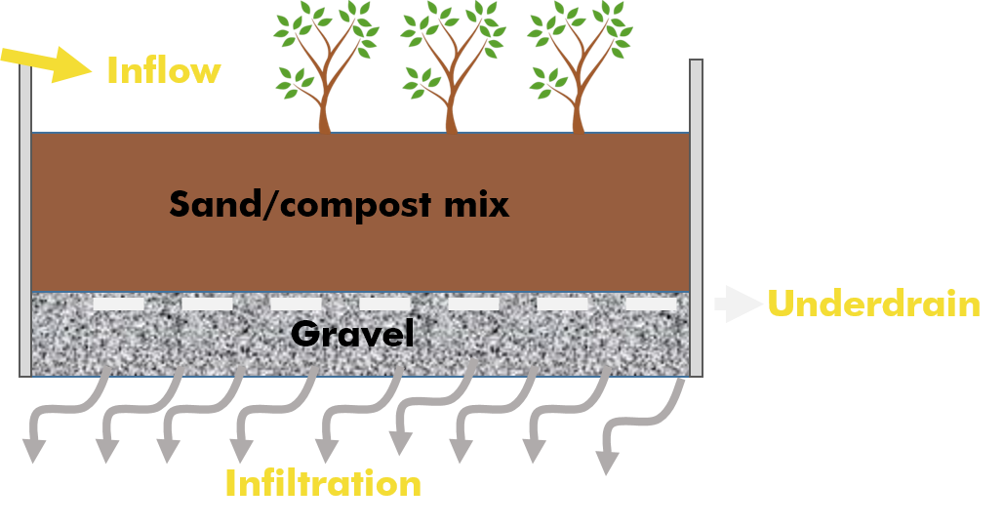
Costs and Useful Life
Have heard $25/SF for planning purposes
Better to estimate components individually
Amount of concrete work varies and could be a significant cost
Useful life of concrete components – 30+ years?
Sand/compost mix, gravel and piping should last at least that long
Plus landscape maintenance

Slide 67
Pollutant Retention and Buildup

Slide 68
Break

Slide 69
BIORETENTION
DESIGN DETAILS
LID Planning, Design, and Construction

Slide 70
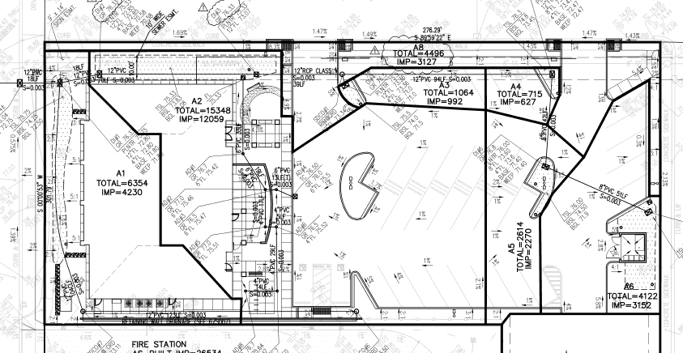
DMAs are as intended
Page
94
Delineate DMAs using a screened grading plan or grading plan + roof plan.

Slide 71
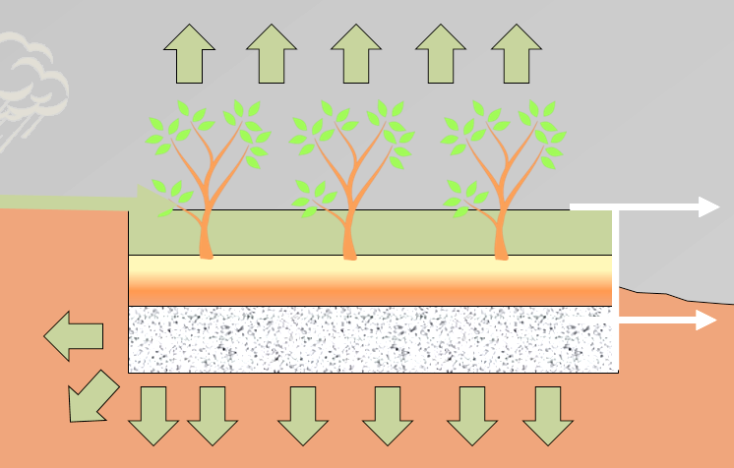
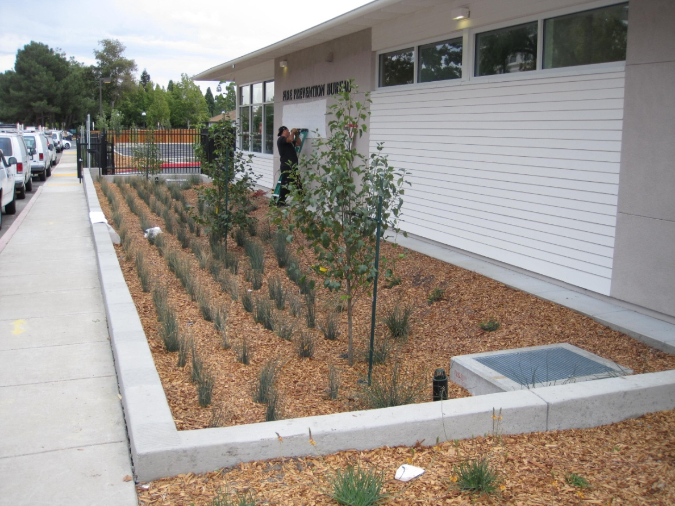
Make This Happen
Bioretention facilities are level so they “fill up like a bathtub.”

Slide 72
Not this
Or this

Slide 73
Page
76

Slide 74
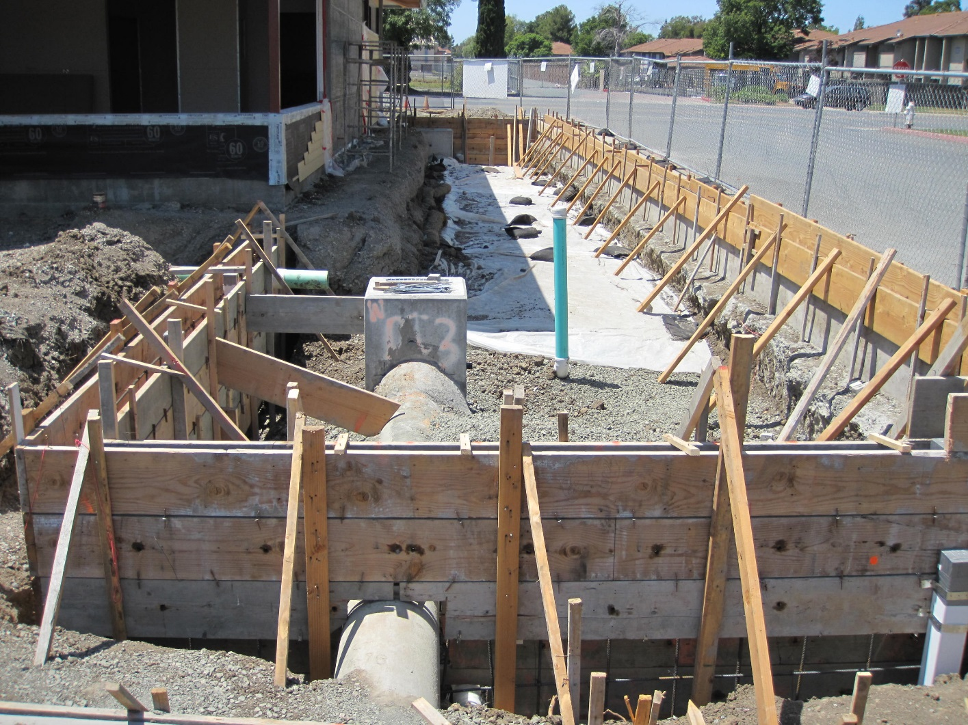
Foundations and Pavement

Slide 75
Page
76
Bioretention Facility
Cross-section
Not to Scale
Overflow structure
Concrete drop inlet or manhole with frame. 24" min x 36“ if access required; atrium or beehive grate preferred, ¼ “ openings
Curb cut (or curb
inlet if needed
to ensure
runoff capture)
4" min. dia. SDR 35 or equiv.
sweep bend and cleanout
min. 2" above overflow level
Walls as needed to
establish constant
rim elevation around
perimeter of facility
Adjacent pavement
Cobbles or
splash block
Min. 6" or as
needed to achieve V₁
Top of Soil Layer TSL
Install all plantings to maintain
TSL at or below specified
elevation
3" max. mulch if
specified in landscape
plans
Male threaded pipe end with cap center-drilled to specified orifice dia. (Omit cap for treatment-only facilities.)
Specified
soil mix
Schedule 80
(no perforations)
seal penetration with grout
Min. 18“
Top of Gravel Layer TGL
4 " min. dia. SDR 35 or equiv., perforations facing down
Min. 12“ or as
needed to
achieve V₂
Class 2 perm
(Assume 40% porosity
for calculation of V₂)
24"
6"
Bottom of Gravel Layer BGL
To storm drain or
approved discharge
point
Moisture barrier if
needed to protect
pavement or structures
Native soil, no compaction.
Rip to loosen.
Large diameter closed perforated pipes
or arches may augment storage to achieve V₂
Notes:
No liner, no filter fabric, no landscape cloth.
Maintain BGL. TGL, TSL throughout facility area at elevations to be specified in plan.
Class 2 perm layer may extend below and underneath drop inlet.
Elevation of perforated pipe underdrain is near top of gravel layer, except when zero
infiltration is expected.
See Appendix B for soil mix specification, planting and irrigation guidance.
See Chapter 4 for factors and equations used to calculate V₁, V_{2 ,}and orifice diameter.

Slide 76
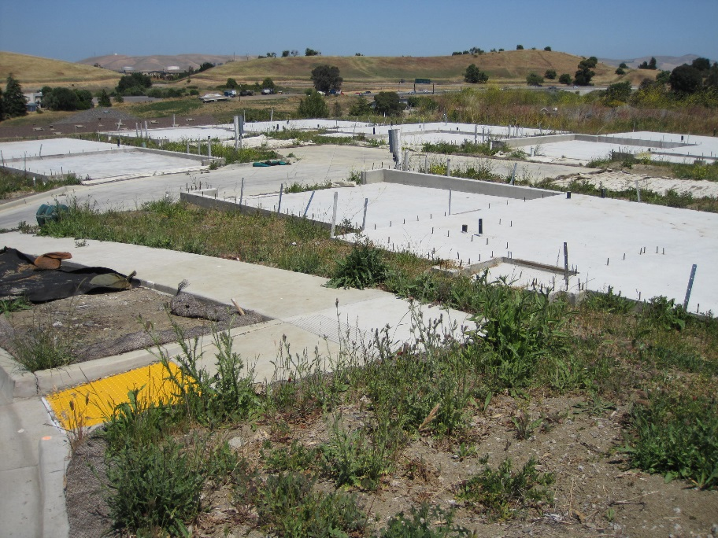
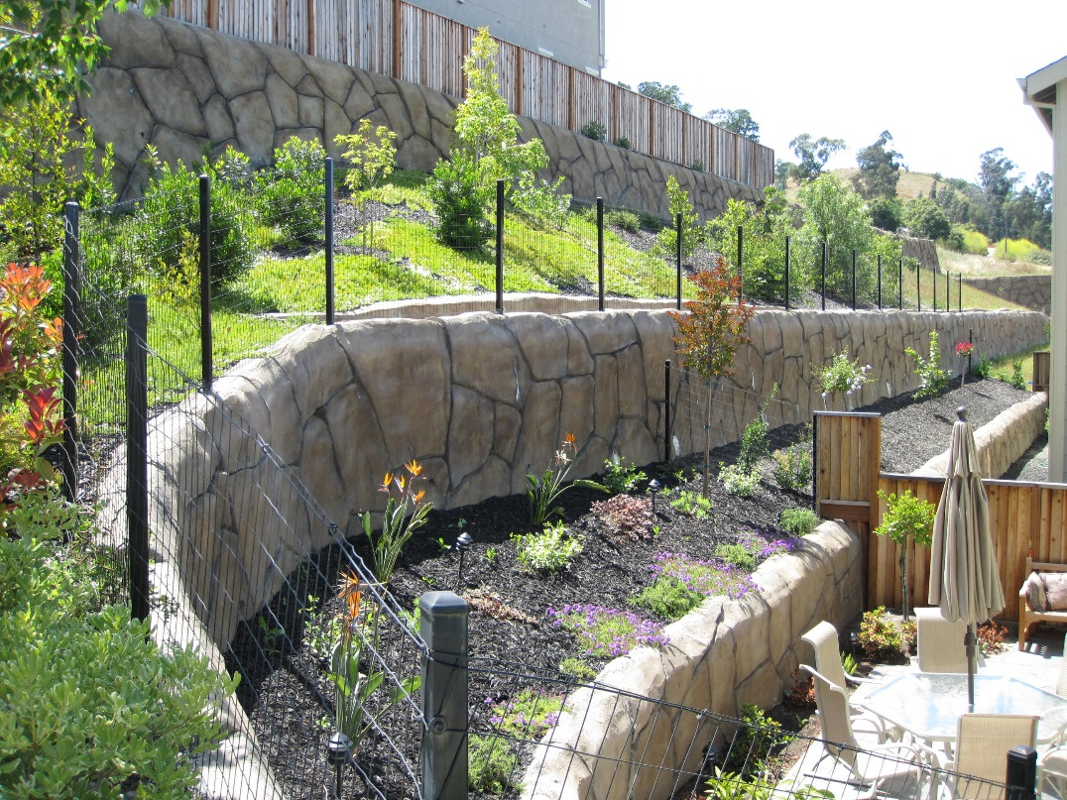

Geotechnically Difficult Sites

Slide 77
High Groundwater
6"
18"

Slide 78
No Storm Drain
6"
18"

Slide 79
Where soil or groundwater is polluted
On plazas or other structures

Slide 80


Call out elevations
Page
94
    Outlet structure
  Top of overflow grate
  Underdrain connection
    Inlet
  Flow line at inlet
  Top of curb
  Top of adjacent paving
    Soil layers
  Top of soil layer
  Bottom of gravel layer
  Bottom of soil layer

Slide 81


Outlets
Page
76
Overflow
elevation

Slide 82

Bioretention Edges
Page
77

Slide 83

Gravel and Underdrain
Page
71
    Class 2 permeable
  Caltrans spec 68-2.02(F)(3)
    No filter fabric
    Underdrain
  Discharge elevation at top of gravel layer
  PVC SDR 35 or equivalent;
  holes facing down
  Solid pipe for 2' closest
  to outlet structure
  Cleanout

Slide 84

Planting Soil
Apx.
B
    60-70% Sand
  ASTM C33 for fine aggregate
    30-40% Compost
  Certified through US Composting Council
  Seal of Testing Assurance Program
    Install in 8"-12" lifts
    Do not compact
    Do not overfill
    Leave room for mulch

Slide 85
Soils, Planting, Irrigation
Apx. B
Select plants for fast-draining soils
Select for facility location
Avoid problem conditions
  Overly dense plantings
  Aggressive roots
  Invasive weeds
  Need for irrigation or fertilization

Slide 86
Plants that work
Apx. B

Slide 87
Landscaping—O&M issues
Page
B-3
Avoid filling in or regrading
No fertilizer
  Compost tea once per year if needed
No pesticides
Clean up as needed and annually
Add mulch if needed annually
  Compost mulch (aged mulch) recommended

Slide 88

Avoid design conflicts
Page
30
Elevations consistent with grading and architectural plans
Facilities do not interfere with parking or pedestrian circulation
Utilities are located elsewhere
Protection of adjacent paving and structures has been considered

Slide 89
Construction of Bioretention facilities
LID Planning, Design, and Construction

Slide 90
Construction Checklist
Page
96
Layout
Excavation
Overflow or Surface Connection
Underground connection (underdrain)
Drain rock/subdrain
Soil Mix
Irrigation
Planting
Final

Slide 91
Construction
Yes, inspections are needed
Special inspections (or inspectors)
may be appropriate
Edit construction checklist and deliver to general contractor at pre-construction meeting
Make sure landscape contractor gets the message(s)
  Elevations
  Additions of material
  Fertilizers

Slide 92
2-Year Warranty
Extension of standard 1-year warranty for landscaping
Allows identification and correction of problems during rainy season

Slide 93
Bioretention facilities Operation & Maintenance
LID Planning, Design, and Construction

Slide 94
Current Approach to Verification

Slide 95
Bioretention O&M
Inspect inlets, outlets, and side slopes
Soils percolate
Check dams and flow spreaders
Healthy vegetation
Removal or alteration
Notes:
More significant problems are removal or alteration

Slide 96



Bioretention—No O&M

Slide 97


Possible new approach to O&M

Slide 98
Possible new approach to O&M
Identify and delineate facilities
  Increase awareness
  Prevent alteration
Track locations and status
  Confirm ongoing operation and effectiveness of individual facilities
  Track rollout of LID across watersheds
Engage property owners and users

Slide 99
Discussion
LID Planning, Design, and Construction

