Slide 1

Planning, Design, and Construction of Low Impact Development
Features and Facilities
Provision C.3 Stormwater Compliance for Land Development Projects
Dan Cloak, P.E.
June 7, 2016

Slide 2
C.3 Basics
A quick review of objectives and methods

Slide 3
C.3 and LID Basics
Mandate
Objectives
Methods
Compliance Process
Tools and Assistance

Slide 4
Mandate
1987 Amendments to the Clean Water Act
Permits issued by California Water Boards
C.3 added to Contra Costa’s permit 2003, 2006
Municipal Regional Permit 2009, 2011, 2015
Municipalities are required to use their land use authority to require controls on runoff from new developments
Low Impact Development (LID) is required

Slide 5

Objectives
Compliance
Mandate
Client support
Acceptance
of costs
Structure
Schedule
Accountability
Project Quality
Enthusiasm
Interest
Energy
Synergies
Opportunities
Elegance
Notes:
Trying to elicit your support

Slide 6
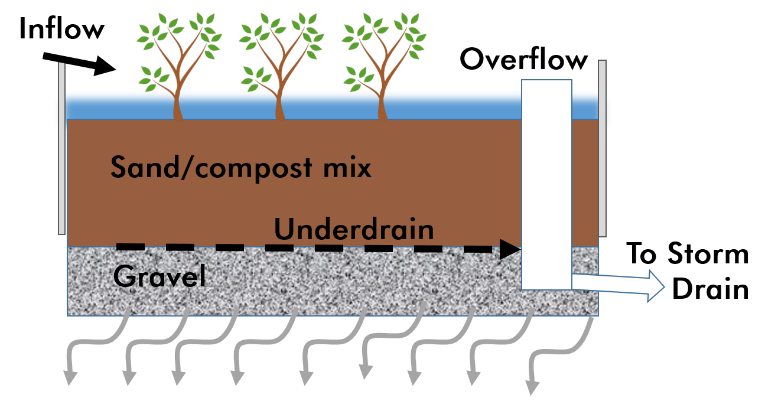
Methods
Minimize imperviousness
  Minimize roofs and paving
  Substitute pervious paving where possible
Disperse runoff to landscaping
Direct runoff
to bioretention
facilities

Slide 7
Methods – Bioretention
Filtration and pollutant sequestration
Biological processing and renewal
No mosquito problems
Mimic natural hydrology
Attractive landscape amenity
Potential use as park or playground
Low maintenance
Easy to inspect

Slide 8
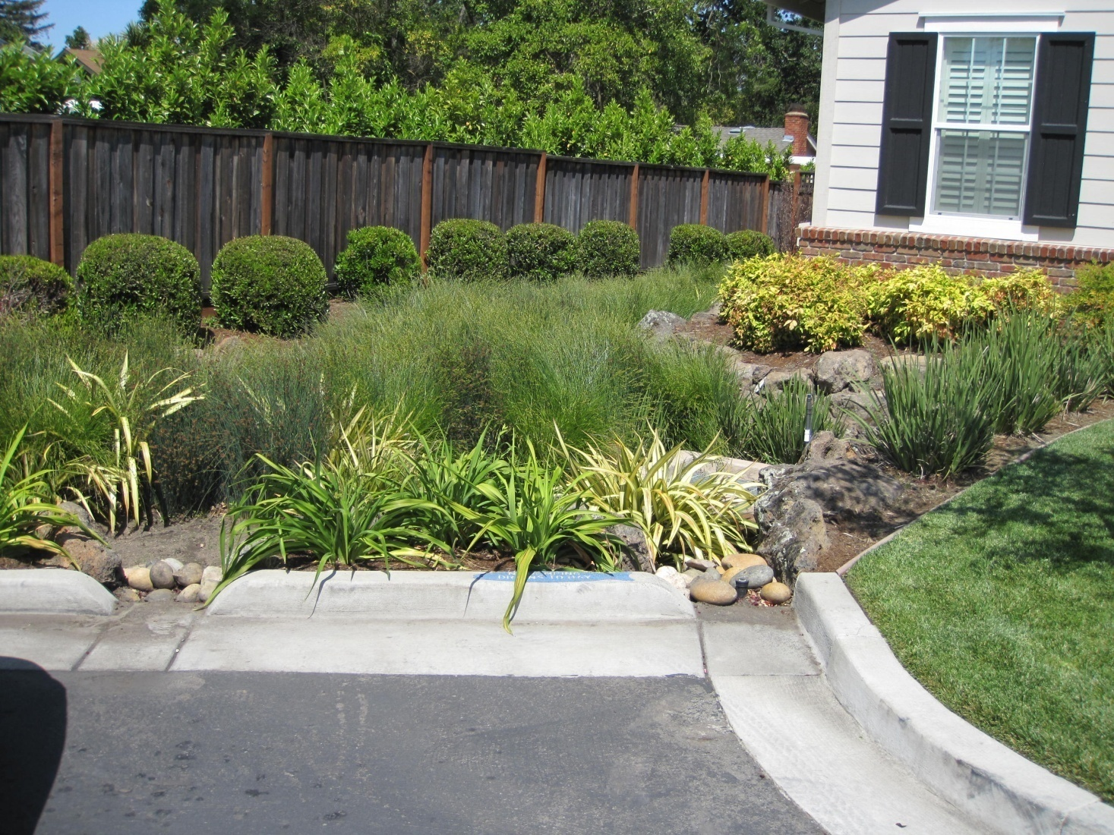
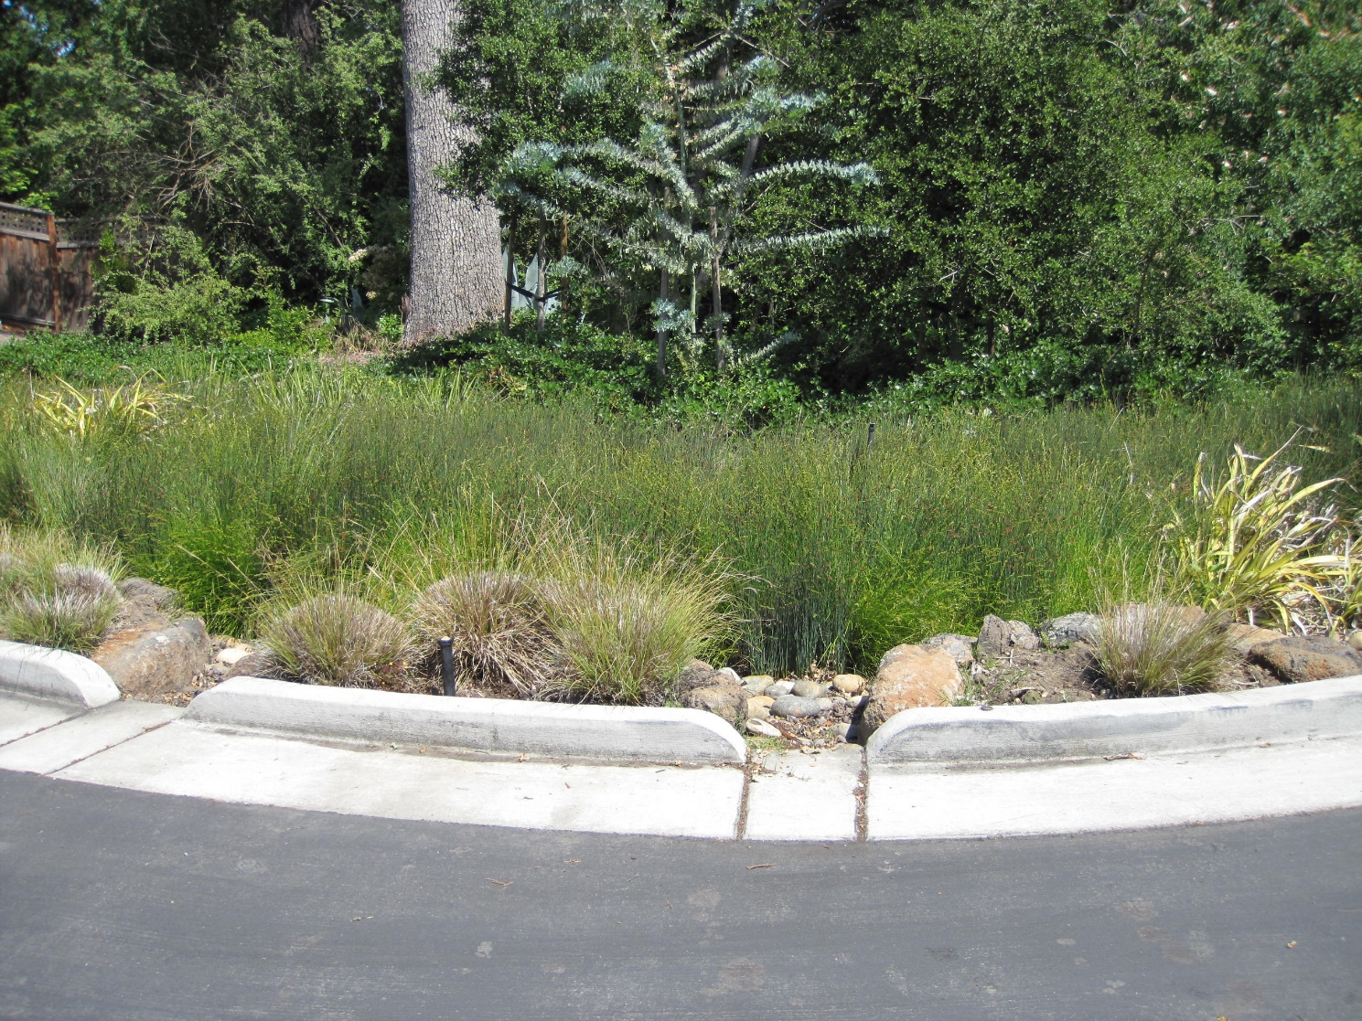
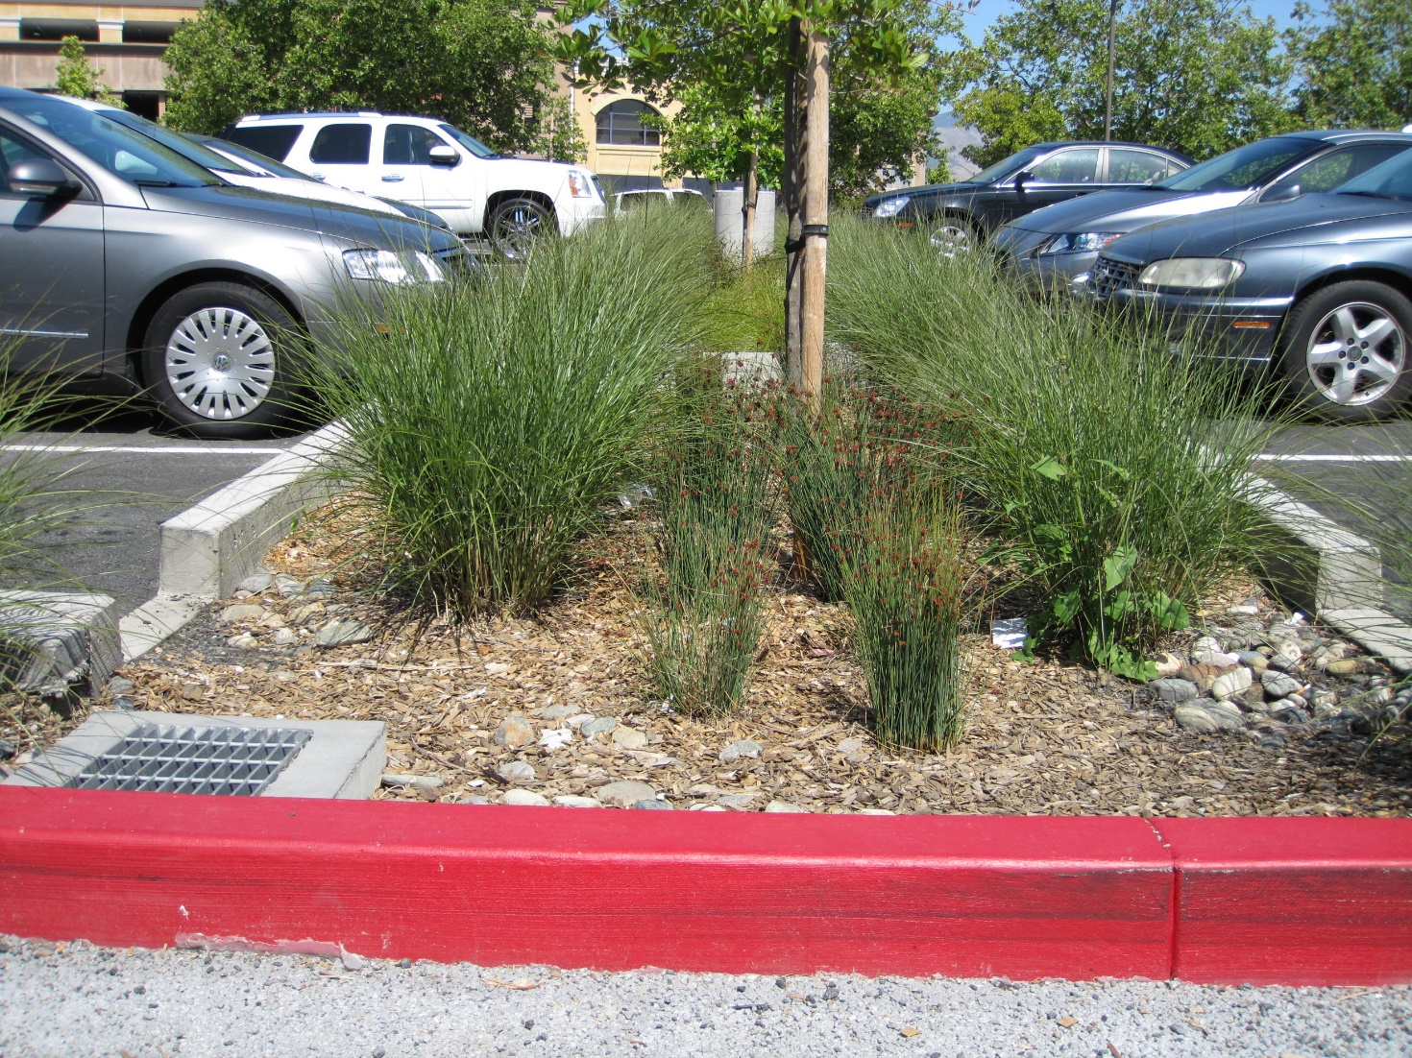
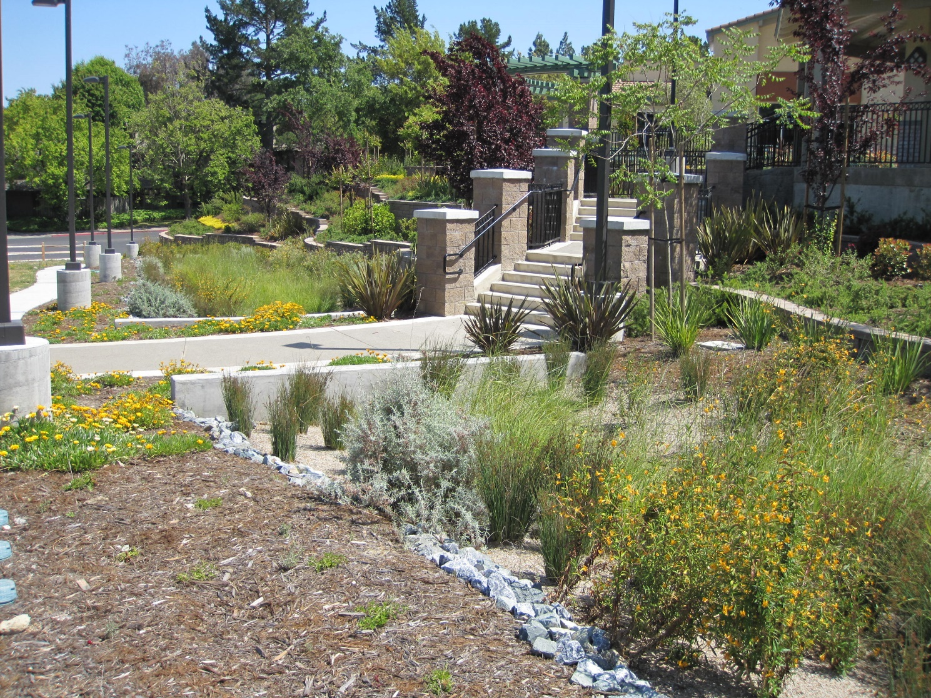
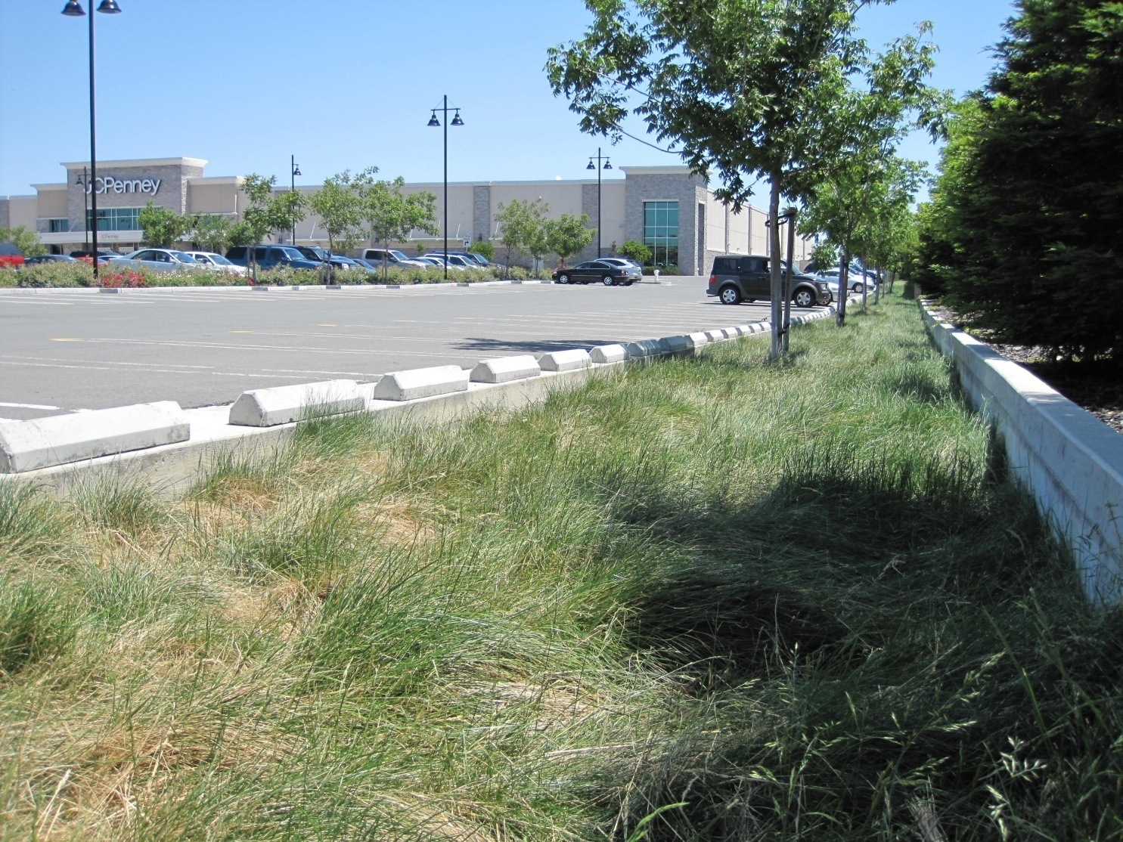
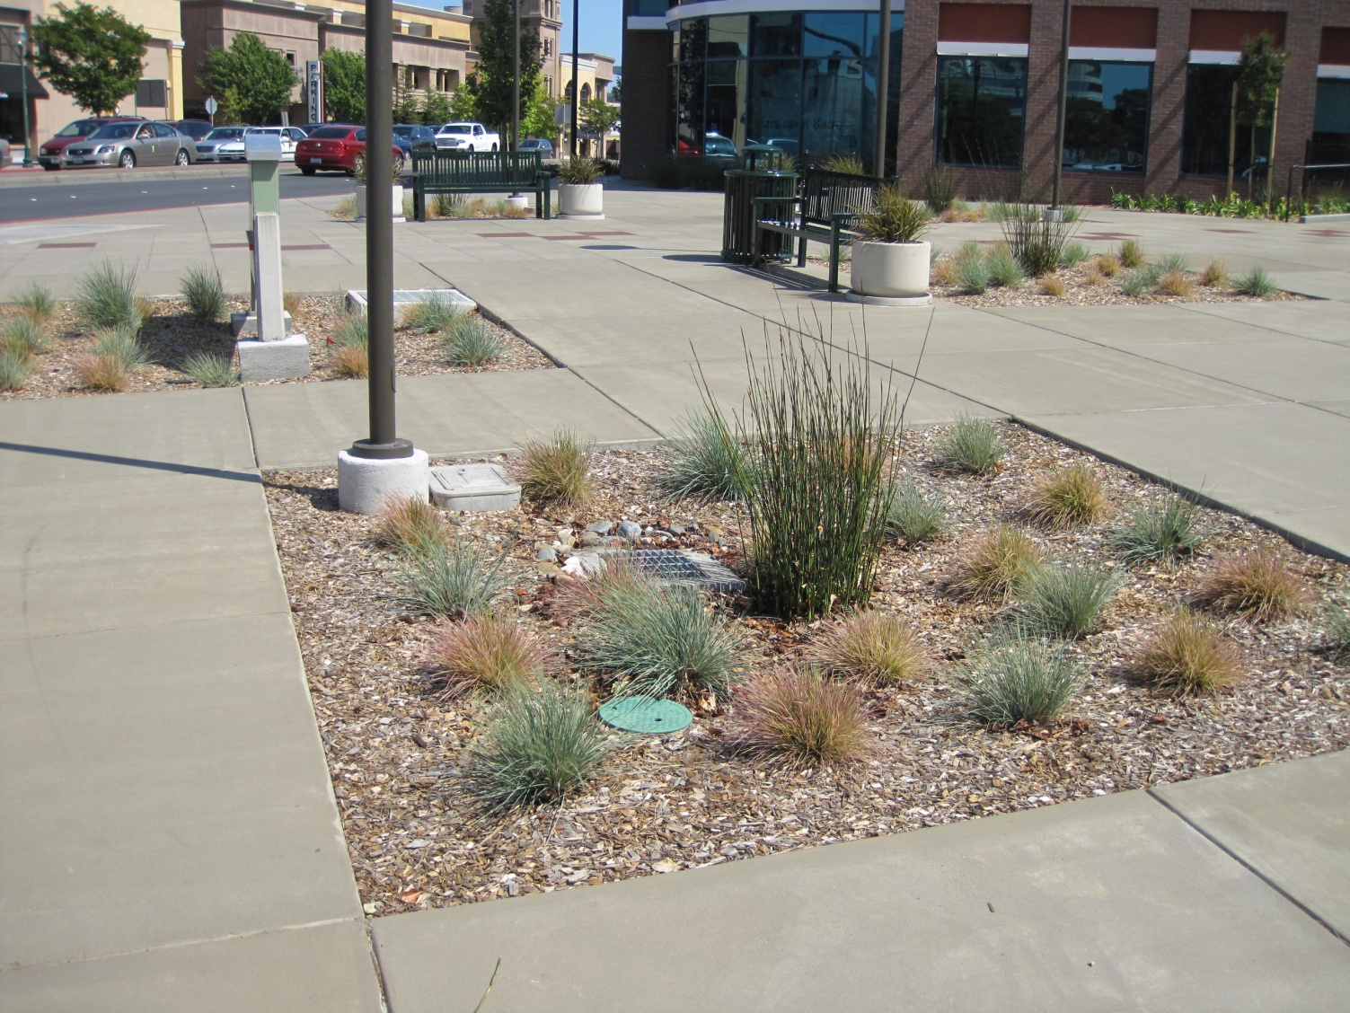
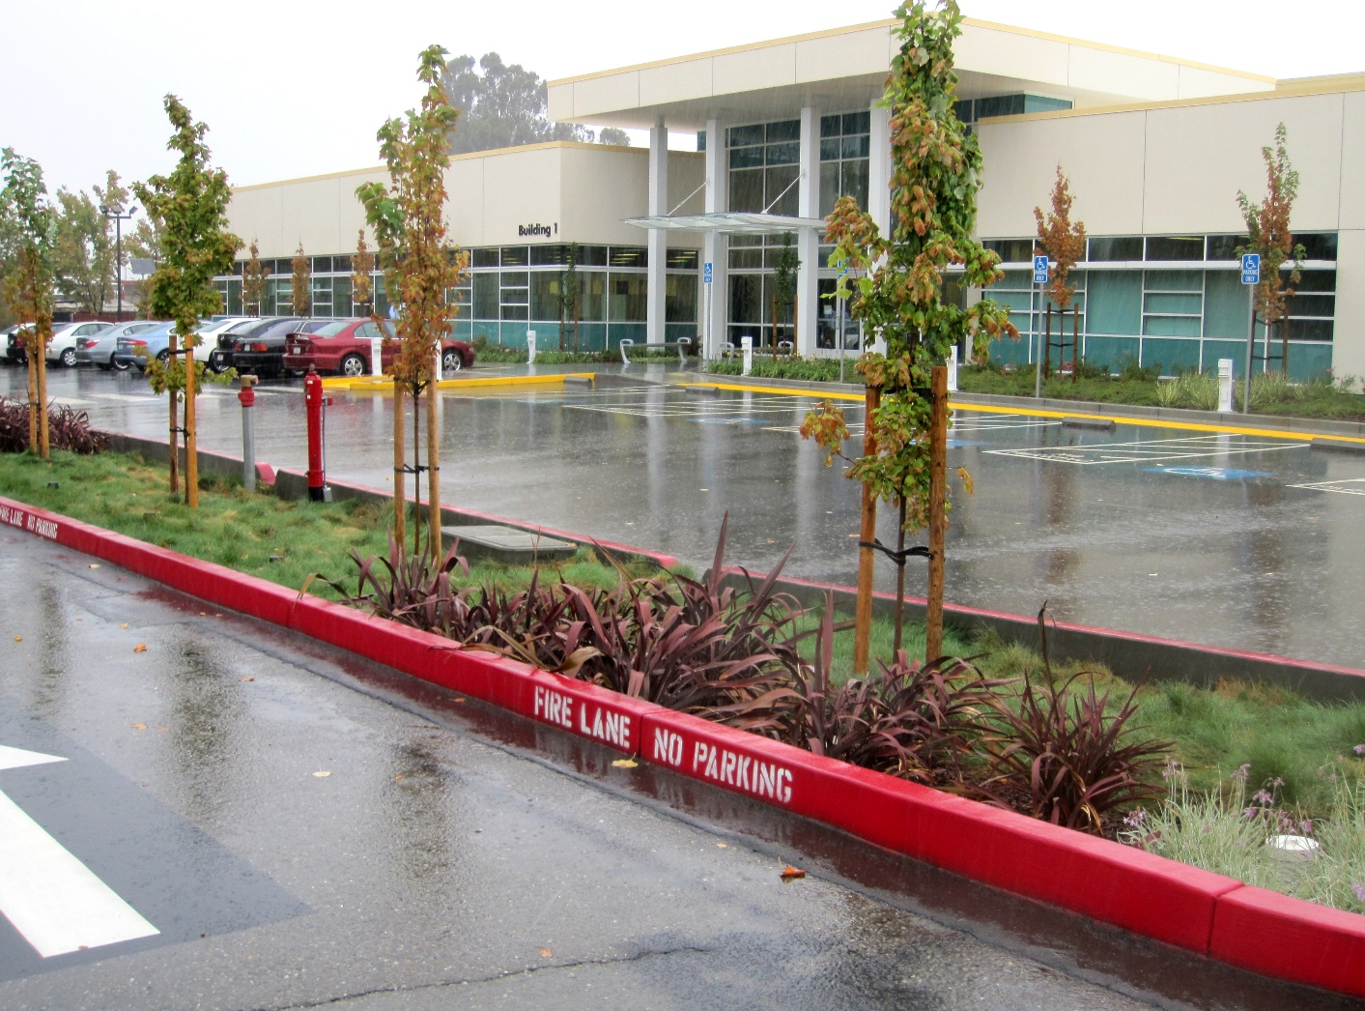
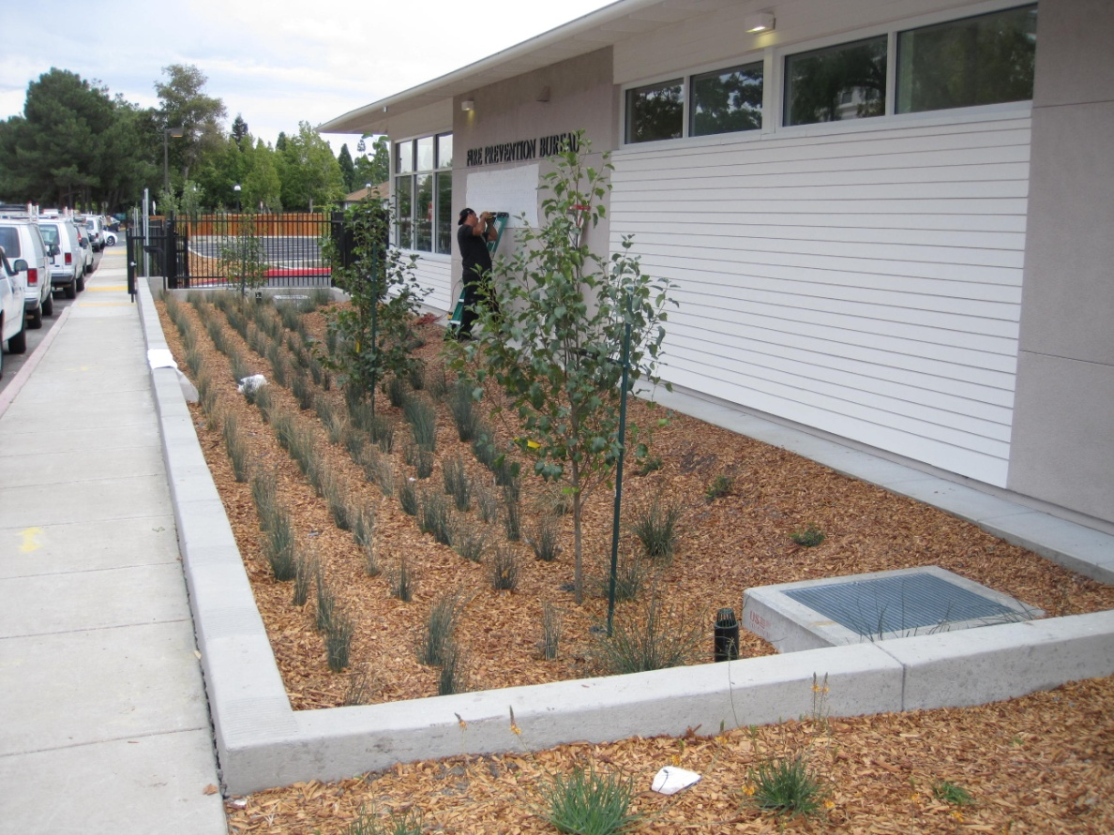
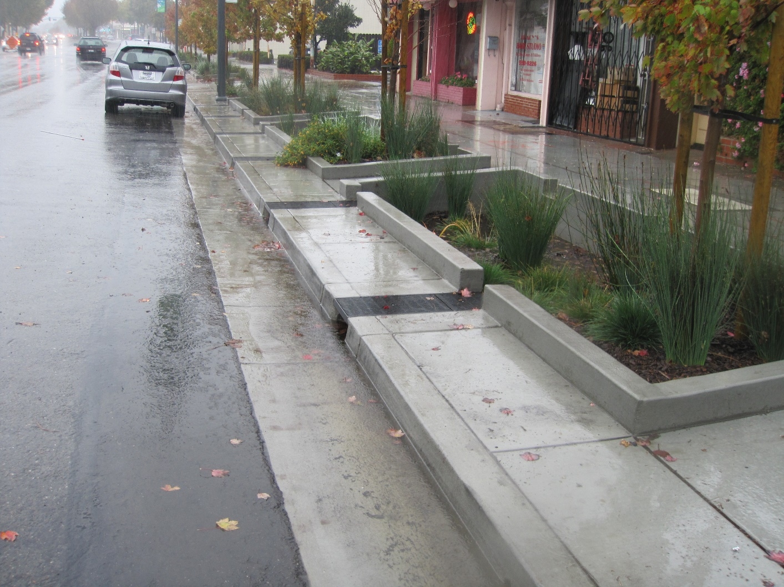
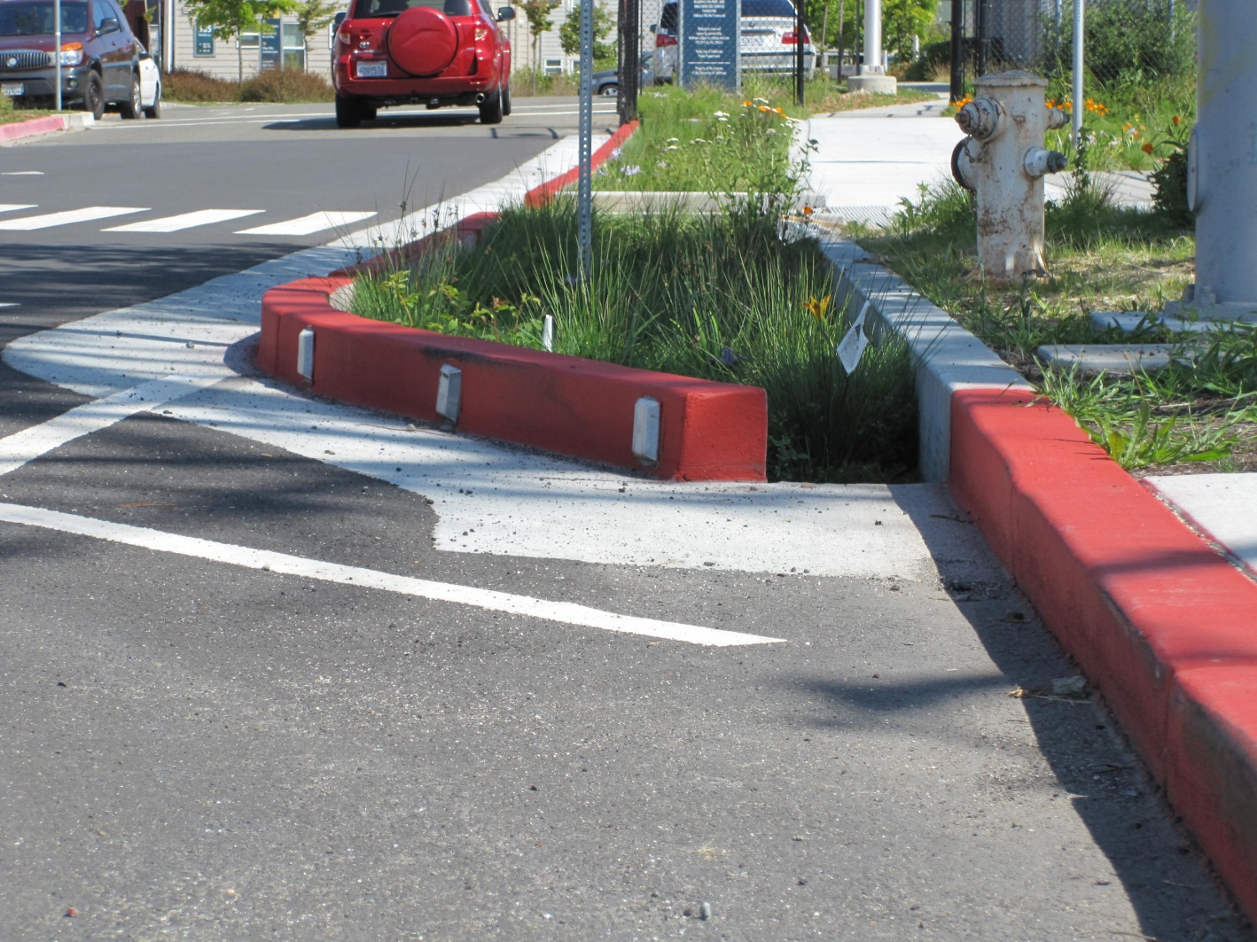
Methods – Bioretention
Notes:
Photos of bioretention in a residential subdivision, shopping centers, office parks, downtown plaza, and within public ROW

Slide 9
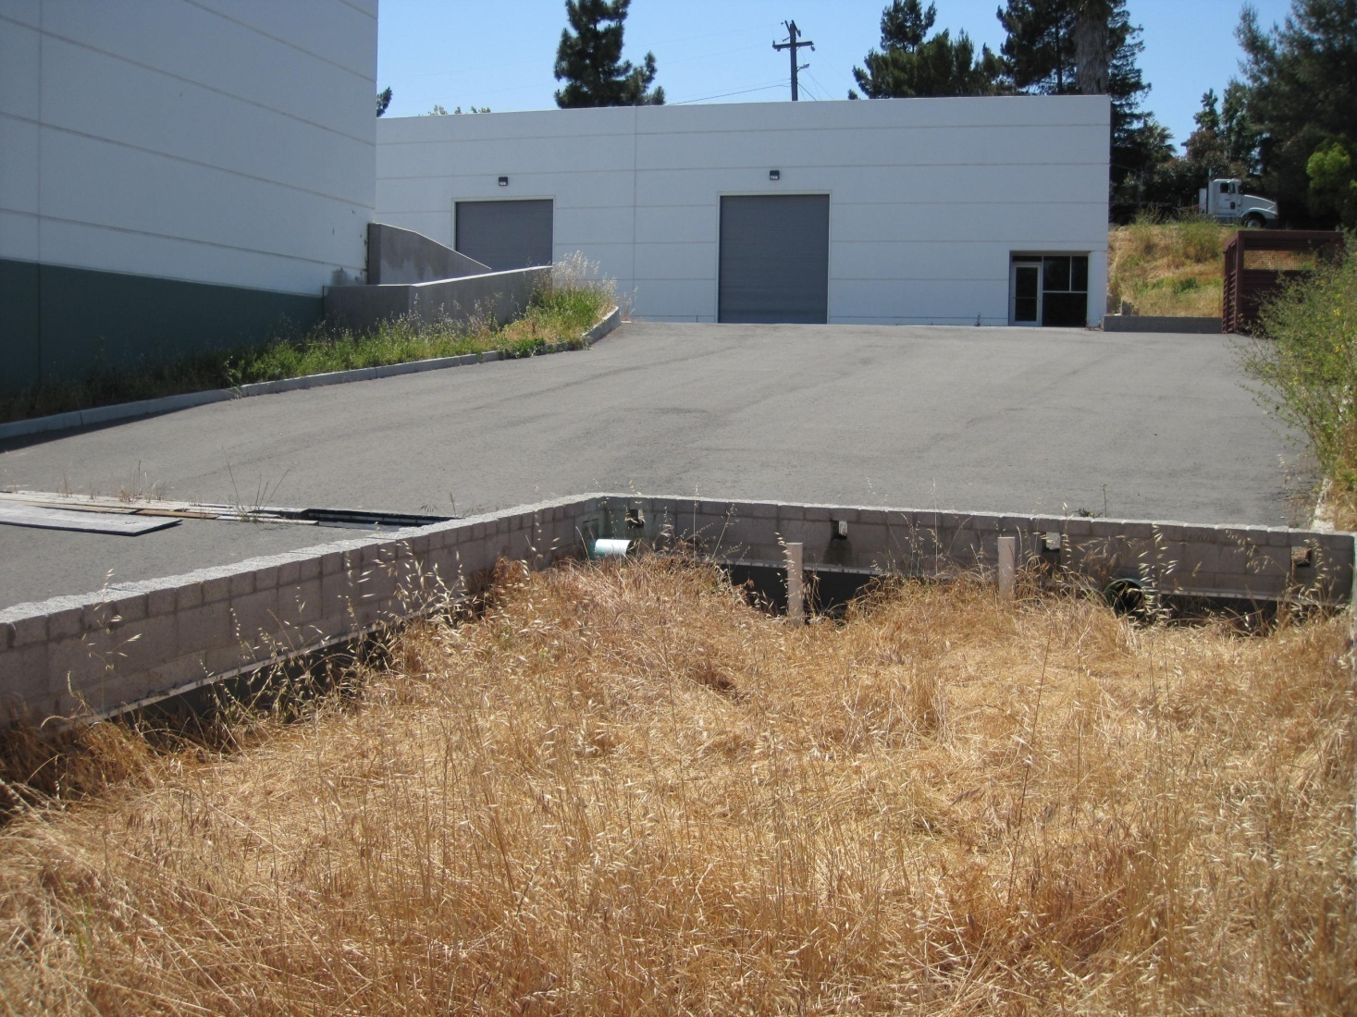
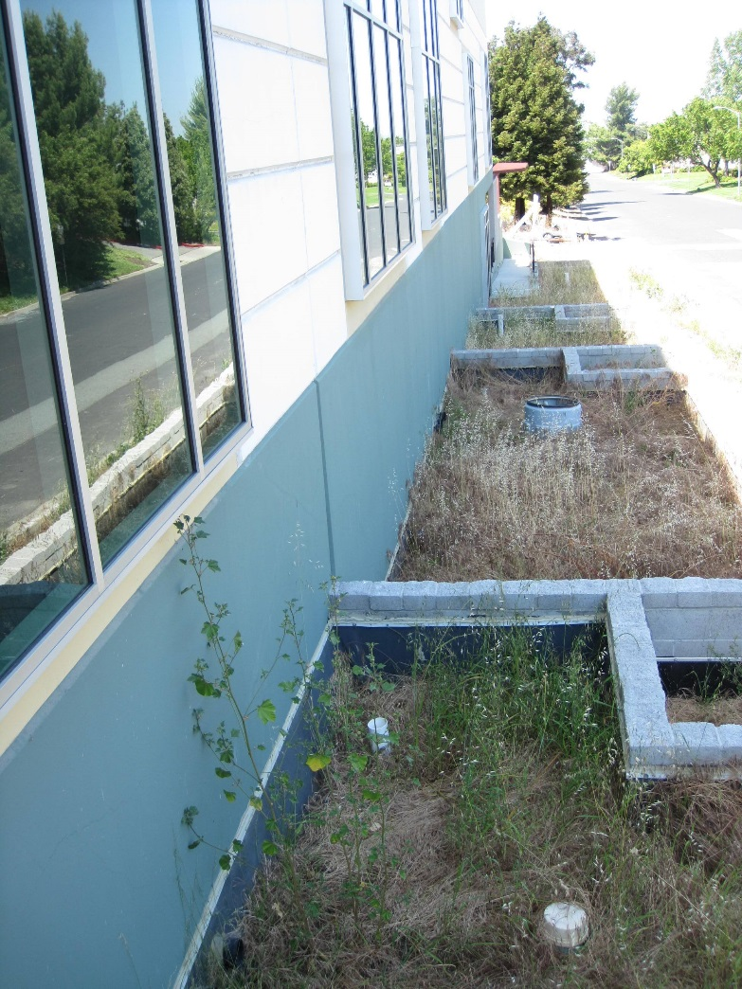
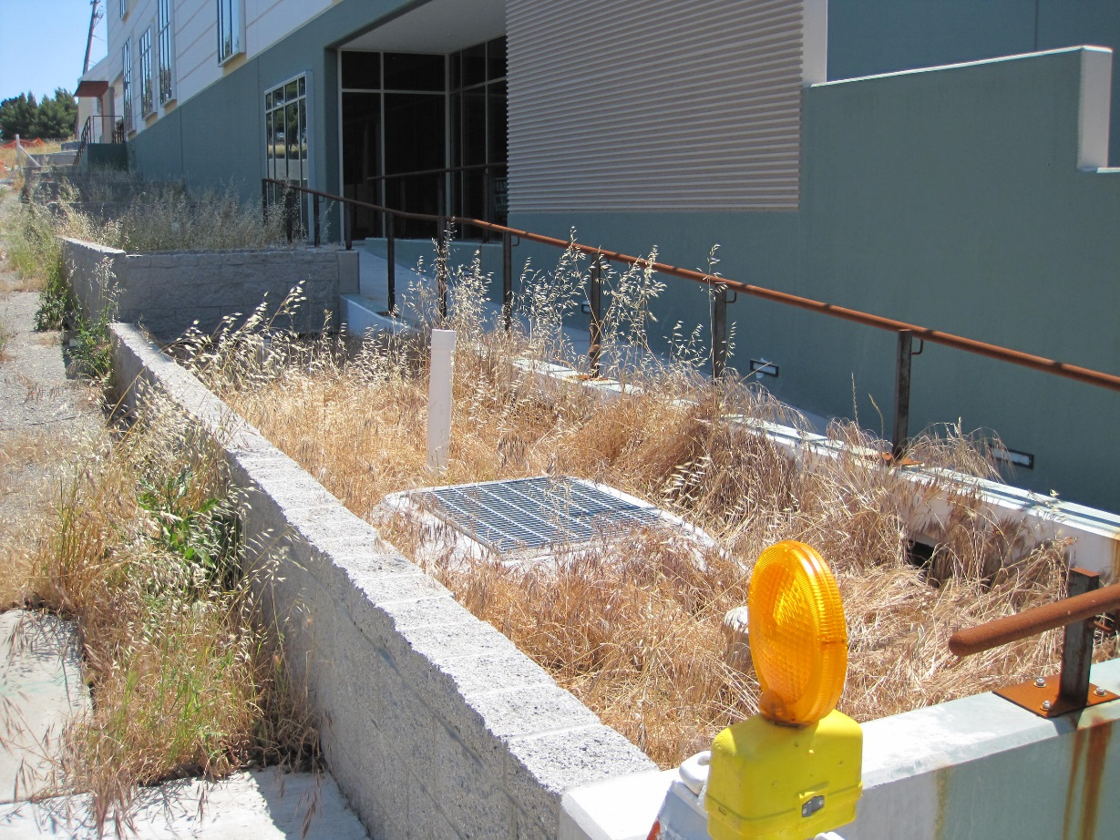
Methods – Bioretention

Slide 10
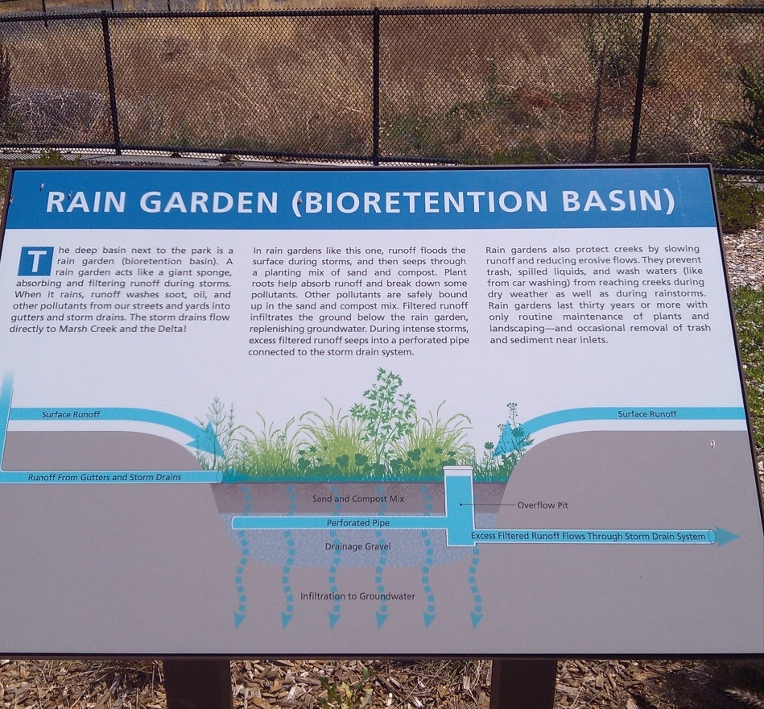
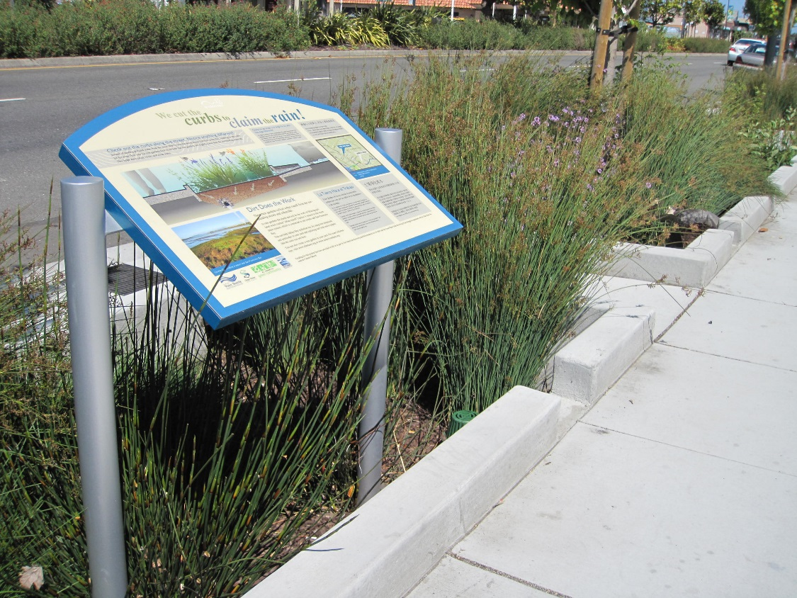
Methods – Bioretention

Slide 11
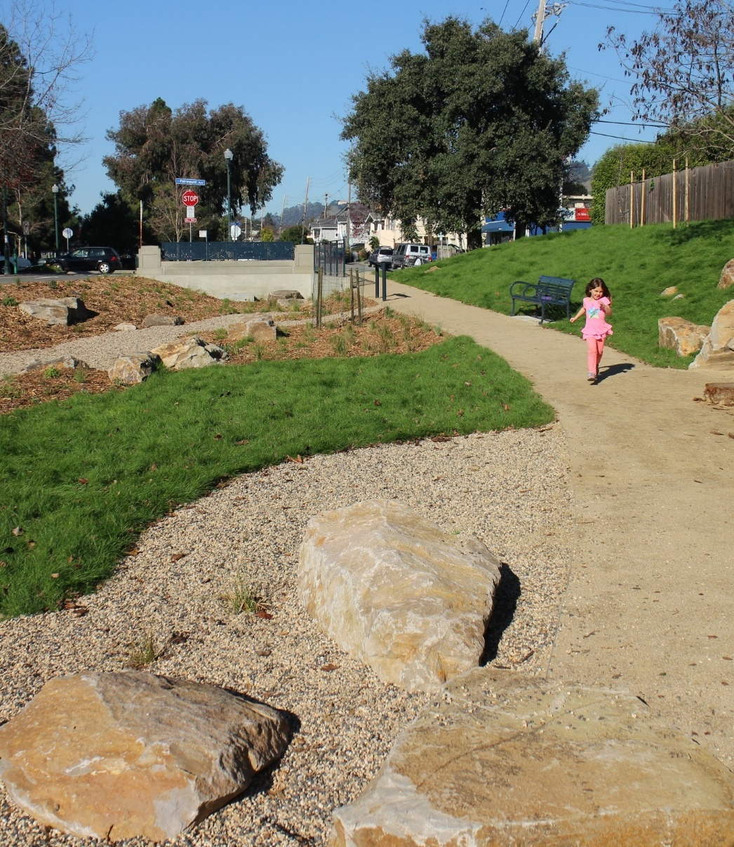
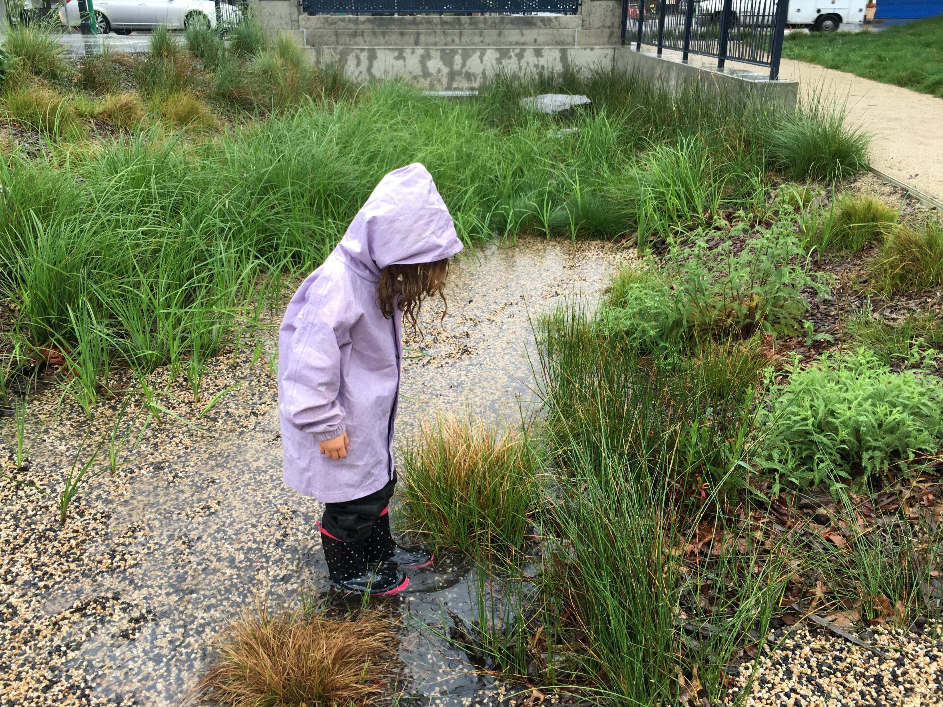
Methods – Bioretention

Slide 12
Compliance Process
Pre-Application
Meeting
Completed
Application
“Deemed
Complete”
Section
Review
Planning
Commission
Conditions of
Approval
CEQA
Review
Detailed
Design
Plan Set and
Permit
Application
Construction

Slide 13
Compliance – Drainage Design
Delineate entire site into Drainage
Management Areas (DMAs).
Categorize and tabulate DMAs. Minimize impervious area and disperse runoff.
Select and lay out LID facilities.
Use the sizing calculator to evaluate facility footprints.
Iterate until all facilities meet or exceed the minimum required area.

Slide 14
Documenting LID Site Design
Paved or
Roofed Area

Slide 15
LID Site Design Principles

Slide 16

LID Site Design Principles
Mimic natural hydrology
Disperse runoff
Keep drainage areas small
Don’t concentrate runoff
Don’t allow run-on from landscaped or natural areas

Slide 17
Drainage Management Areas

Slide 18
Drainage Management Areas
DMA 1
DMA 4
DMA 3
DMA 2

Slide 19
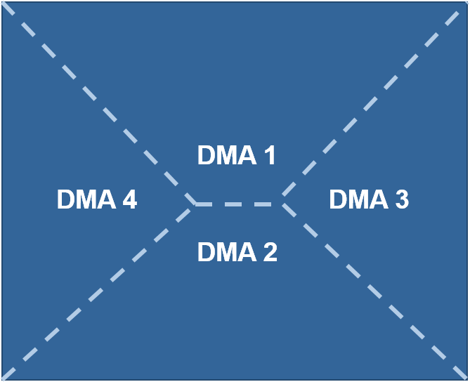
Drainage Management Areas

Slide 20
Drainage Management Areas
Natural
DMA-8
DMA-5
Paved
LLandscaped
DMA-6
La ndscaped
DMA-7
Landscaped

Slide 21
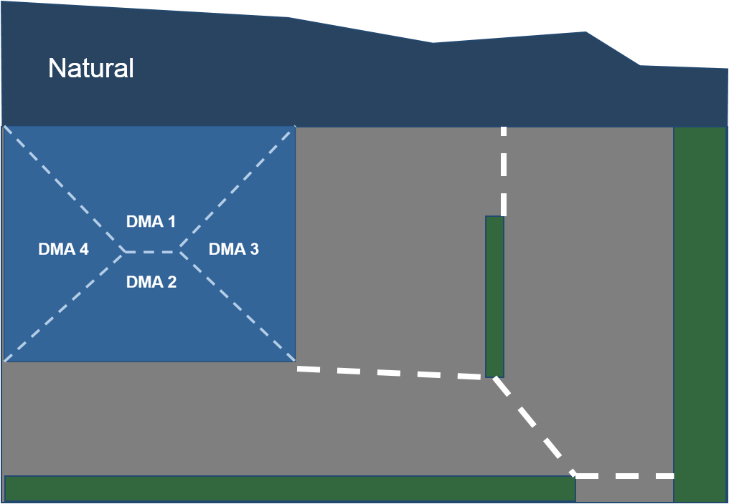
Drainage Management Areas
Possible
Bioretention
Locations

Slide 22
Options – Pervious DMAs
DMA-8
  Self-treating?
  Self-retaining?
  Drain to Facility?
DMA-8

Slide 23
DMA 8
Self-Treating
  Drain directly to storm drain system
Self-Retaining
  Retain first inch of rainfall without producing runoff
Drain to Facility
  Use runoff factor to account for contribution

Slide 24
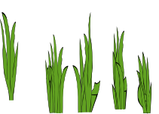

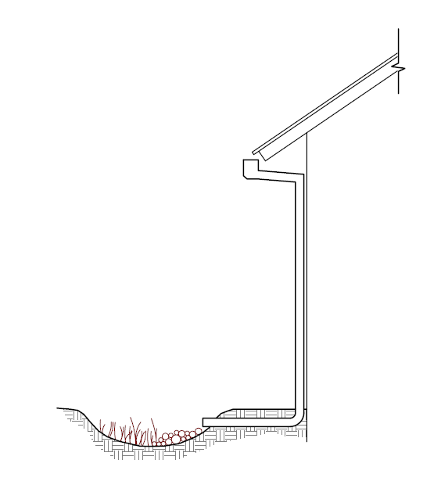
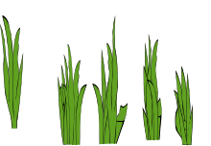

Self treating and self-retaining
Use a curb to avoid run-on
from self-treating areas
To storm drain
Grade self-retaining areas
to drain inward. Set any area drains to pond 3"-4"
Consider that adjacent roofs or paved areas could drain to self-retaining areas (not to exceed 2:1)

Slide 25
2. Tabulate DMAs
DMA-8
9350 SF
DMA | SF
1 | 1300
2 | 1050
3 | 1300
4 | 1050
5 | 4000
6 | 5570
7 | 7025
8 | 9350
Total | 30645
1300 SF
5570 SF
DMA-5
4000 SF
1050 SF
1050 SF
1300 SF
LLandscaped
DMA-6
DMA-7
7025 SF

Slide 26
3. Select and Lay Out Facilities
DMA-8
9350 SF
DMA | SF
1 | 1300
2 | 1050
3 | 1300
4 | 1050
5 | 4000
6 | 5570
7 | 7025
8 | 9350
Total | 30645
1300 SF
5570 SF
DMA-5
4000 SF
1050 SF
1050 SF
1300 SF
LLandscaped
DMA-6
DMA-7
7025 SF
375 SF

Slide 27
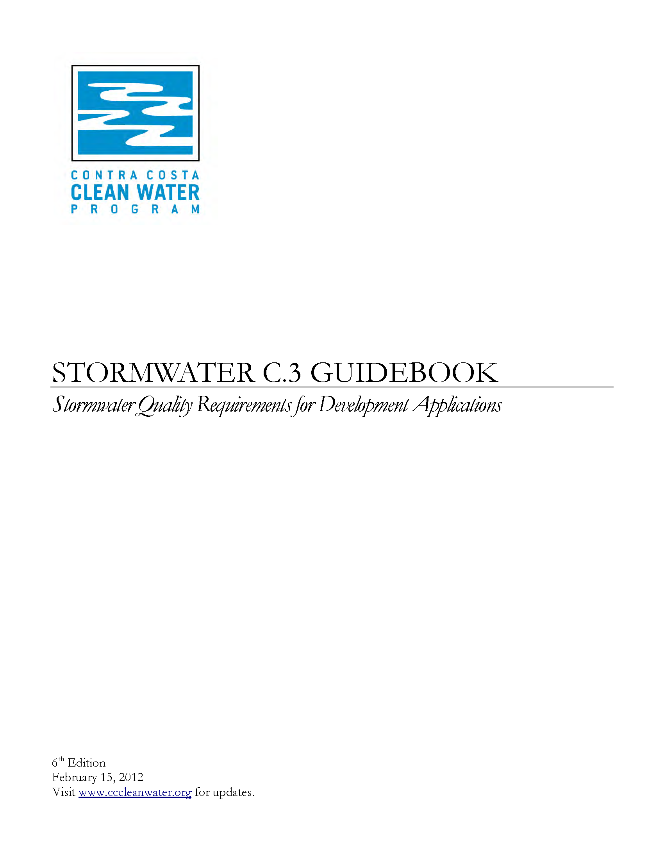
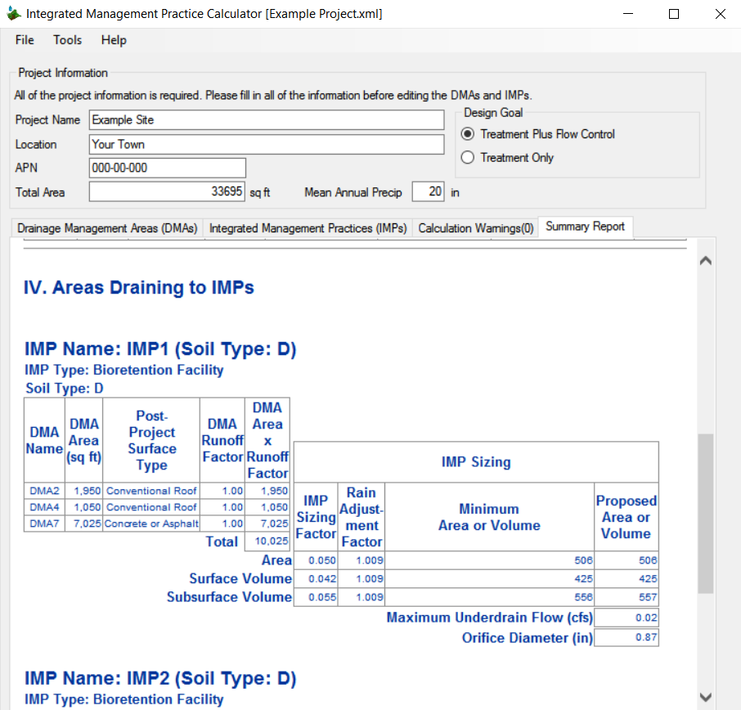
Tools and Assistance
Stormwater C.3 Guidebook
  Template for a
  Stormwater Control Plan
    Small Project
    Regulated Project
  IMP Sizing Calculator
Workshops
Technical Assistance

Slide 28
C.3 and LID Basics
Mandate
Development Review
Elegance
Bioretention
Drainage Management Areas
Calculations
Guidebook

Slide 29
Provision C.3 Changes
In MRP 2.0, effective January 1, 2016

Slide 30
Changes to Provision C.3
Grandfathering
Pervious Pavements
  Design Specifications
  Inspect installations ≥3,000 SF (contiguous)
Special Projects/Non-LID Treatment
  Changes to density criteria (definitions)
  Must show infeasibility of using LID

Slide 31
Changes to Provision C.3
Hydromodification Management
  Made requirements regionally consistent
  Applicability Map
  Contra Costa update in January 2018

Slide 32
Changes to Provision C.3
Green Infrastructure
  Means streets and storm drains, plus development on previously developed sites
  Load reductions for PCBs and Mercury
  Looking for opportunities to implement LID

Slide 33
Guidebook Updates
In the 7th Edition

Slide 34
Guidebook Updates
Chapter 1: Policies and Procedures
Chapter 2: Preparing Your Plan
Chapter 3: LID Site Design Guide
Chapter 4: Design and Construction
Chapter 5: Operation and Maintenance
Page
#s
Notes:
Discuss elimination of Chapter 2 and reorganization of Chapters 2, 3, and 4.

Slide 35
Guidebook Updates – Chapter 1
3
Pavement resurfacing—when does it
count as replaced impervious area?
Impervious surfaces constructed in adjacent ROW are part of the project
Grandfathering
Subdivisions
Hydromodification Management
  options for compliance
6
7
10

Slide 36
Guidebook Updates – Chapter 2
13
Using the template
Stormwater Control Plan Exhibit
Integrating Stormwater Facilities
into the Project
Example Stormwater Control Plans
15
16
Notes:
Add graphic for replaced impervious surface, for SCP exhibit, examples

Slide 37
Chapter 2 - Project Data Form
13
New Impervious Area
Replaced Impervious Area
Pre-Project Impervious Area
Post-Project Impervious Area

Slide 38
Guidebook Updates – Chapter 3
Hydromodification requirements on sites that were already partially developed
No analysis of harvesting and use
More on LID site planning and placement of bioretention facilities within the site
Use the calculator to show calculations
Special Projects and Non-LID treatment
24
28
30
44
Notes:
Annotate with page numbers

Slide 39
Guidebook Updates – Chapter 4
Show DMAs in
Construction Documents
Bioretention Facilities
  Call out key elevations on civil plans
  Call out top of soil on landscape plans
  Bioretention facilities must be unlined except…
Pervious pavements
46
67
Notes:
Call out page numbers

Slide 40
Hot Topics
Implementing Low Impact Development
Drainage Design in
Land Development Projects

Slide 41
Hot Topics
C.3 and Project Entitlement Process
Pervious Pavements
Self-Treating and Self-Retaining Areas
Bioretention Facility Placement
Special Projects/High Density Projects
Bioretention Facility Design
Green Infrastructure

Slide 42
Issues: C.3 & Project Entitlements
Approval of Subdivision Tentative Maps
  Bioretention not integrated into neighborhood
  Bioretention on individual lots
  Bioretention not visible or accessible;
  limited aesthetic benefit
Higher density projects
  Townhomes
  Multi-family
Lot line changes without
improvement plans
6-9
Notes:
Need to integrate LID into project before tentative map submitted

Slide 43
Integrating Bioretention into Layout

Slide 44
Accessibility

Slide 45
Townhomes and Higher Density

Slide 46
Issues: Pervious Pavements
Not suitable in many locations
High cost
How long will they last?
  Structural stability
  Surface raveling
  Patching or replacing small areas
53

Slide 47
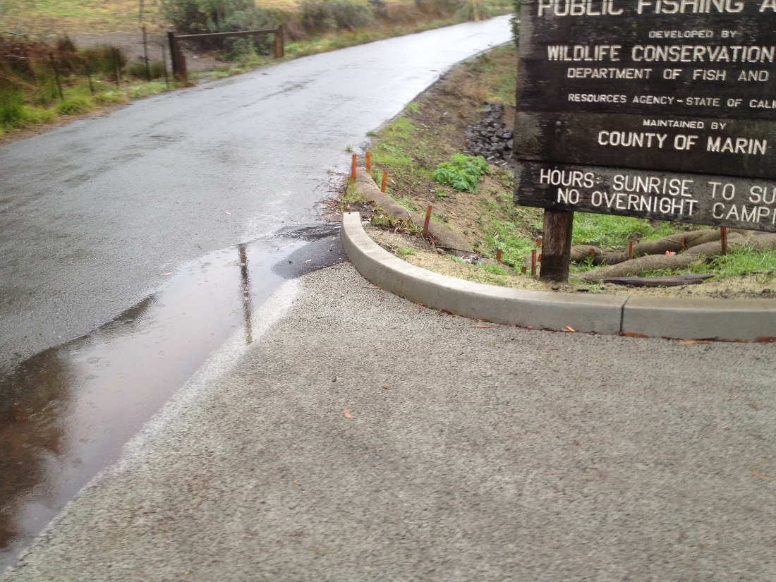
Issues: Pervious Pavements
As proposed in Stormwater Control Plans
  On steep slopes and at base of slopes
  Where not economic to use

Slide 48
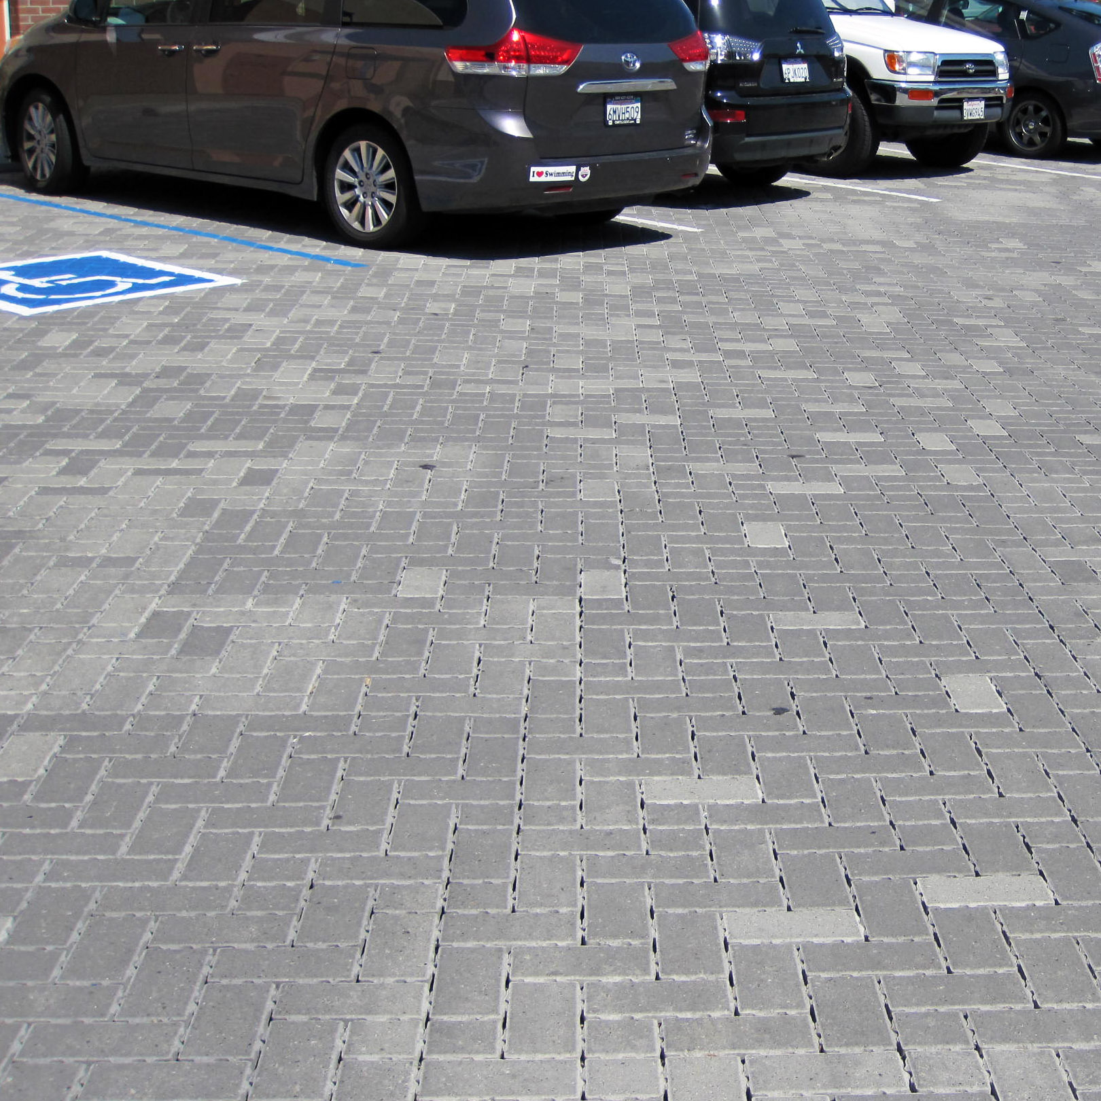
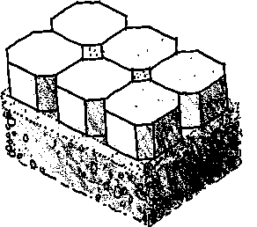
Issues: Pervious Pavements
In Construction Plans
  Need engineering criteria
  Need expertise to review
concrete unit pavers
sand setting bed
reservoir base course

Slide 49
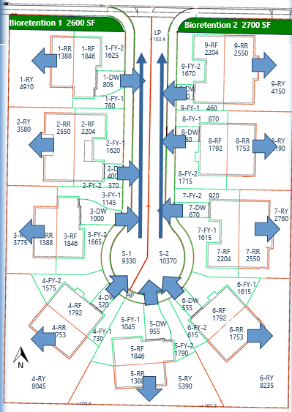
Issues: Self-Treating/Self-Retaining
Not always used optimally
Confusion over terms
Especially important for projects with hydromodification management
Using judgment when applying criteria for self-retaining areas
49

Slide 50
Issues: Bioretention Placement
High-visibility, well-trafficked areas
In common areas of subdivisions
Drainage
  Only impervious roofs and pavement
  Keep ‘em high; use short drainage runs
Integrate with site landscaping
Flat and level
Adjacent to buildings
28
58

Slide 51
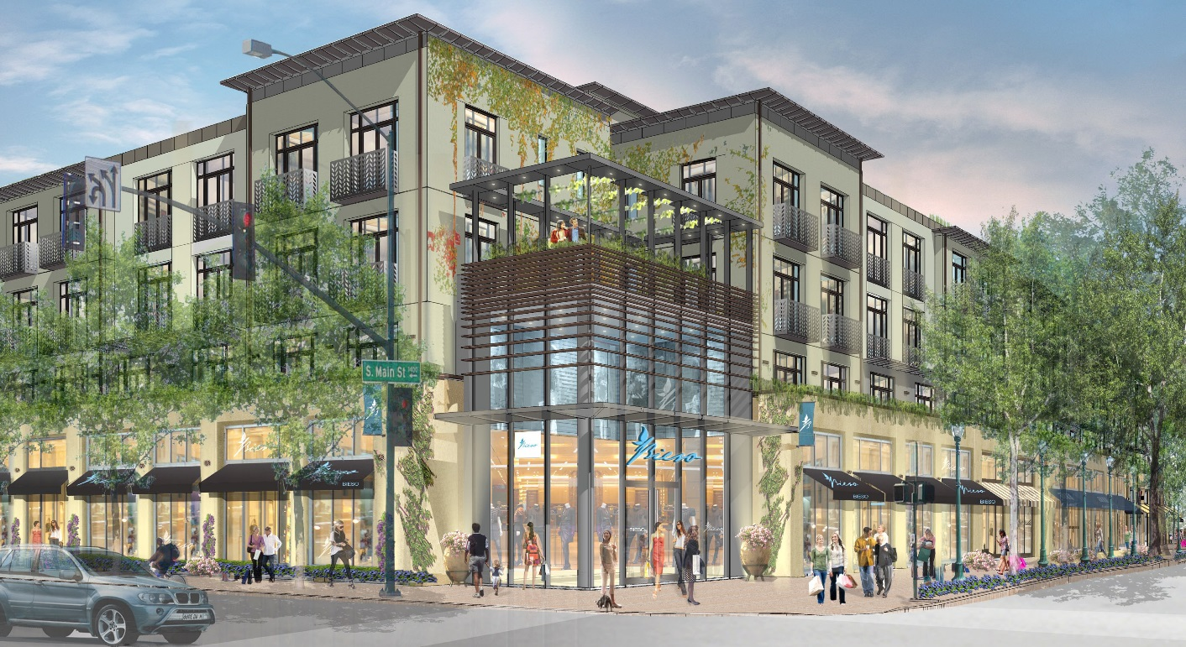
Issues: Special Projects
Need to review feasibility for LID
Locations for bioretention facilities

Slide 52
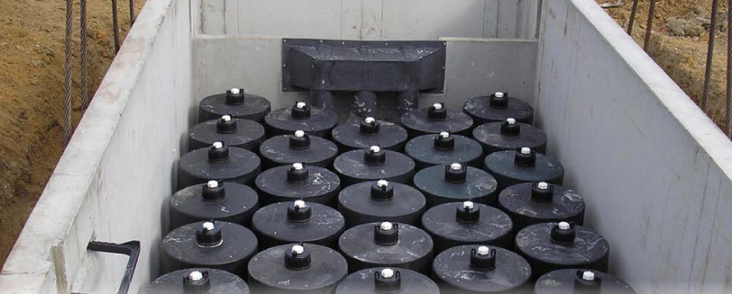
Issues: Special Projects
Criteria for non-LID

Slide 53
Issues: Bioretention Design
57
Using the current design standard
  Each layer is flat
  Underdrain discharge is at top of gravel layer
  Overflow structure is a catch basin
Open bottom
(allow
infiltration)

Slide 54
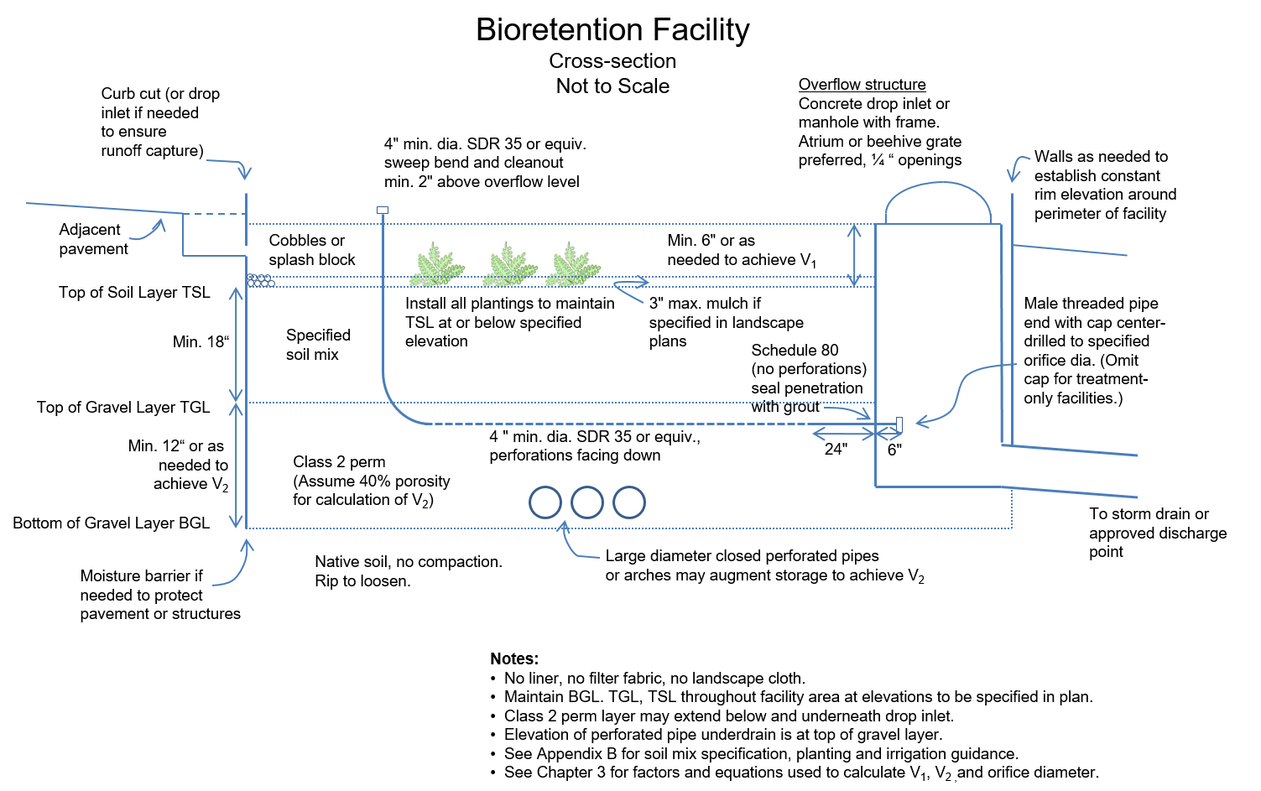
Illustrative cross-section
64

Slide 55
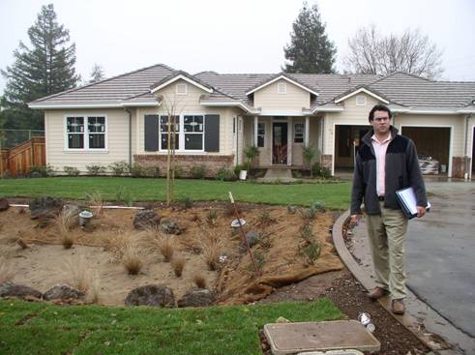
Don’t create pits

Slide 56
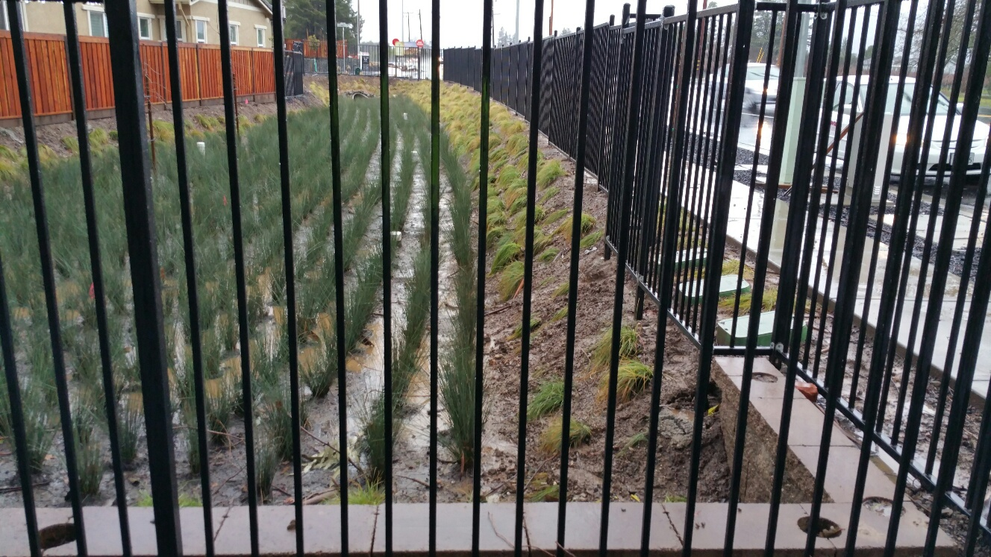
Don’t create pits

Slide 57
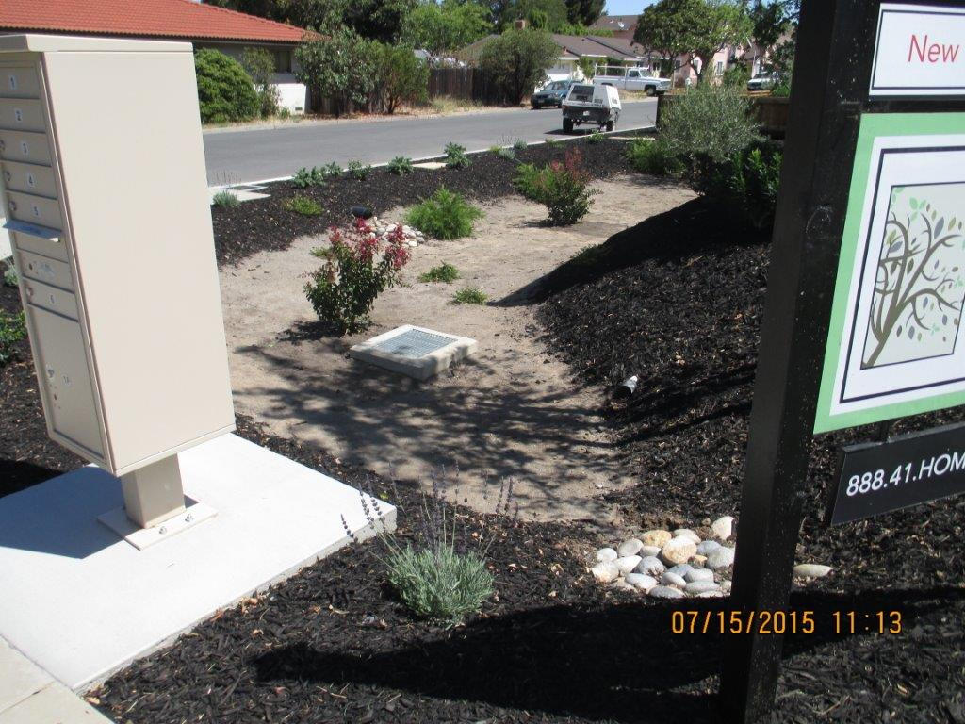
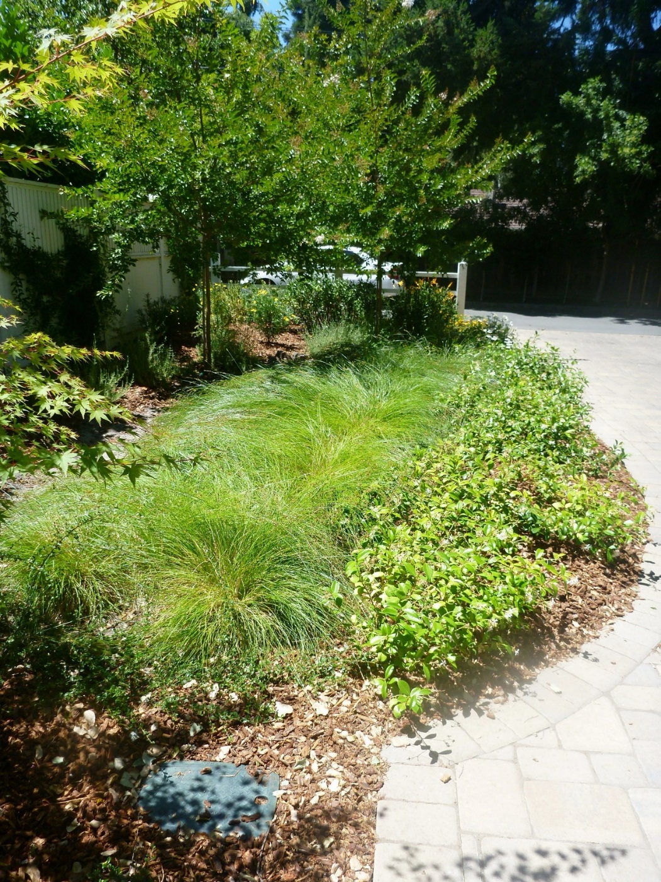
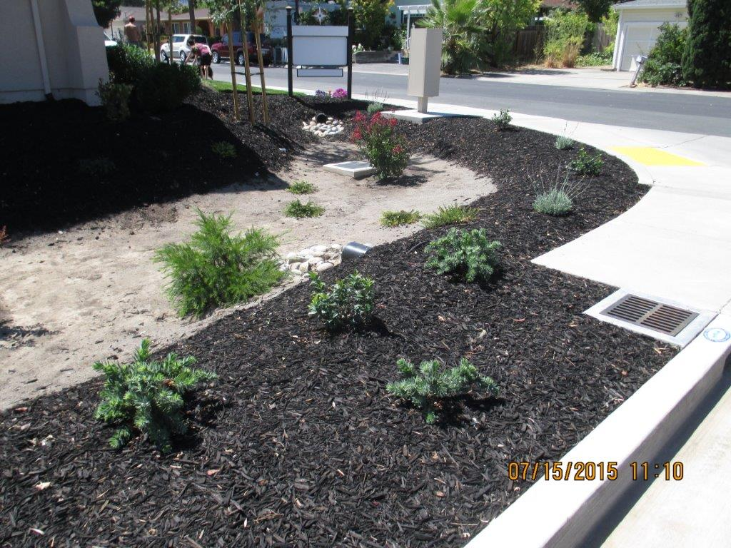
That’s better

Slide 58
Make This Happen
Bioretention facilities are level so they “fill up like a bathtub.”

Slide 59
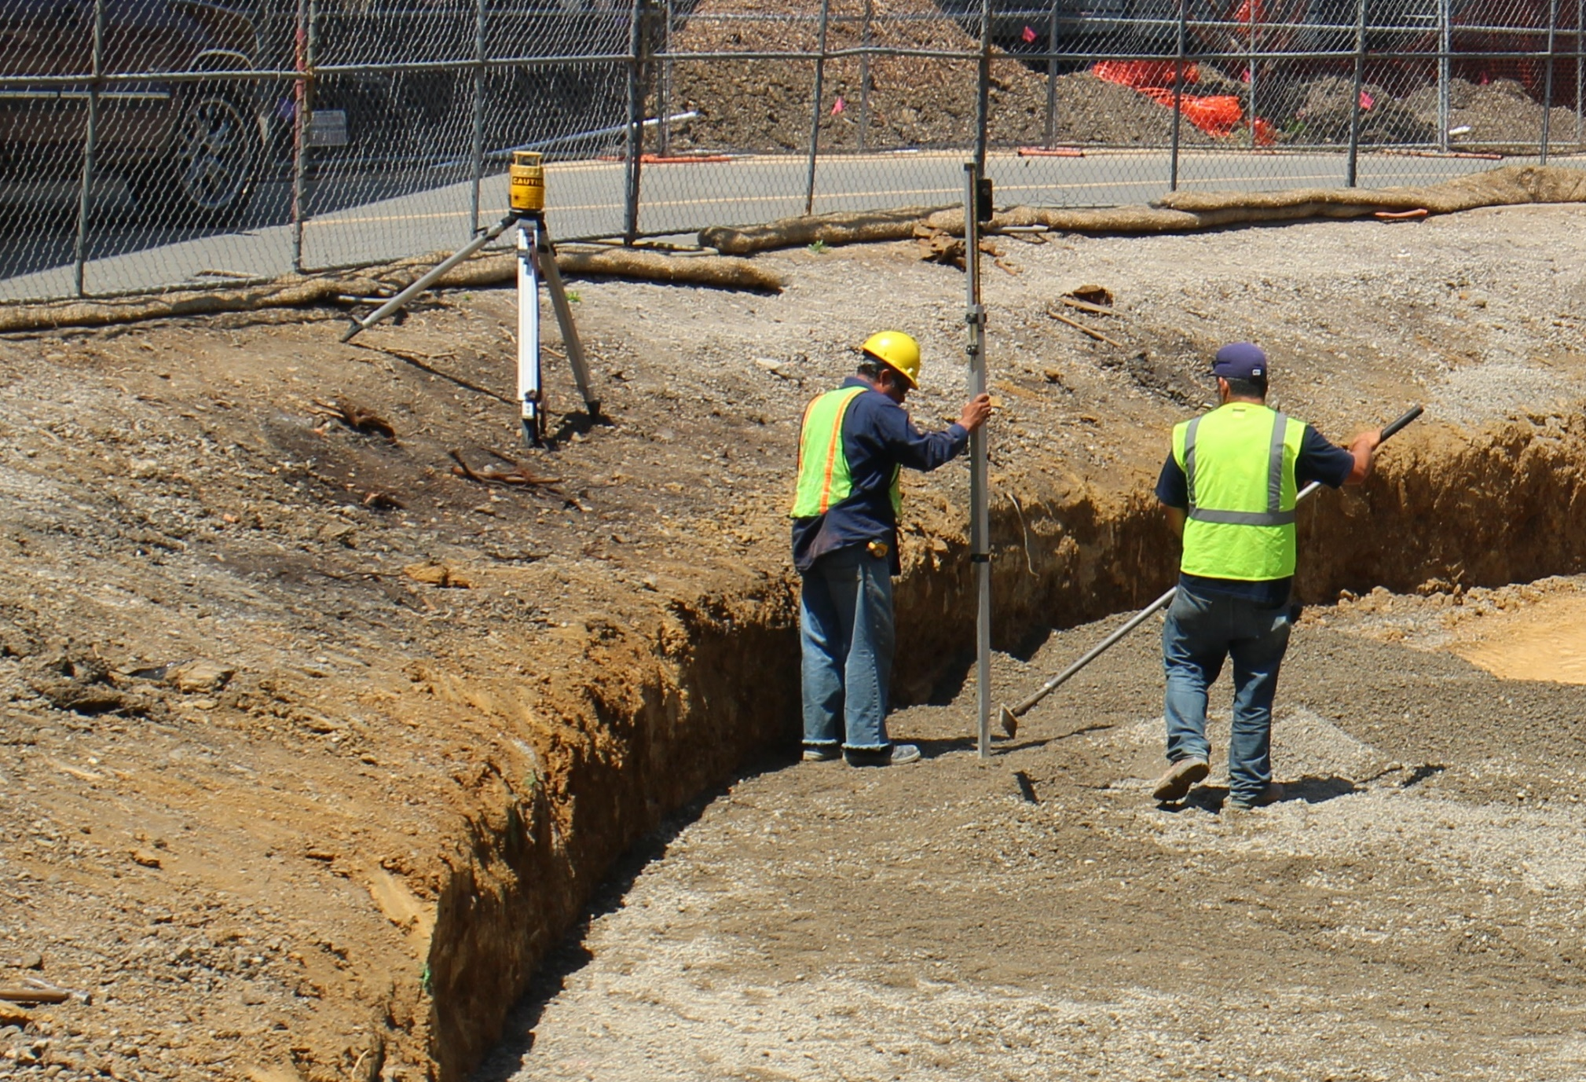
Flat, Flat, Flat

Slide 60
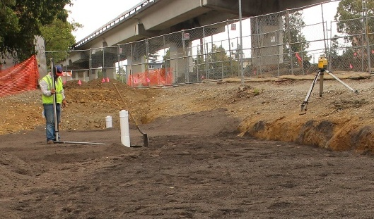
Flat, Flat, Flat

Slide 61
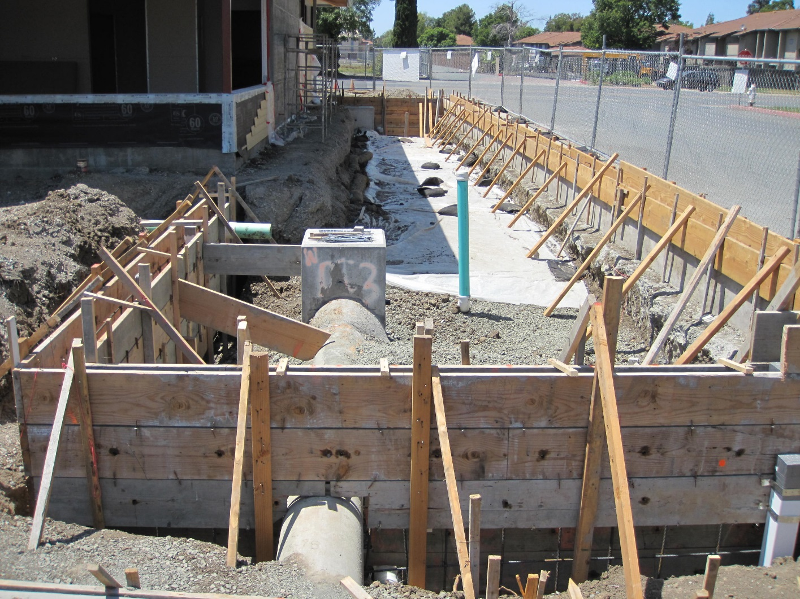
Foundations and Pavement

Slide 62
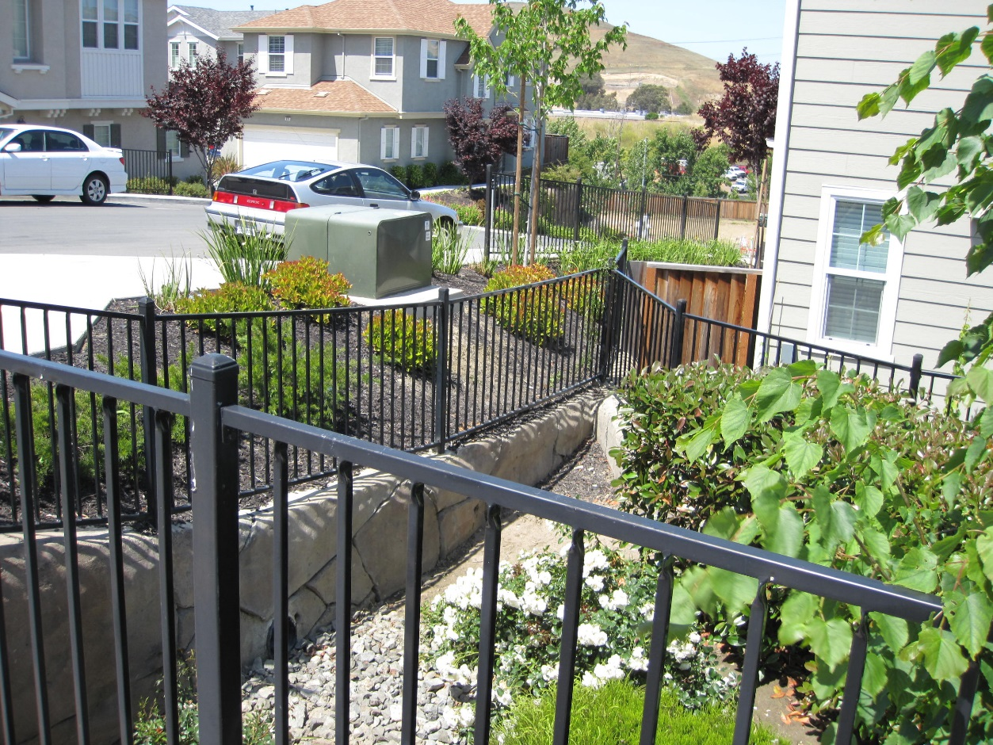
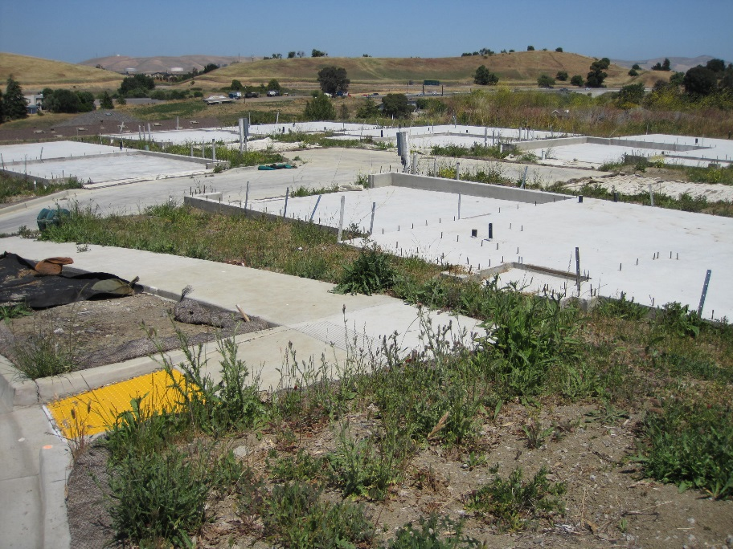
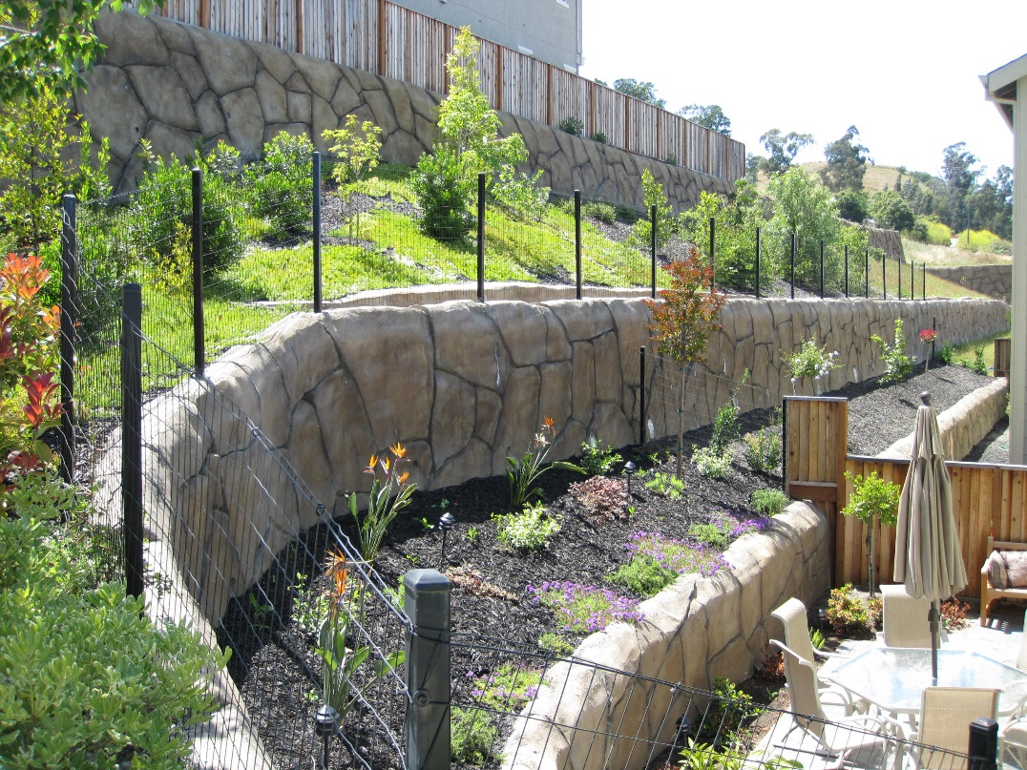
Geotechnically Difficult Sites

Slide 63
Issues: Green Infrastructure
Municipalities are looking for opportunities to treat street drainage
Policies for street frontage improvements
Opportunities to offset untreated areas within private development
Draining and treating runoff from public ROW on a private site
Draining and treating runoff from private site within public ROW

Slide 64
Green Infrastructure in Frontage

Slide 65
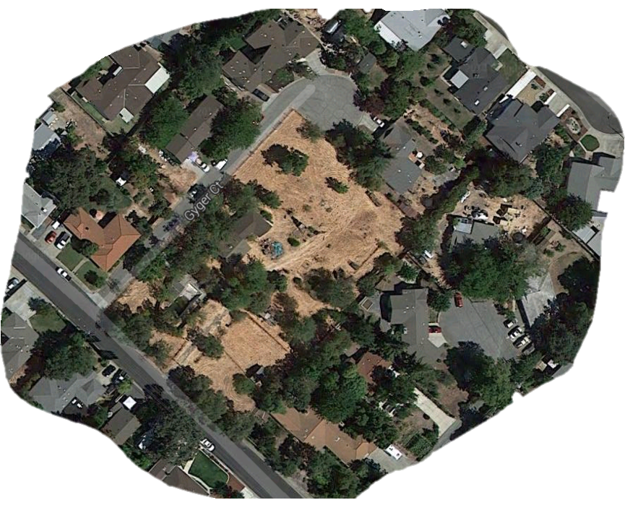
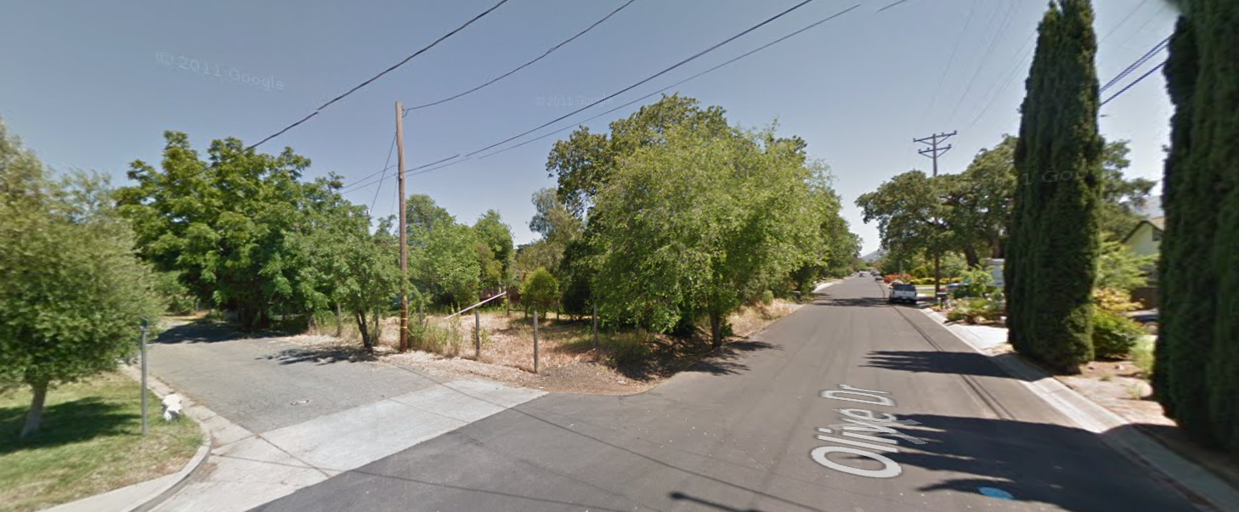
Public and Private Drainage

Slide 66
Workshop Summary

