Slide 1
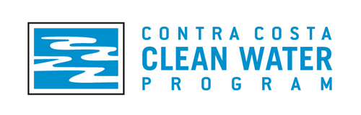
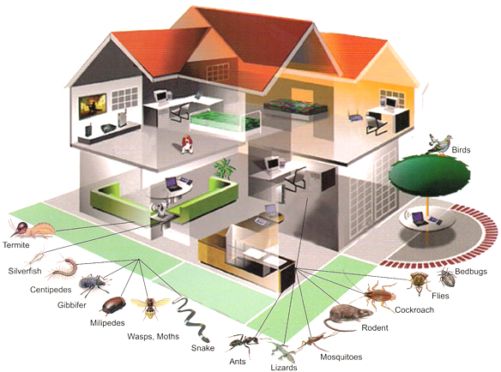
Structural IPM Tailgate
Contra Costa Clean Water Program
June 30, 2011

Slide 2
Agenda
IPM in a nutshell
NPDES requirements for IPM
IPM Policy and Program
IPM philosophy
Structural IPM
Break (video)
Structural IPM from a stormwater perspective
MRP pesticide reduction requirements
Pesticides that threaten stormwater runoff
Structural IPM examples

Slide 3
Disclaimer
I AM NOT AN IPM PROFESSIONAL

Slide 4
What is a pesticide?
A pesticide is a chemical used to prevent, destroy, or repel pests. Examples:
Algicidees, Antifouling agents, Antimicrobial, Attractants, Biopesticides, Biocides, Disinfectants and sanitizers, Fungicides, Fumigants, Herbicides, Insecticides, Miticides, Microbial pesticides, Molluscicides, Nematicides, Ovicides, Pheromone, Repellents, Rodenticides, Defoliants, Dessicants, Insect growth Regulators, Plant growth Regulators

Slide 5
What is IPM?
Integrated Pest Management (IPM) is an effective and environmentally sensitive and long-term approach to pest management that relies on a combination of common-sense practices.
IPM takes advantage of all appropriate pest management options including, but not limited to, the use of pesticides and pesticide alternatives to manage pests with the least possible hazard to people, property, and the environment.

Slide 6
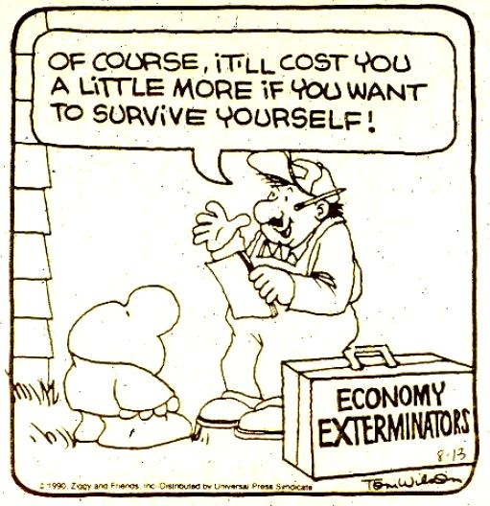
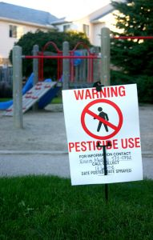
Why IPM?
Contamination of creeks, rivers, and oceans
  California creeks, rivers, and oceans are being contaminated with pesticides and other chemicals commonly used around our homes and gardens. These chemicals are not only a threat to aquatic life, but they can also affect the quality of our drinking water.
Toxicity to living organisms
  All pesticides are toxic at some level, but each varies in their toxicity to humans and other animals. Organophosphates, including diazinon and chlorpyrifos, are insecticides that contain phosphorus; they are nerve poisons and act by inhibiting important enzymes in the nervous system in animals. Pyrethroids are another class of insecticides that are not as toxic to humans and other mammals, but are quite toxic to fish and invertebrates. Both the organophosphates and pyrethroids pose serious threats to aquatic invertebrates in California waterways.

Slide 7


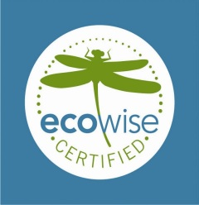

NPDES requirements for IPM
C.9 Pesticide Toxicity Control:
  Implement a pesticide toxicity control program that addresses use of pesticides within your municipality that threatens water quality
  C.9.a Adopt an IPM Policy or Ordinance
  C.9.b Implement IPM Policy or Ordinance
    Establish written SOPs for pesticide use and report trends in pesticide use
  C.9.c Train Municipal Employees (every three years)
  C.9.d Require Contractors to Implement IPM with contracts including IPM or through IPM certification.
  C.9.e Track and Participate in Relevant Regulatory Processes
  C.9.f Interface with County Ag Commissioners (report improper pesticide usage)
  C.9.g Evaluate Implementation of Source Control Actions Relating to Pesticides
  C.9.h Public Outreach (point of purchase, residents, and PCOs)
Notes:
The red is their responsibility. The black is the Program’s.

Slide 8
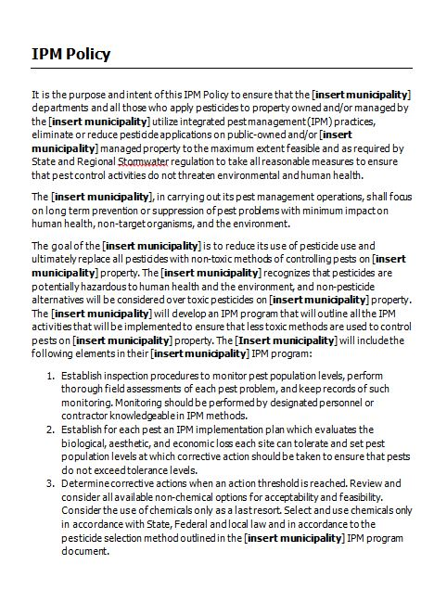
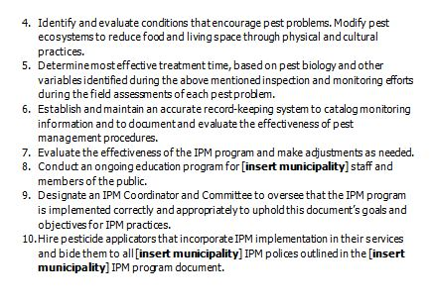
IPM Policy
Notes:
Be familiar with your policy and make it your bible.

Slide 9
IPM Program
Goals and Purpose
IPM Policy
Roles and Responsibilities (may include an IPM coordinator and/or a IPM committee)
Implementation Practices
  Pesticide selection and approval
  Establishing pesticide free zones (for sensitive public areas and creeks)
  Pesticide applicator selection and approval process (for hiring a contractor)
  IPM application (who applies and where)
  Education and training
  Notification for pesticide applications
  Record keeping/program review
  Outreach to the public
Notes:
IPM goals, procedures, plans and actions for managing pests.

Slide 10
IPM Philosophy
IPM is not a single pest control method but, rather, a series of pest management evaluations, decisions and controls using a tiered approach (using the least toxic pest control method first then using different methods as needed).
Methods to manage pests in an IPM program must have the lowest toxicity to people, animals, and plants.
IPM programs use current, comprehensive information on the life cycles of pests and their interaction with the environment.
NO one method is going to work for every pest situation

Slide 11
IPM Tiered Approach
Use a step method:
Set Action Thresholds
Before taking any pest control action, set an action threshold, a point at which pest populations or environmental conditions indicate that pest control action must be taken. Sighting a single pest does not always mean control is needed. The level at which pests will either become an annoyance, problem, or economic threat is critical to guide future pest control decisions.
Monitor and Identify Pests
  Not all insects, weeds, and other living organisms require control. Many organisms are innocuous, and some are even beneficial. IPM programs work to monitor pests and identify them accurately, so that appropriate control decisions can be made in conjunction with action thresholds. This monitoring and identification removes the possibility that pesticides will be used when they are not really needed or that the wrong kind of pesticide will be used.
Prevention
The first line of pest control is prevention by managing the exterior or indoor space to prevent pests from becoming a threat. These control methods can be very effective and cost-efficient and present little to no risk to people or the environment.
Control
Once monitoring, identification, and action thresholds indicate that pest control is required, and preventive methods are no longer effective or available, then evaluates the proper control method both for effectiveness and risk. Effective, reduced action methods are chosen first, including highly targeted chemicals, such as pheromones to disrupt pest mating, or mechanical control, such as trapping. If further monitoring, identifications and action thresholds indicate that reduced action methods are not working, then additional pest control methods would be employed, such as targeted spraying of pesticides. Broadcast spraying of non-specific pesticides is a last resort.

Slide 12
Pesticide Tiered Approach
Approved use
  Baits/traps/caulking/crack sealants/borates, silicates, diatomaceous earth/soap/natural products like oils/mechanical methods/biological controls/physical barriers
Limited use
  Pesticides not classified as banned and approved for use as a last resort
Banned use
  Carcinogens/cause birth defects/hormone inhibitors/banned by US EPA

Slide 13
Structural IPM

Slide 14
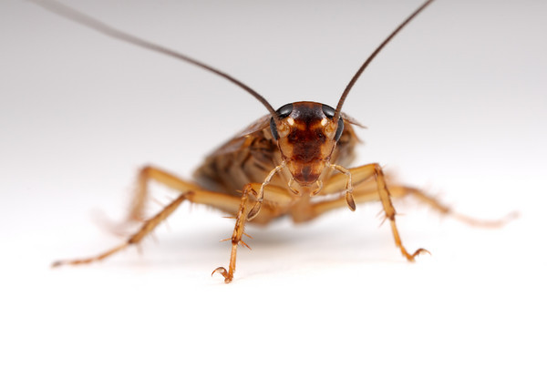
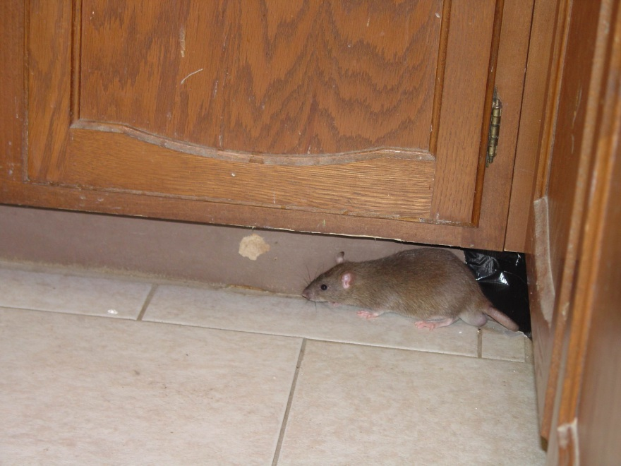
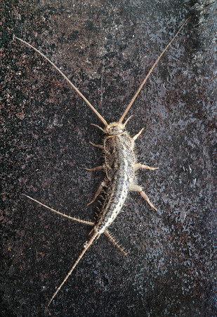
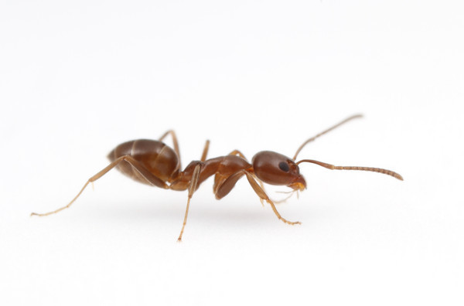
Pest Identification

Slide 15
Pests of Buildings
Pests that Sting, Bite, or Injure: | Wood-destroying, Food, Fabric, and Nuisance Pests: | Vertebrate Pests –Birds, Mammals, and Reptiles
Ants Bed bugs Bees Conenose bugs Fleas Flies Head Lice Hobo spider Lyme disease Mosquitoes Poison Oak Recluse spiders Scorpions Ticks Wasps Widow spiders | Ants Bees Beetles Boxelder Bug Carpenter Bees Centipedes Cockroaches Earwigs Flies Head lice Horntails Millipedes Moths Silverfish Termites Wasps Worms | Bats California ground squirrel Cliff Swallows Deer Gophers House Mouse Lizards Moles Opossum Pocket Gophers Rabbits Raccoons Rattlesnakes Rats Skunks Tree squirrels Voles Woodpeckers

Slide 16
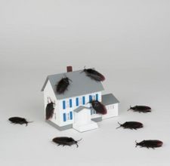
Pest Biology
Life cycle
Breeding habits
Favored habitats
Behavior
Pest status

Slide 17
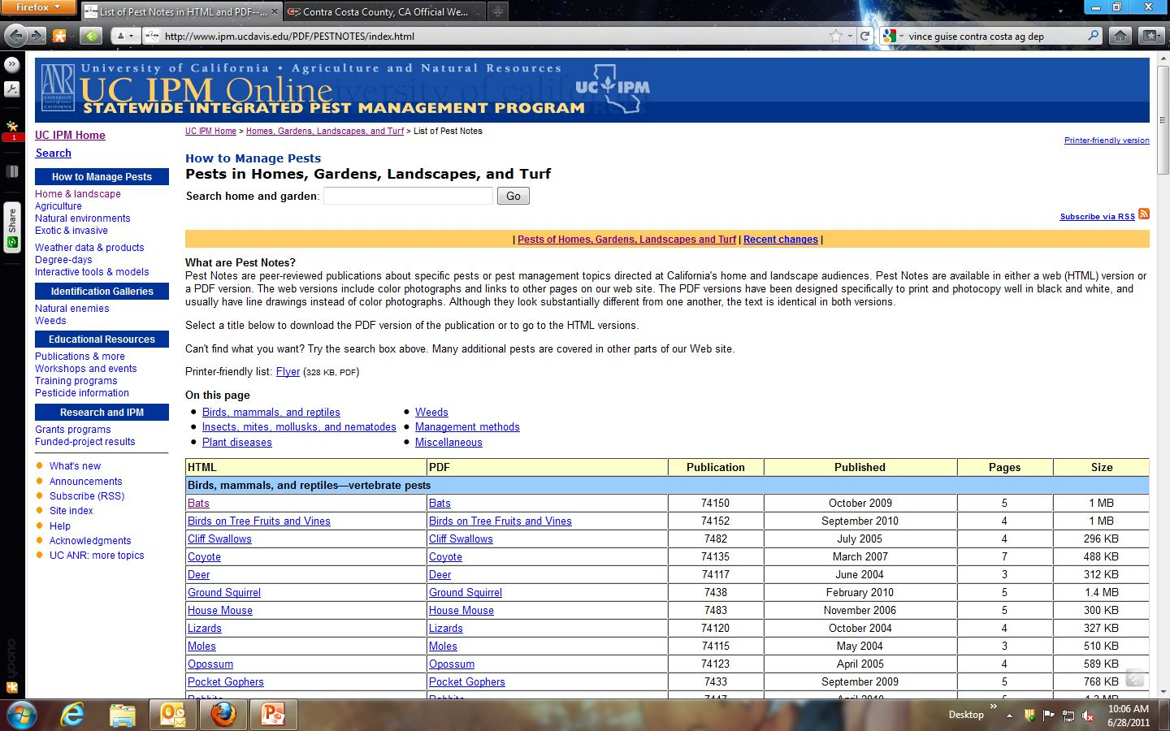
Pest Biology

Slide 18
Break

Slide 19
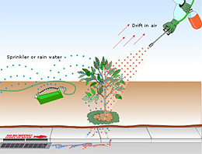
Structural IPM from a Stormwater Perspective
Structural IPM under a stormwater program will include any and all pesticide use in and around buildings that has the potential to enter the storm drain system (from illicit discharge and/or from stormwater runoff)

Slide 20
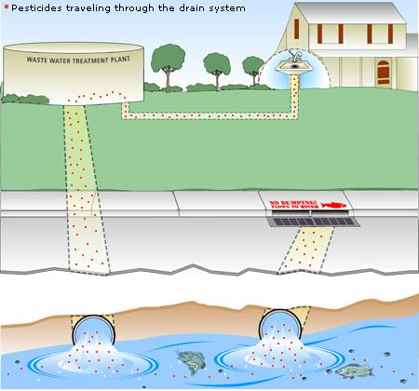
How pesticides enter the storm drain system:

Slide 21
MRP Pesticide Reduction Requirements
Stormwater programs are not solely responsible for achieving TMDL compliance and urban runoff allocations for pesticide related toxicity for urban creeks.
Stormwater programs are required under the Municipal Regional Permit (MRP) to implement IPM, show trends in pesticide use, and provide reasons for increases in pesticide use.

Slide 22
Pesticides that Threaten Stormwater Runoff
Organophosphorous pesticides (chlorpyrifos, diazinon, and malathion)
Pyrethroids (bifenthrin, cyfluthrin, beta-cyfluthrin, cypermethrin, deltamethrin, esfenvalerate, lambda-cyhalothrin, permethrin, and tralomethrin)
Carbamates (e.g., carbaryl)
Fipronil

Slide 23
Known problem pesticides: Pyrethroids and Organophosphates
Pyrethroids are common residential insecticides, found in products for ant control, home lawn, garden and landscape care, as well as in structural pest control products. Common pyrethroid active ingredients in home use products include bifenthrin, cypermethrin, permethrin, and cyfluthrin. Pyrethroids mimic the mode of action of the plant-derived pesticide pyrethrin, but are much more toxic and persistent in the environment. They attach to soil particles and are washed into waterways on sediment.
Organophosphate pesticides containing diazinon and chlorpyrifos were widely used in the 1990s but were withdrawn from the market for home use in the early 2000s because of risks to children. These materials are highly soluble in water and have been found in California creeks at levels toxic to aquatic invertebrates.

Slide 24
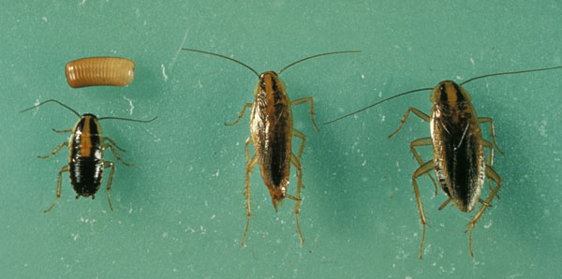
IPM Example:
German cockroach
Blatella germanica
Notes:
Picked this one because it is a common problem inside and outside and people will spray on the perimeter to get rid of it.

Slide 25
German cockroach
Most prolific of all cockroaches
30 to 40 eggs per ootheca
2 month development time
Found only indoors
Public health threat
Germ transport
Allergen production

Slide 26
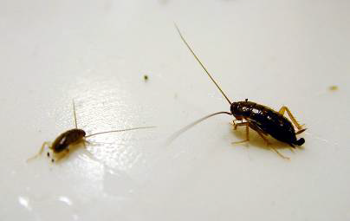
German Cockroach Biology
Egg case, nymph, adult stages
Maximum growth rate at 33oC (91oF), preferred temps 75o to 90oF
Spend most time in cracks (1 to 4 mm-wide)
Found mostly in close proximity to food, water and harborage

Slide 27
Example thresholds for German Cockroach
Average # cockroaches per zone | Action
0 | None
1-2 | Bait Stations; check sanitation
3-6 | Spot treat; add or replace baits; review sanitation
7-15 | Thorough bait and spot treat applications; revisit in two weeks
15+ | Close facility; conduct thorough inspection and sanitation improvement; increase baits in infested

Slide 28
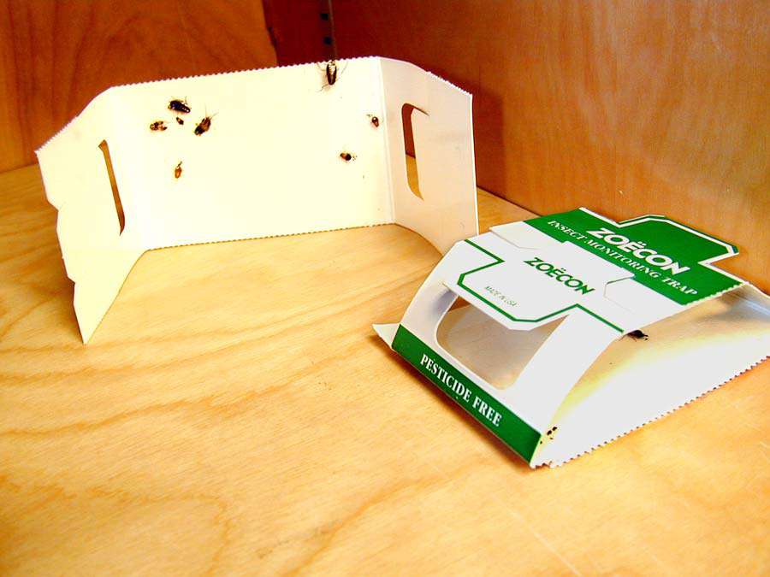
Proper placement of sticky trap

Slide 29
Treatment areas for German
Cockroach

Slide 30
Effective controls
Caulk and seal harborages
Eliminate, reduce, separate water and food resources
Bait and dust harborage areas identified by sticky traps
Apply residual sprays to harborages
Monitor and test different methods to determine if pesticide treatment is necessary and when and where to apply.

Slide 31
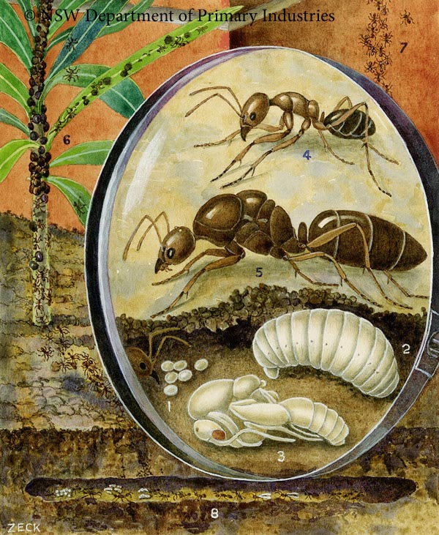
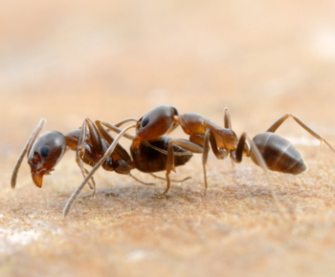
IPM Example:
Argentine Ant
Linepithema humile
Notes:
Picked this one because it is a common problem inside and outside and people will spray on the perimeter to get rid of it.

Slide 32
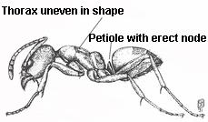
Argentine Ant
Most common ant occurring in and around the house and garden
Workers are all the same size, small, 1/8-inch long
Uniformly dull brown
Petiole with 1 erect node
Thorax uneven in shape when viewed from side
Musty odor emitted when crushed

Slide 33
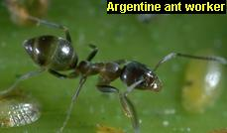
Argentine Ant Biology
Outdoors in soil, under wood, slabs, debris, mulch, or in branches and cavities of trees and shrubs
Shallow, 1- to 2-inch deep mounds in open, often disturbed habitats, either moist or dry
Millions of ants per colony with multiple queens and many subcolonies

Slide 34
Behavior
Feed on sweets, fresh fruit, and buds of some plants
Tend honeydew-producing species
Forage for sweets and oils in homes
Travel rapidly in distinctive trails along sidewalks, up sides of buildings, along branches of trees and shrubs, along baseboards, and under edges of carpets
Colonies may split in spring and summer when queen and workers move to new site; not antagonistic toward each other

Slide 35
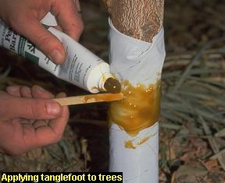
Prevention
Manage honeydew-producing insects such as aphids and soft scales on trees and shrubs near the house. Once in trees, ants protect these pests from natural enemies, making many pest problems worse.
Remove trees and shrubs that consistently host ants and are adjacent to houses. Honeydew producers provide a great source of food for ants, and ant colonies may enlarge as a result and frequently invade nearby structures.
Band tree trunks with sticky substances such as Tanglefoot.
Trim branches to keep them from touching structures or plants so that ants are forced to climb up the trunk through the Tanglefoot.
Protect young or sensitive trees from possible injury by wrapping the trunk with a collar of heavy paper, duct tape, or fabric tree wrap and coating this with the sticky material.
Check the sticky material every 1 to 2 weeks and stir with a stick to prevent it from getting clogged with debris that allows ants to cross.

Slide 36
Effective controls
Sponge invaders with soapy water as soon as you see them.
Plug up ant entryways with caulk or petroleum jelly.
Remove infested potted plants.
Clean up food sources such as sugary spills, pet food, or garbage.
Rely on baits to control the ant colony.
Indoor sprays are not usually necessary.
Monitor and test different methods to determine if pesticide treatment is necessary and when and where to apply.

Slide 37
Take Home Message
Urban runoff is the leading source of pollution to the S.F. Bay
All stormwater programs are required to have IPM programs/policies and to implement those program/policies
All pesticide use has to be tracked to show trends
IPM Programs or SOP need to be written and contain a tiered approached to pesticide use with an approved/limited/banned classification of pesticide use.
IPM is a long-term, common-sense program of managing pests with the least toxic effect on people and the environment.
Come see me in three years.

