Slide 1


What is Green Infrastructure?
Bioretention Maintenance Workshop
March 21, 2019

Slide 2
Topics
The mandate for Green Infrastructure
  Green Infrastructure Plans in progress
The benefits of Green Infrastructure
Low Impact Development design
  Why bioretention?
Key bioretention design issues that affect maintenance and maintainability

Slide 3

Two Objectives
Compliance
Mandate
Money
Structure
Schedule
Accountability
Community Benefit
Enthusiasm
Attention
Energy
Synergies
Opportunities
Notes:
Trying to elicit your support

Slide 4
Green
Infrastructure
Planning

Slide 5
Mandate – Private Development
1987 Amendments to the Clean Water Act
Permits issued by California Water Boards
C.3 added to Contra Costa’s permit 2003, 2006
Municipal Regional Permit 2009, 2011, 2015
Municipalities are required to use their land use authority to require controls on runoff from new developments
Low Impact Development (LID) is required

Slide 6
Mandate – Retrofit Drainage
Covers municipalities in Alameda, Contra Costa, Santa Clara, and San Mateo
New mandates in 2015 permit renewal
  Green Infrastructure Plans due in 2019
  Early Implementation/No Missed Opportunities
  PCB and Hg load reductions
    Some reductions must be via Green Infrastructure
    Old Industrial and Old Urban Areas
  Trash load reductions

Slide 7
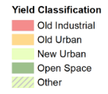
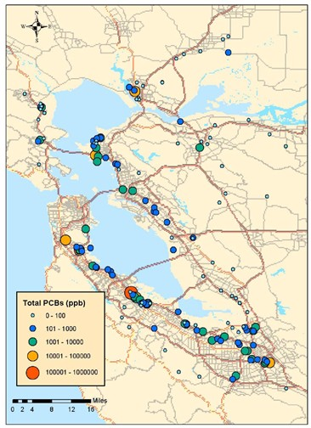
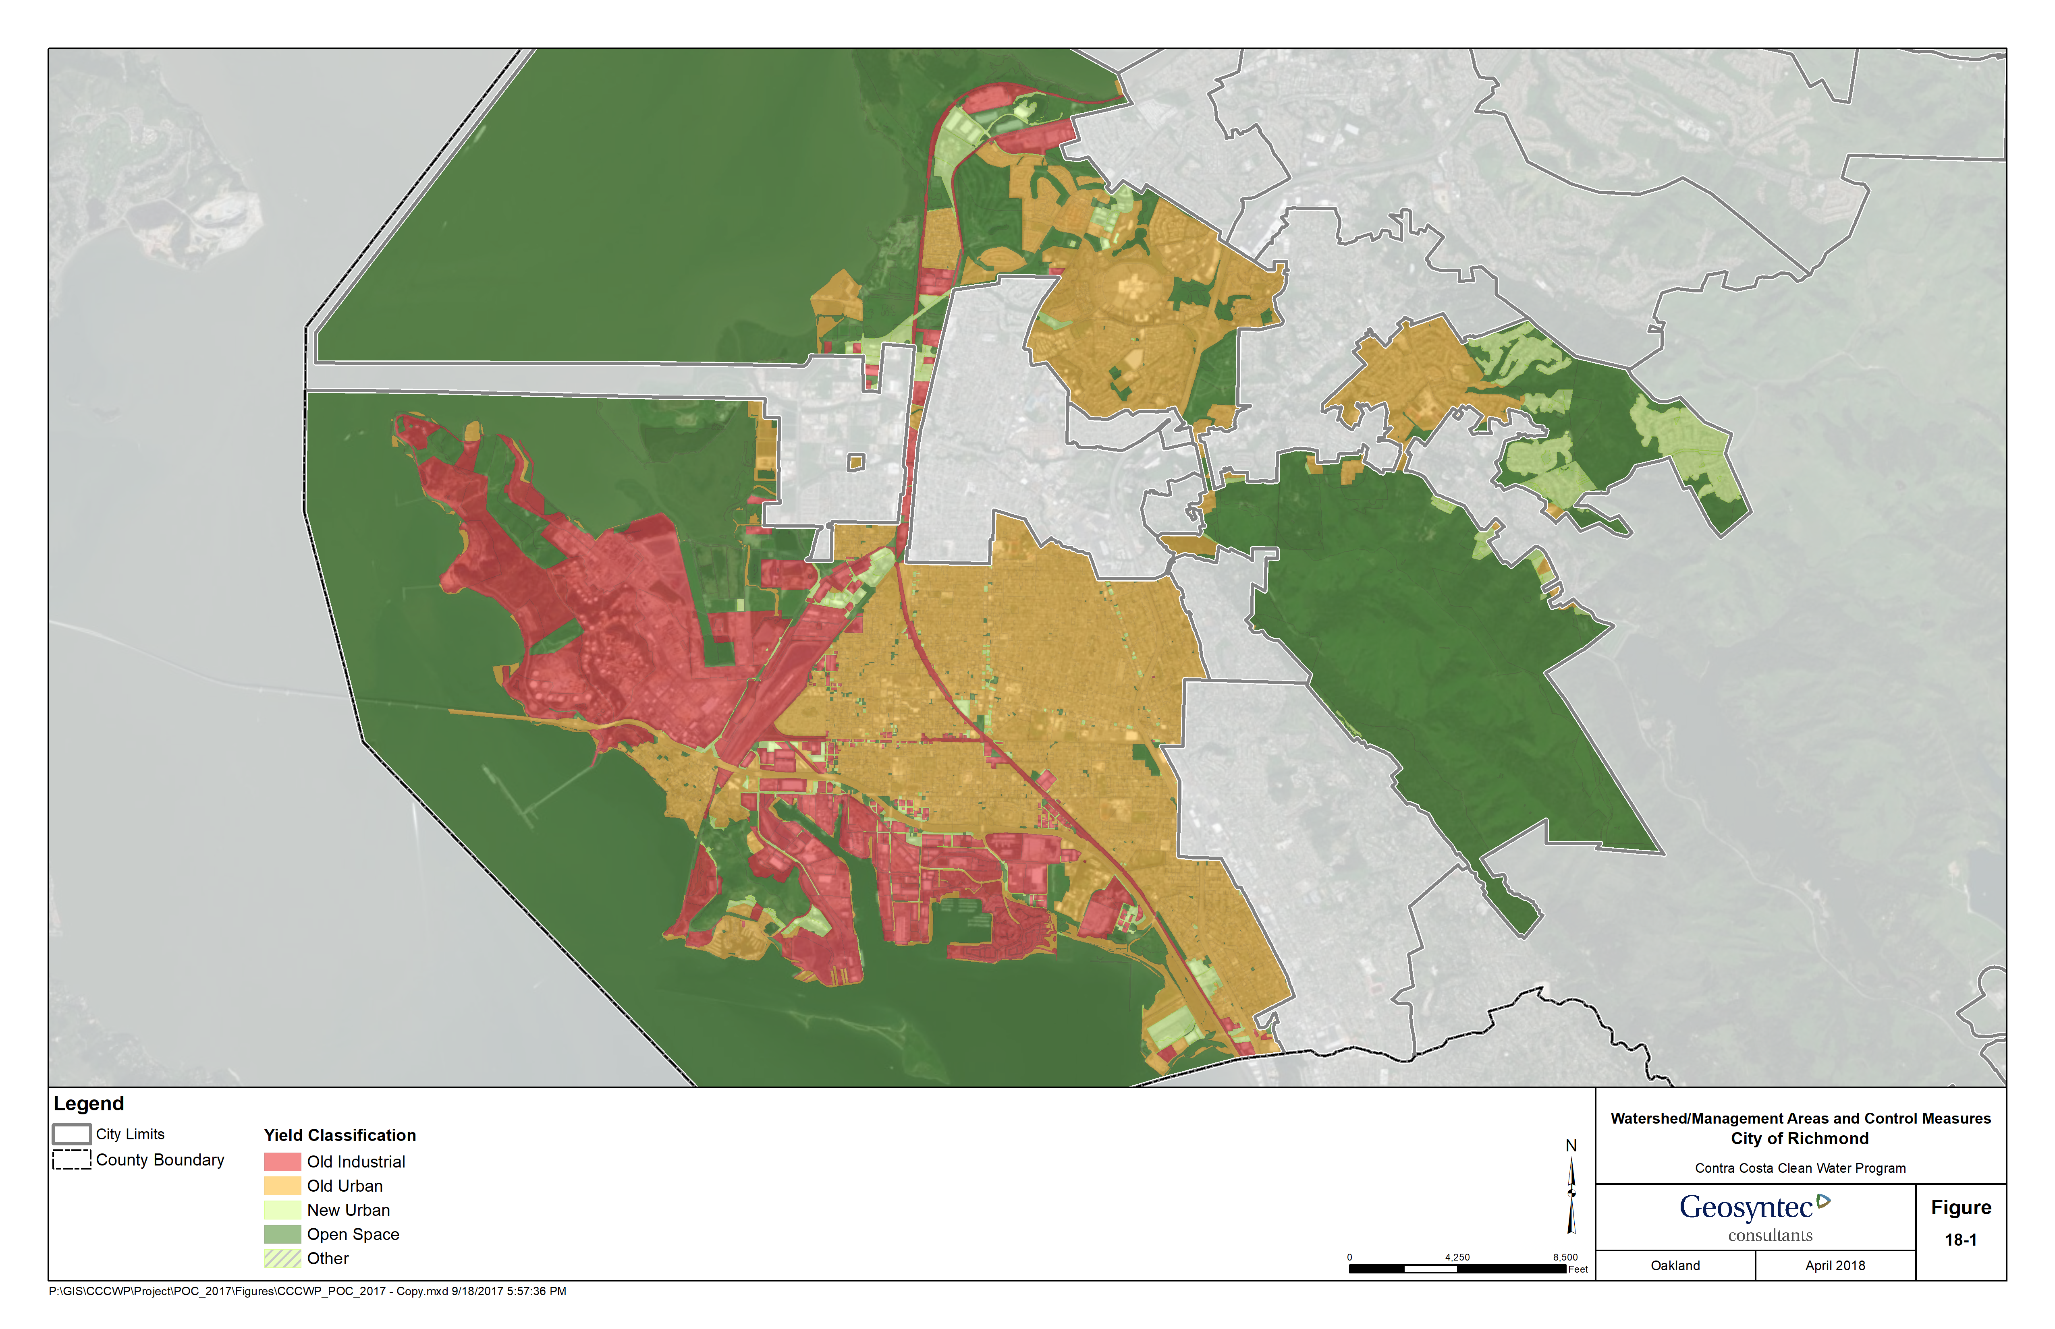
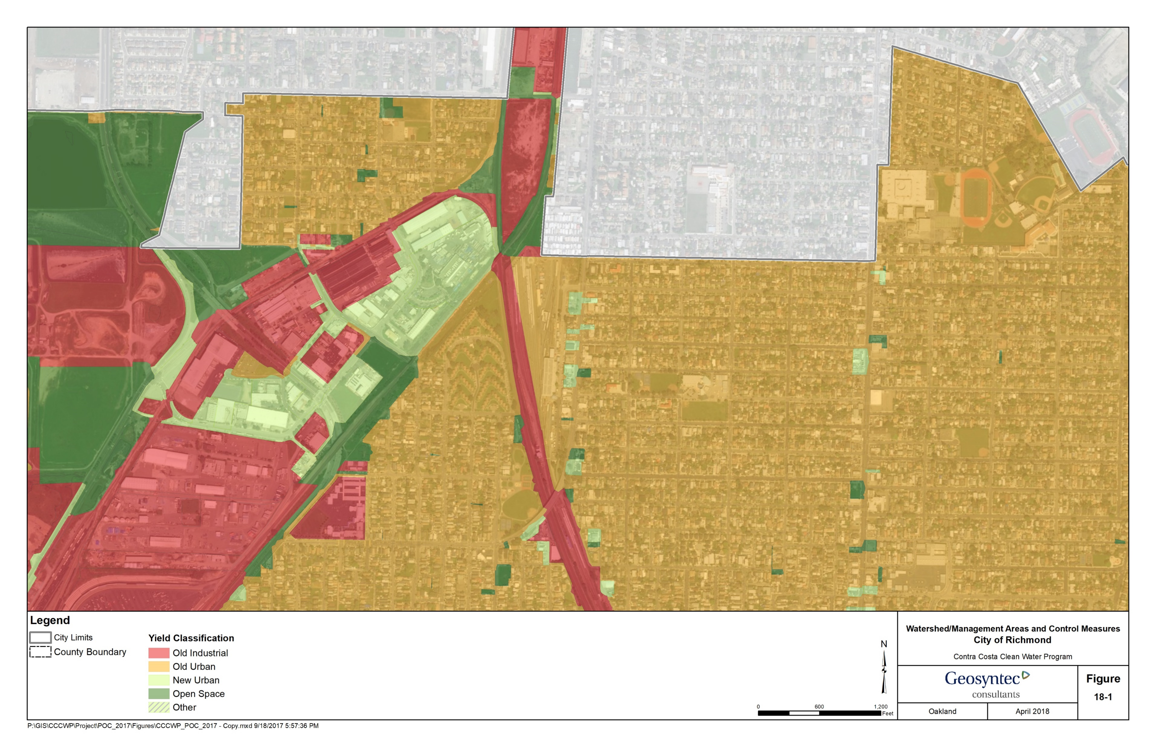
GI and Load Reductions

Slide 8
Countywide and Local Planning
Notes:
Credit: Geosyntec Consultants
SWRP = Storm Water Resource Plan
RAA = Reasonable Assurance Analysis

Slide 9
Compiling a GI Project List
Total “target” amount of impervious surface to be
retrofitted
Additional areas to achieve target (“x”% of existing impervious area)
D
C
Additional areas to achieve optimized countywide PCB attainment
Areas converted to Green Infrastructure by locally identified public projects
B
A
Parcels projected to be
converted to Green
Infrastructure by private
development
Baseline

Slide 10
Implementation and Funding
Opportunistic Approach
Redevelopment on private parcels
Build in Green Infrastructure as cities are redeveloped and infrastructure is renewed
Align funding streams
  Transportation funding is limited
  Funding oriented toward active transportation/ Complete Streets
  There is some grant funding for GI
  Many funding streams for each project

Slide 11
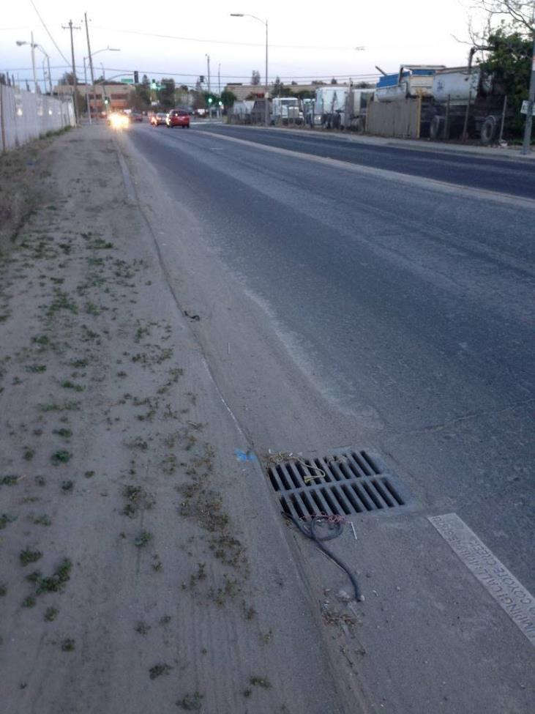
Locations for GI Facilities
Flat areas near catch basins
Notes:
Also discuss GI Opportunities

Slide 12
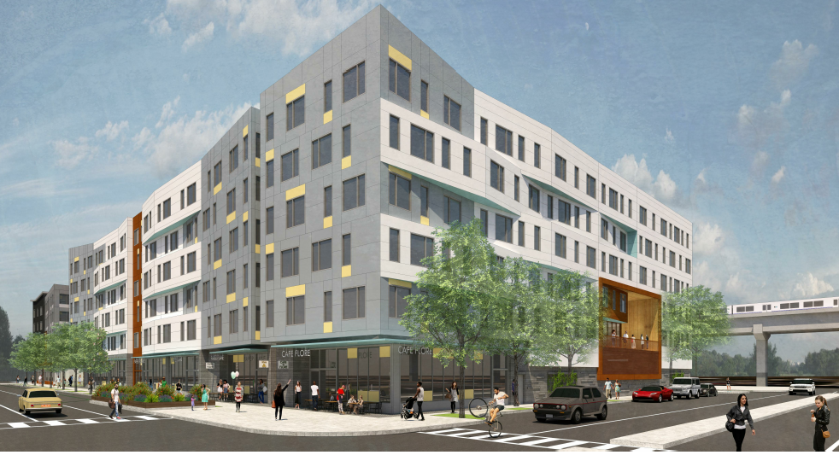
Frontage Improvements

Slide 13
Green Infrastructure in Frontage

Slide 14
Community and Environmental Benefits

Slide 15
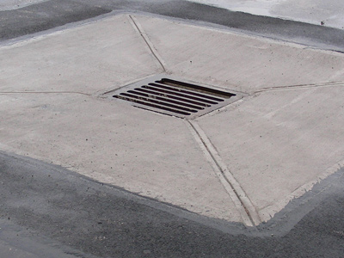
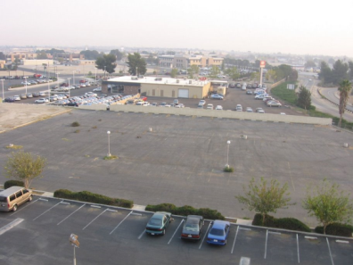
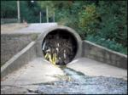
Conventional Urban Drainage
Impervious surfaces:
roofs and pavement
Catch basins and
piped drainage
“Collect and
convey” design
objective

Slide 16
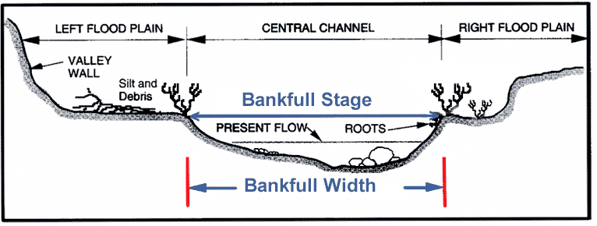
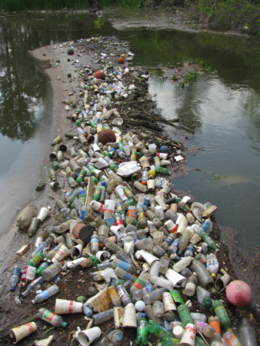
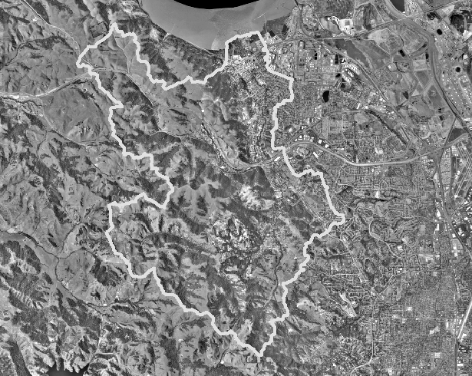
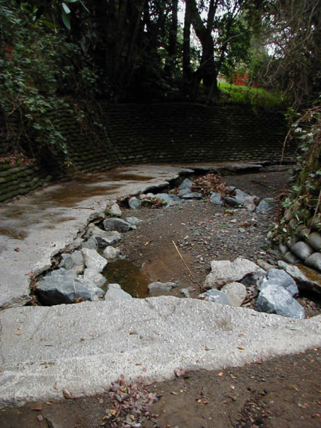
Drainage Impacts
Site Scale | Watershed and Stream Scale
Higher peak flows | Flooding and scouring of stream beds
Lower time of concentration | Flash flows
Runoff from small storms | Discharge when runoff did not previously occur
Increased runoff durations | Stream erosion at moderate stream flow rates
Greater runoff volumes | Higher pollutant loading
Greater runoff energy | Conveys trash and gross pollutants to streams
Decreased infiltration | Lower and less frequent stream base flow
Dry weather discharges | High pollutant concentrations during low flows
Notes:
The pictures relate to items #1, #4, and #6 in the table.

Slide 17
LID Design Objectives
Watershed and Stream Scale | Site scale
Reduce peak flows | Detain runoff on site
Increase time of concentration | Slow runoff from leaving site
No runoff from small storms | Infiltrate, evapotranspirate and reuse
Reduce duration of moderate flows | Let runoff seep away very slowly
Reduce runoff volume | Infiltrate and reuse where possible
Reduce runoff energy | Detain and slow flows
Increase groundwater storage and stream base flows | Facilitate infiltration
Reduce pollutants in runoff | Detain and filter runoff
Protect against spills and dumping | Disconnect drainage and filter runoff

Slide 18
Low Impact Development Drainage Design

Slide 19
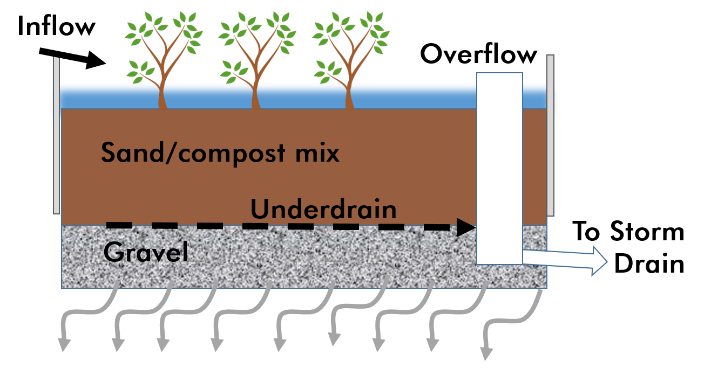
LID Drainage Design
Minimize roofs and paving
Substitute pervious paving where possible
Disperse runoff to landscaping
Direct runoff to
bioretention
facilities

Slide 20
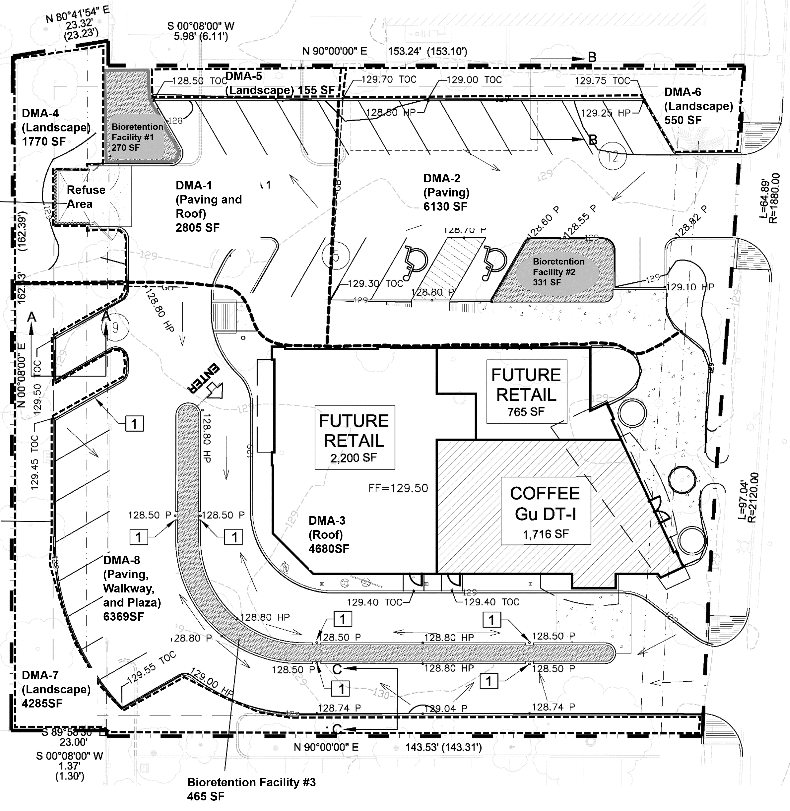
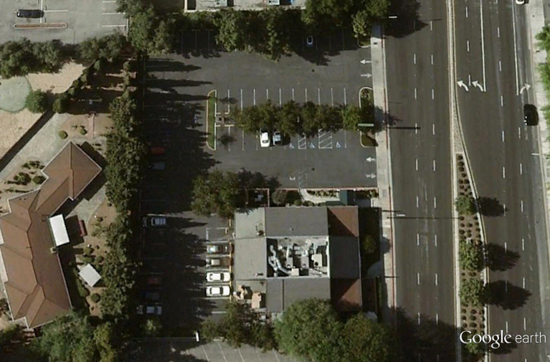
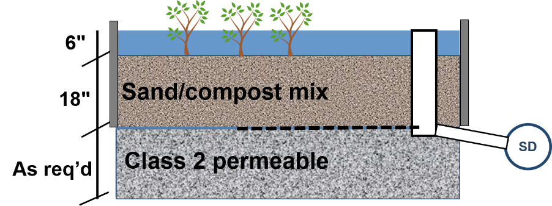
Commercial Project

Slide 21
Self-treating Areas
Notes:
Impervious areas flow to dispersal or treatment
Pervious areas may run off to street or MS4.

Slide 22
Self-retaining Areas
Notes:
If surrounding area is flat, very little depression is sufficient. Avoid an engineered look.
These are not treatment facilities!

Slide 23
Areas draining to self-retaining
Notes:
A way to quantify and track dispersal to landscape. Max. ratios: 2:1
If design is not close to max., and the self-retaining areas are in a flat area and gently concave, don’t get too formal about the design.
At ratios closer to max., more scrutiny is appropriate.
Same applies to the issue of whether self-retaining area may be affected in future by impervious encroachments

Slide 24
Bioretention

Slide 25
Bioretention Advantages
Filtration and pollutant sequestration
Biological processing and renewal
No mosquito problems
Mimic natural hydrology
Attractive landscape amenity
Potential use as park or playground
Low maintenance
Easy to inspect

Slide 26
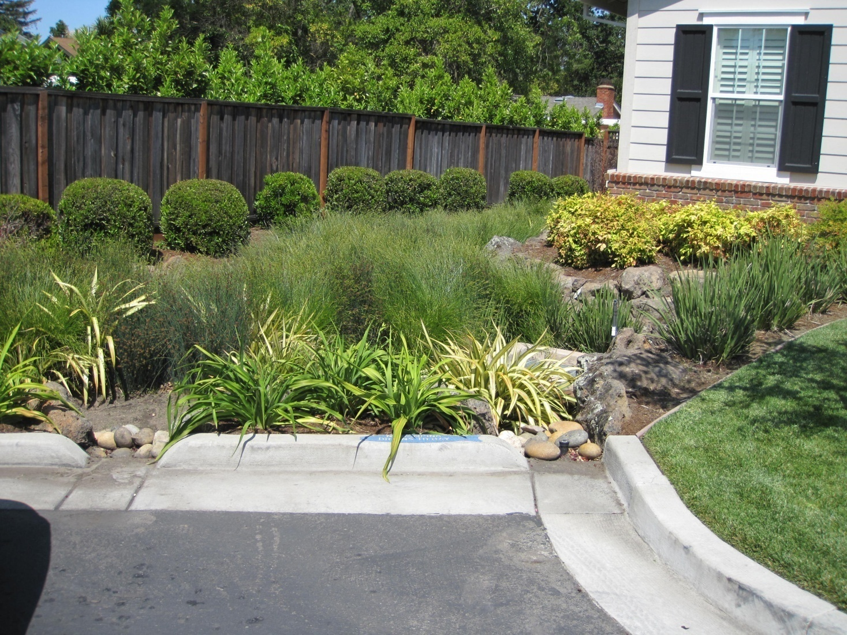
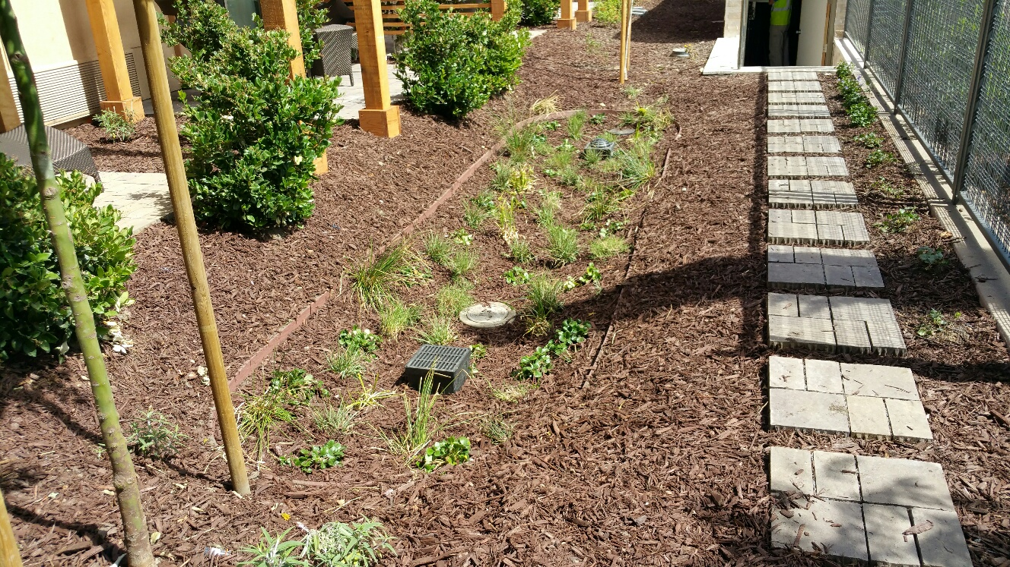
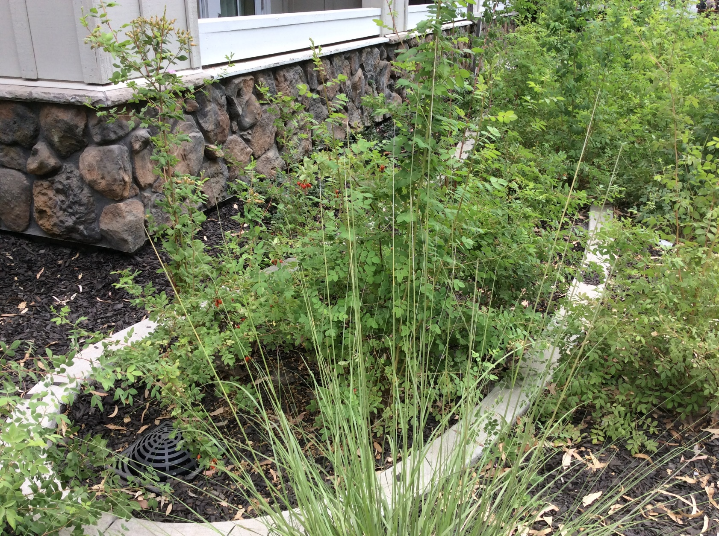
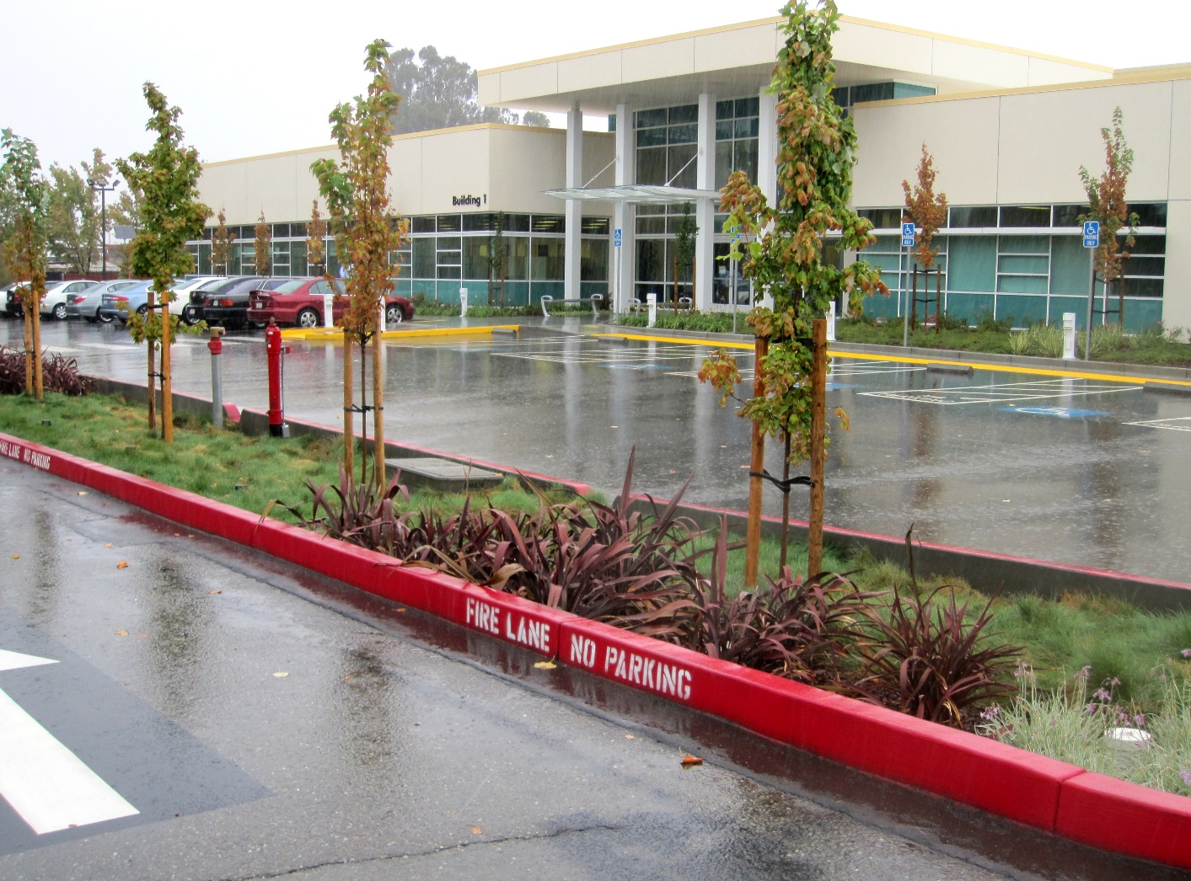
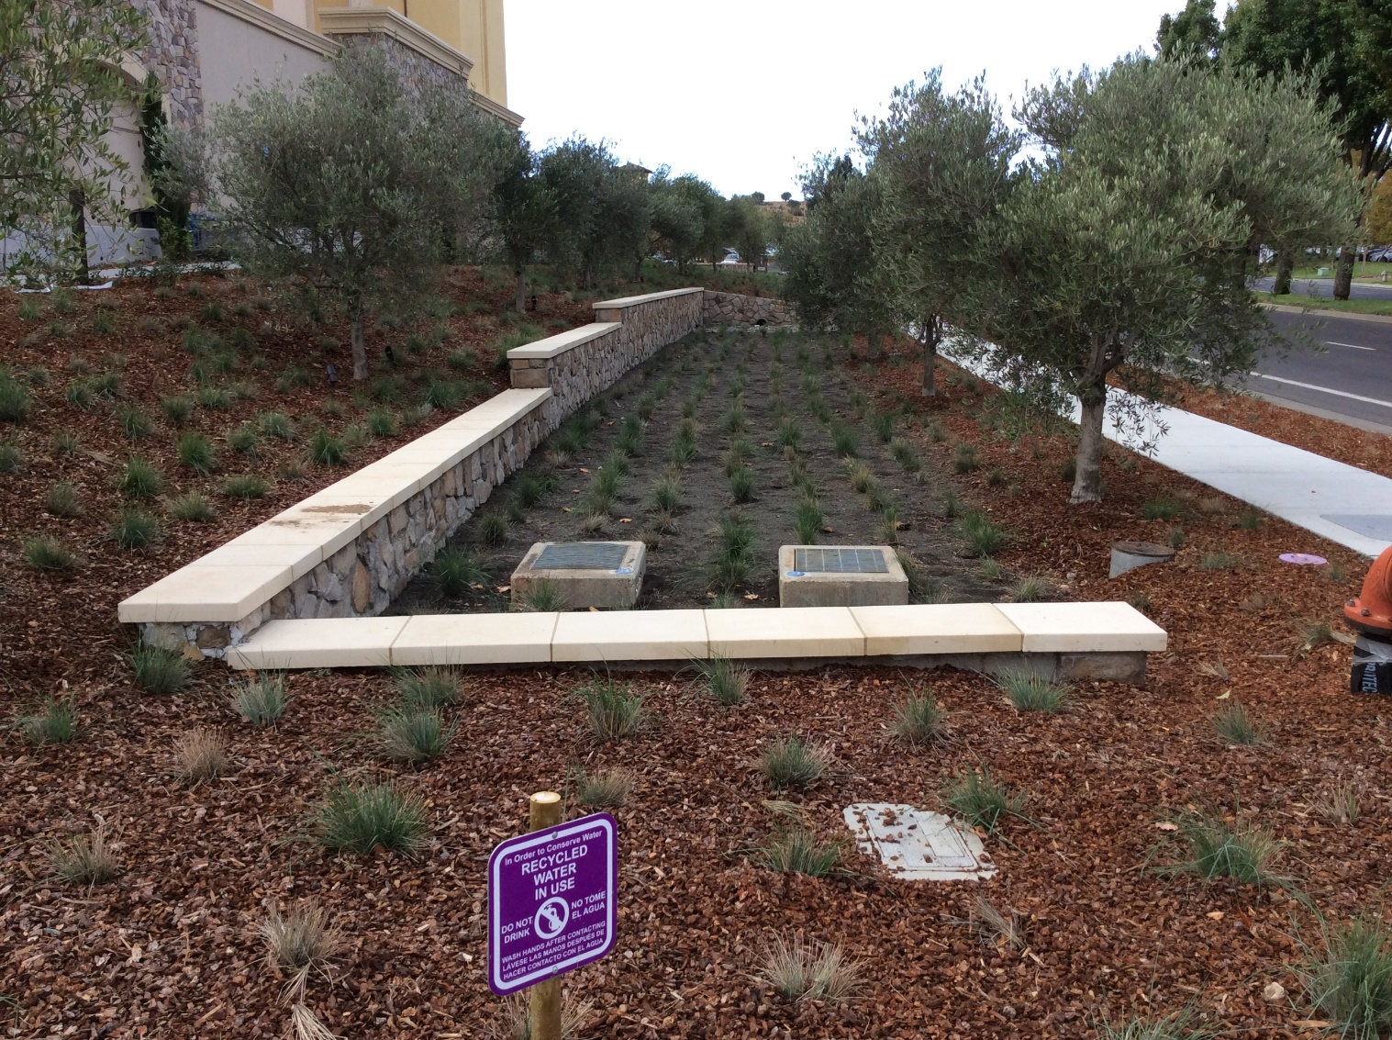
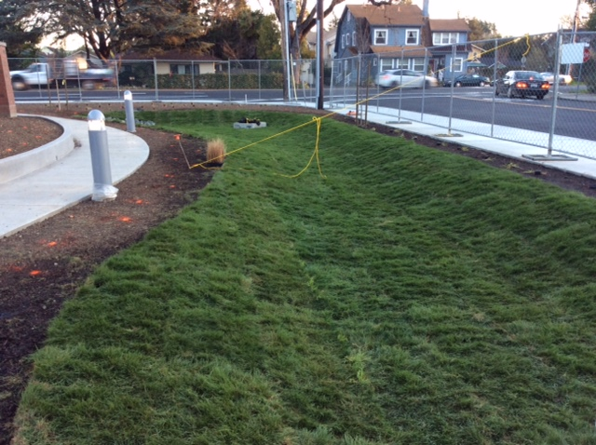
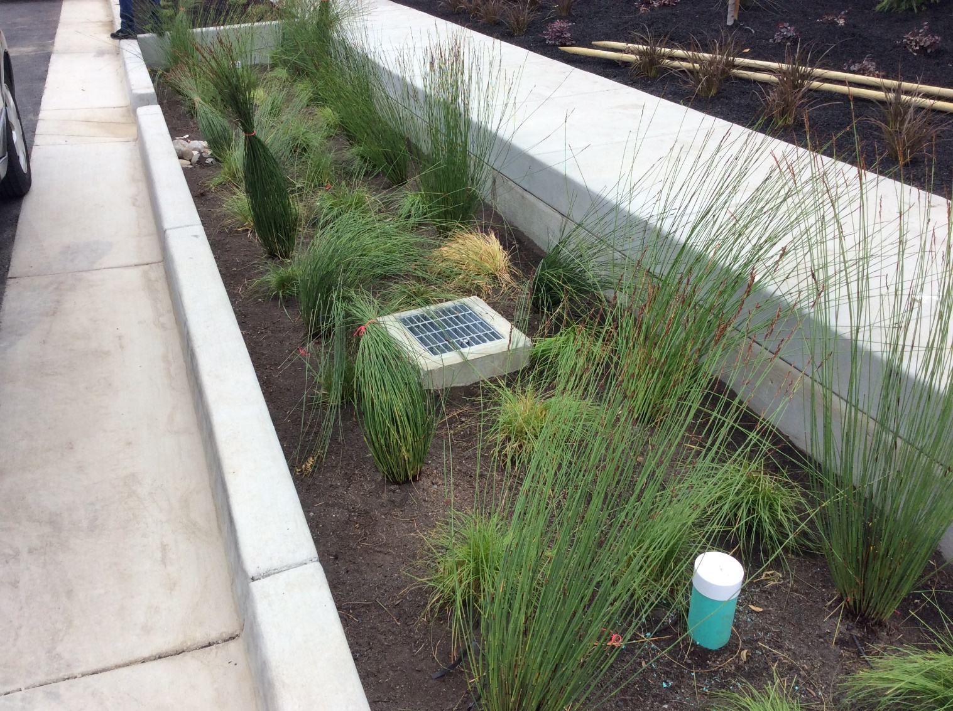
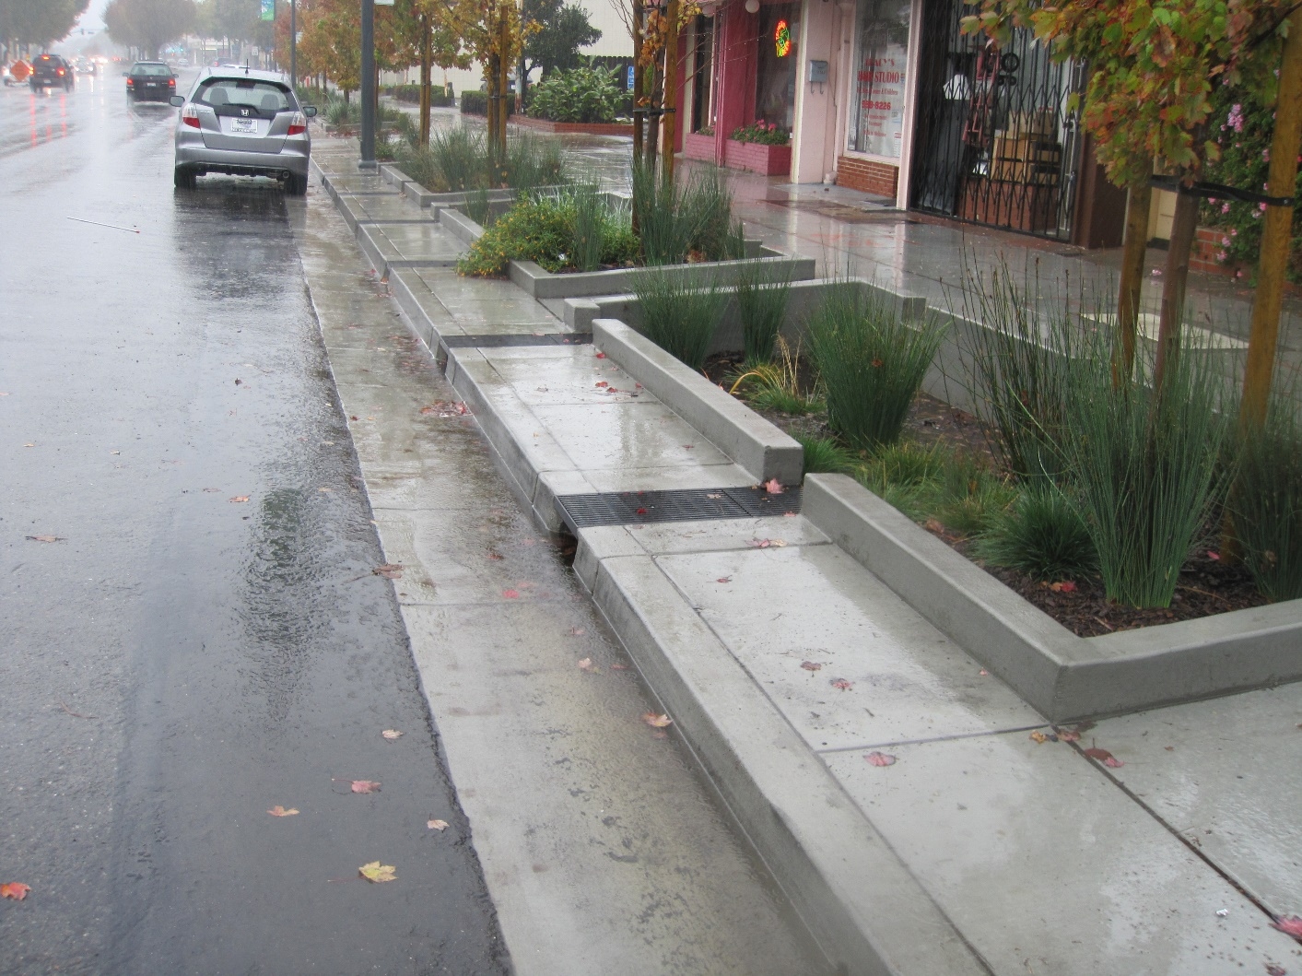
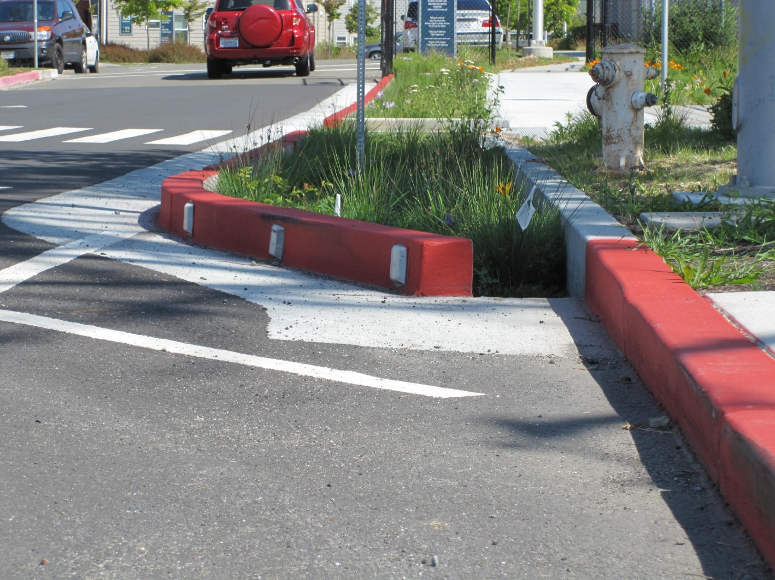
Bioretention & Urban Landscape
Notes:
Photos of bioretention in a residential subdivision, shopping centers, office parks, downtown plaza, and within public ROW

Slide 27
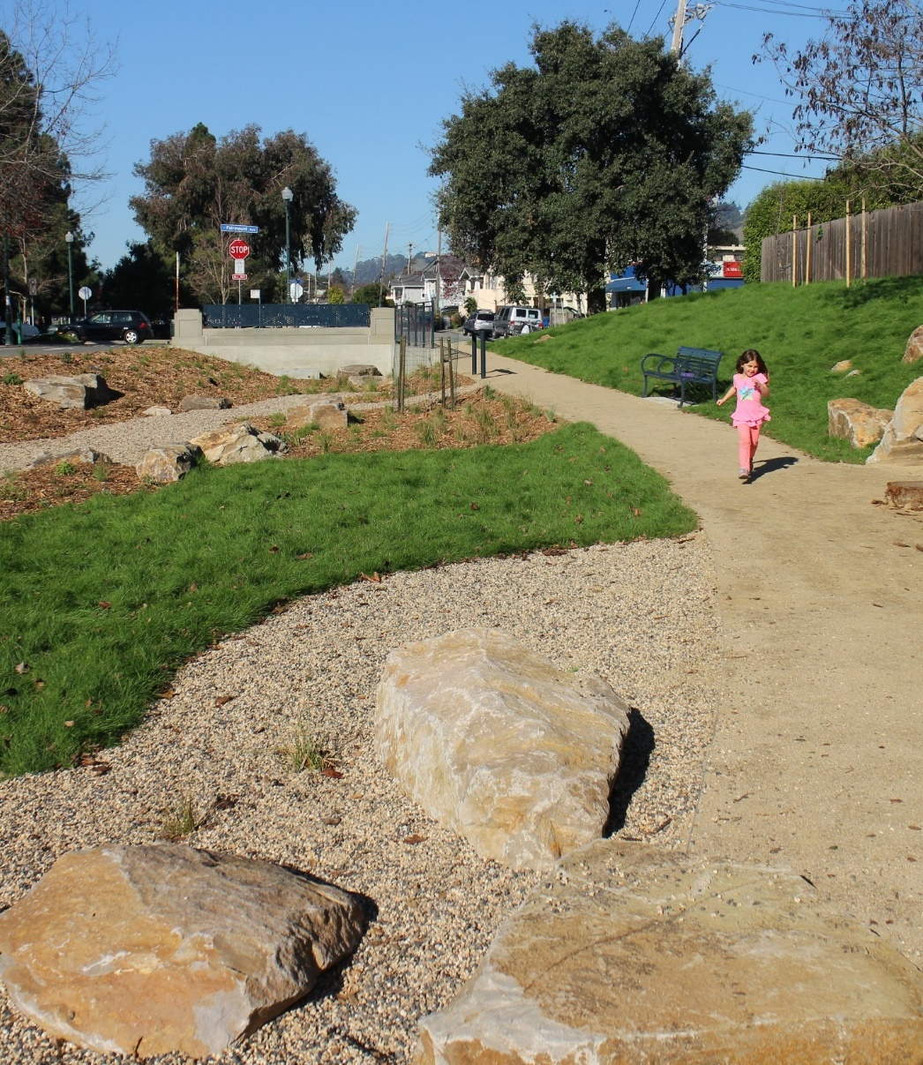
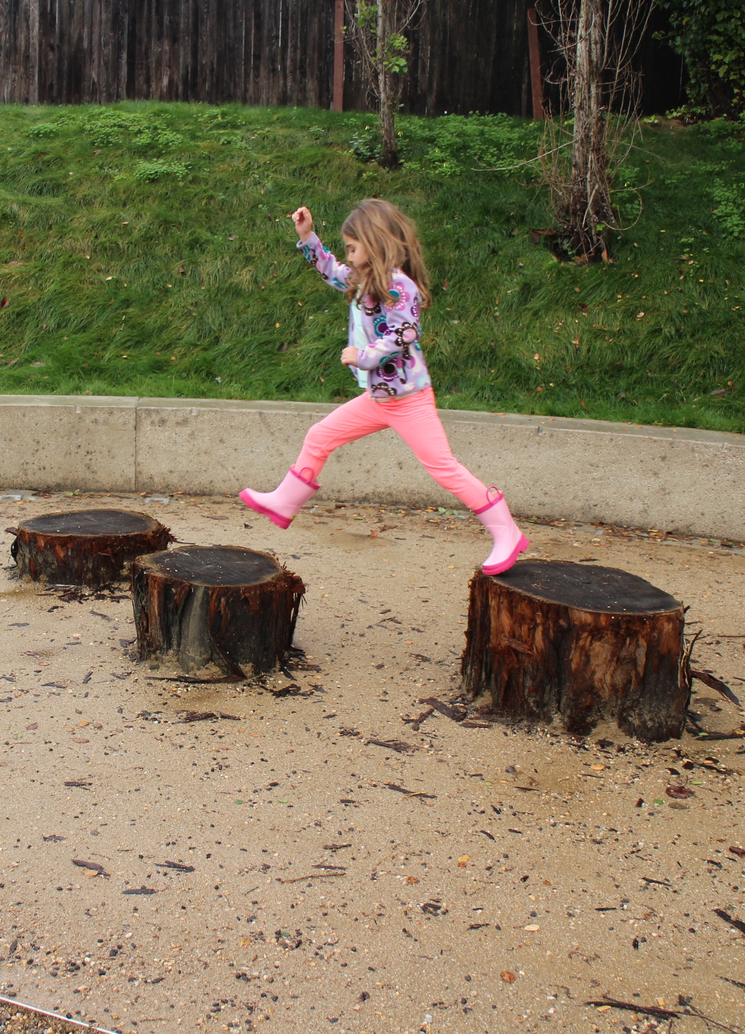
Multiple Use

Slide 28
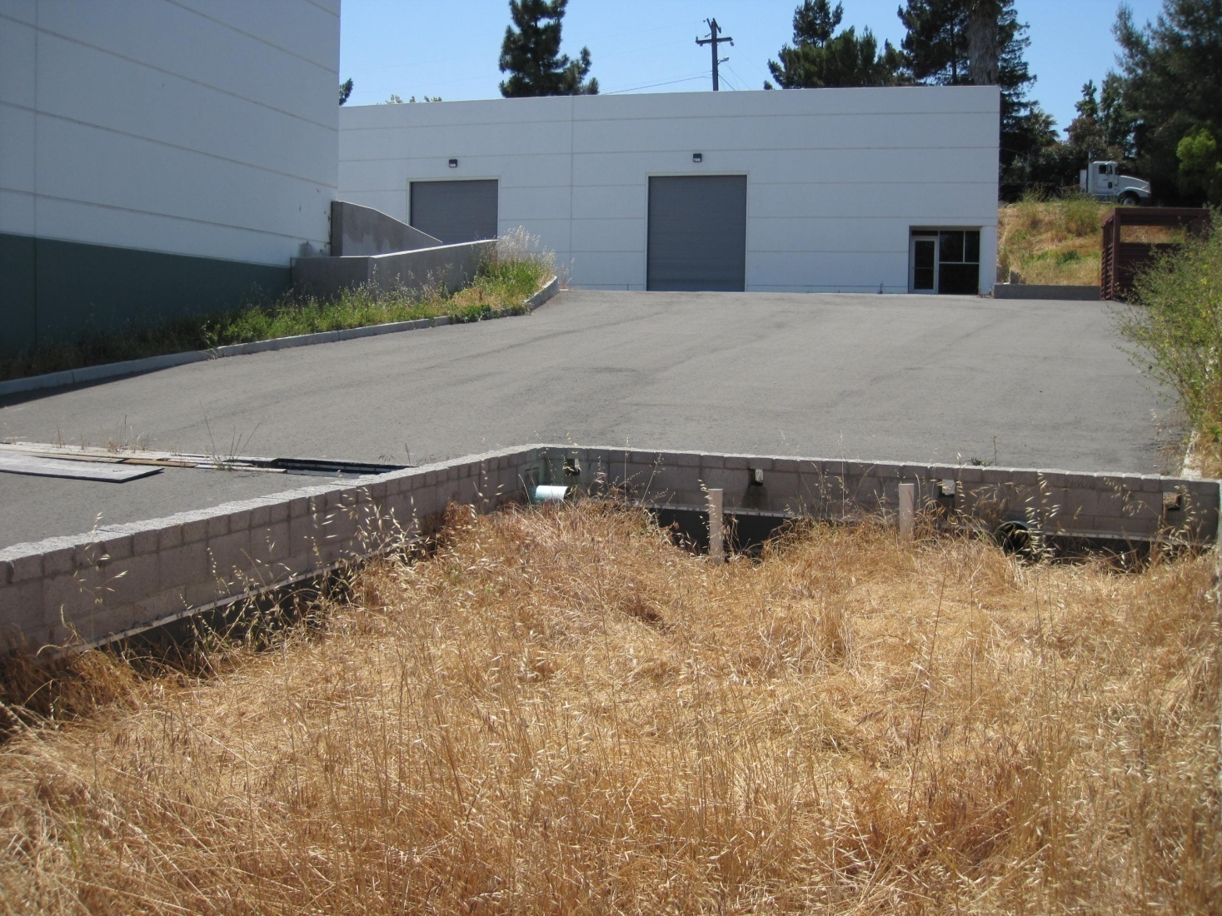
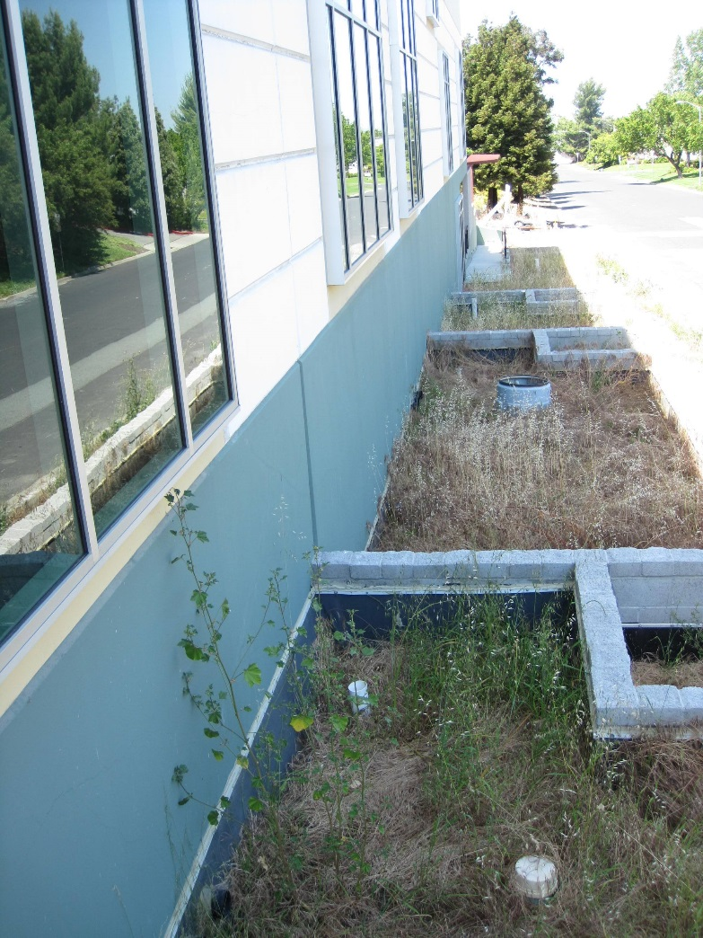
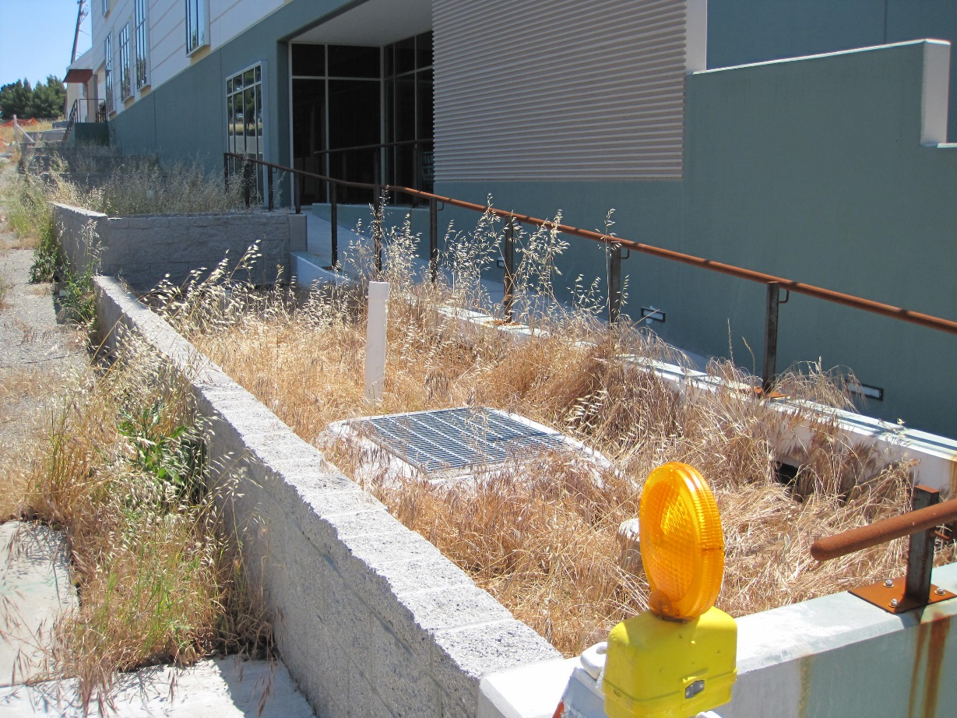
Resilience

Slide 29
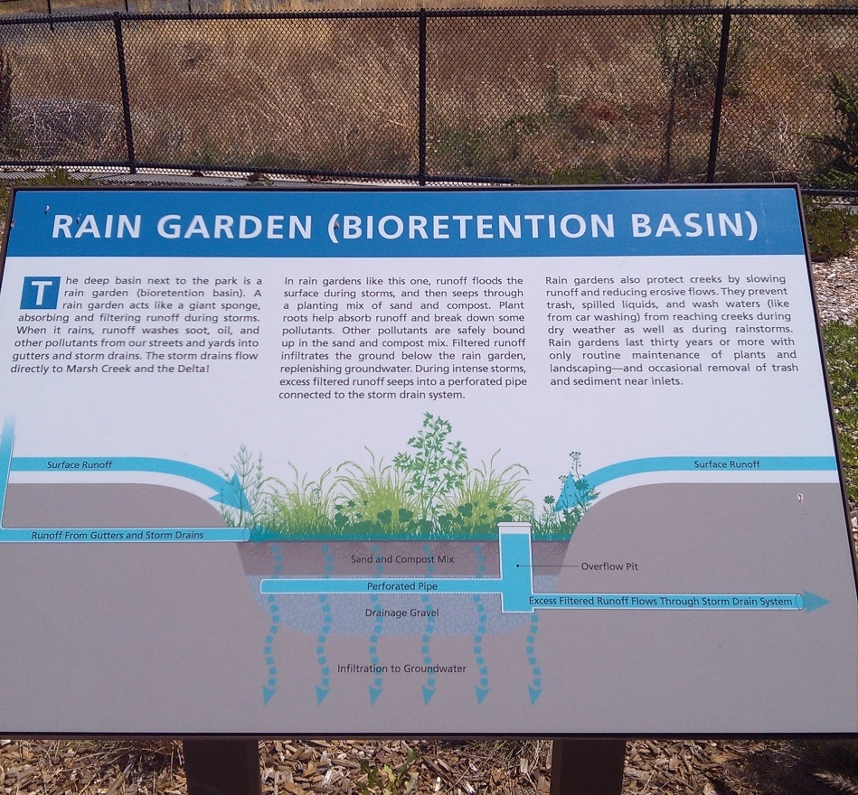
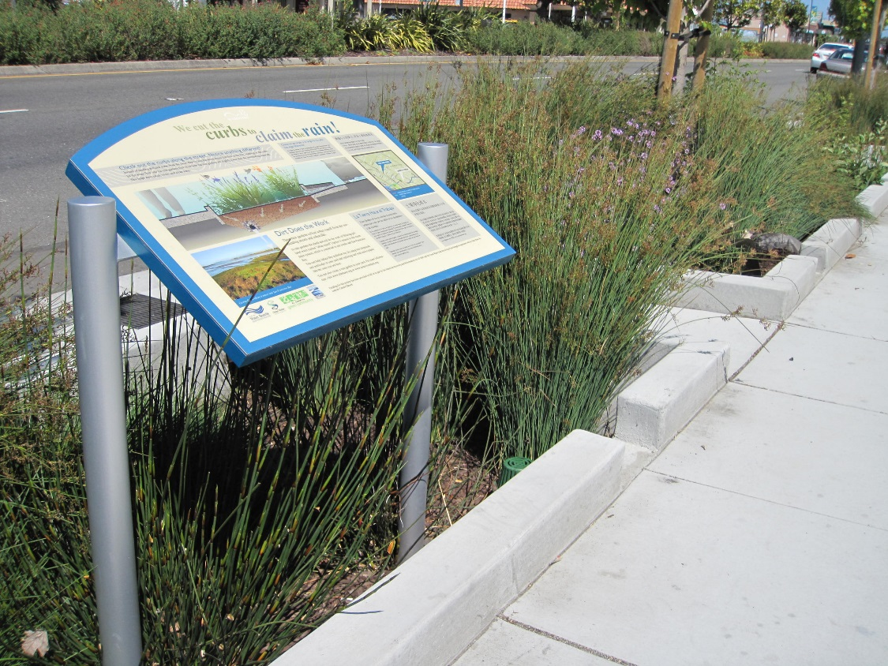
Resilience

Slide 30
Resilience

Slide 31
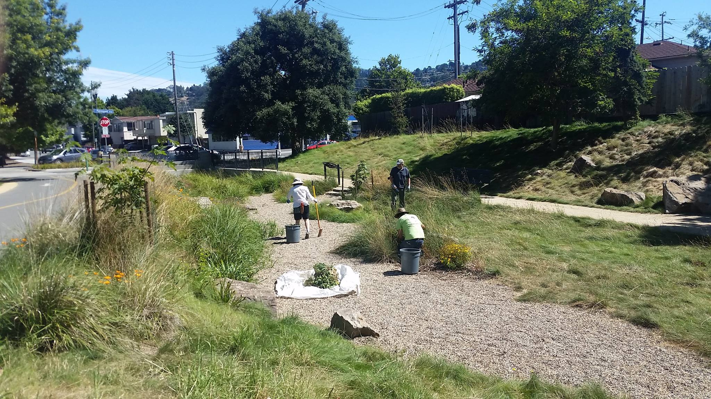
Resilience

Slide 32
Bioretention
Design and Construction Issues

Slide 33
Bioretention Design Criteria

Slide 34
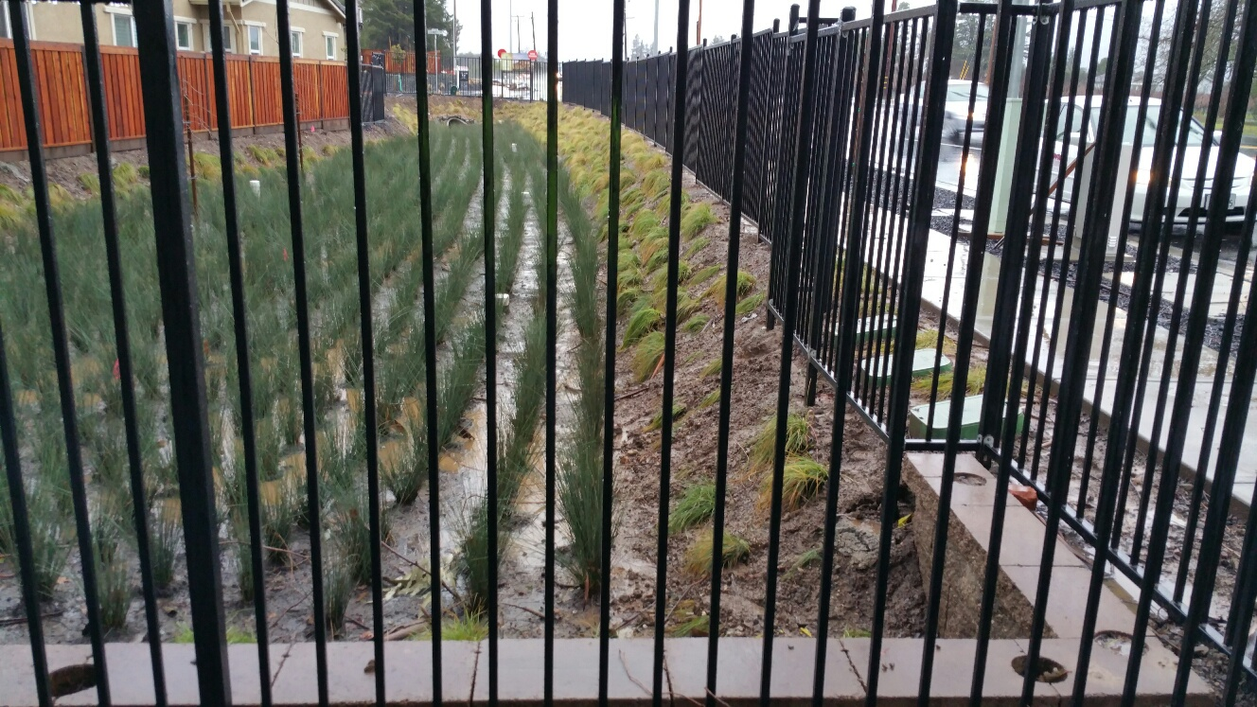
The pit problem

Slide 35
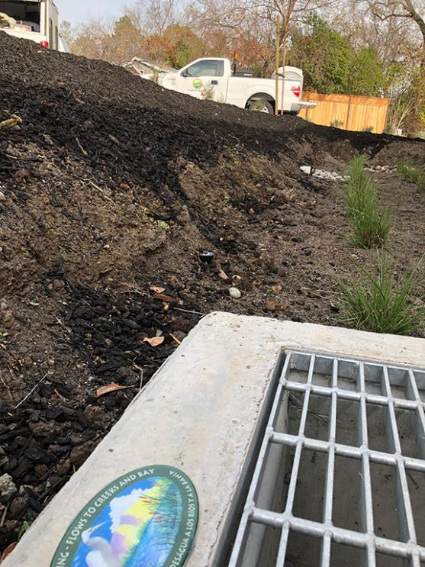
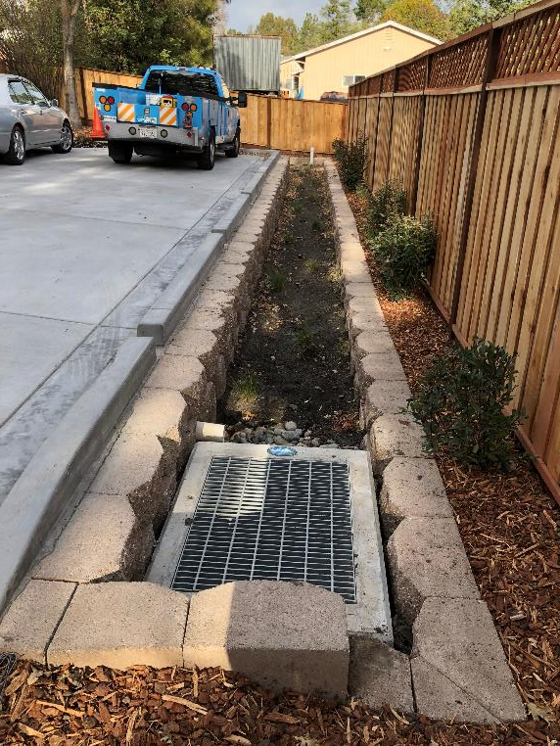
More pits

Slide 36
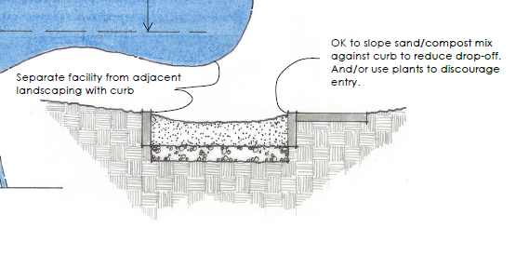
Edge Treatments

Slide 37
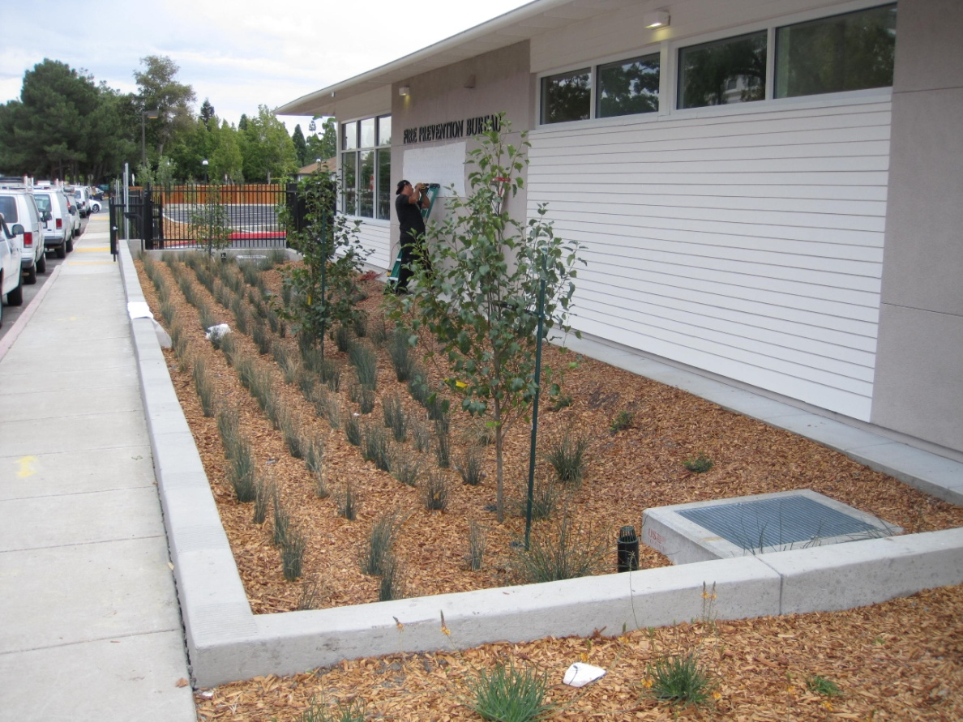
Flat and Near Surface
Bioretention facilities are level so they “fill up like a bathtub.”

Slide 38
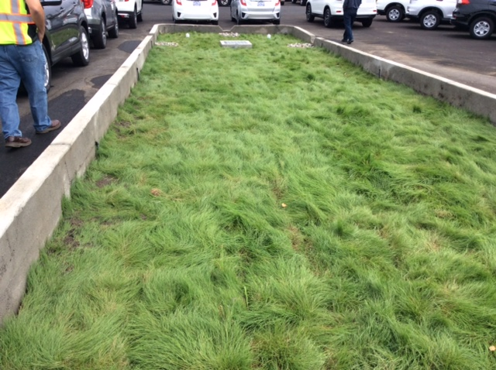

Slide 39
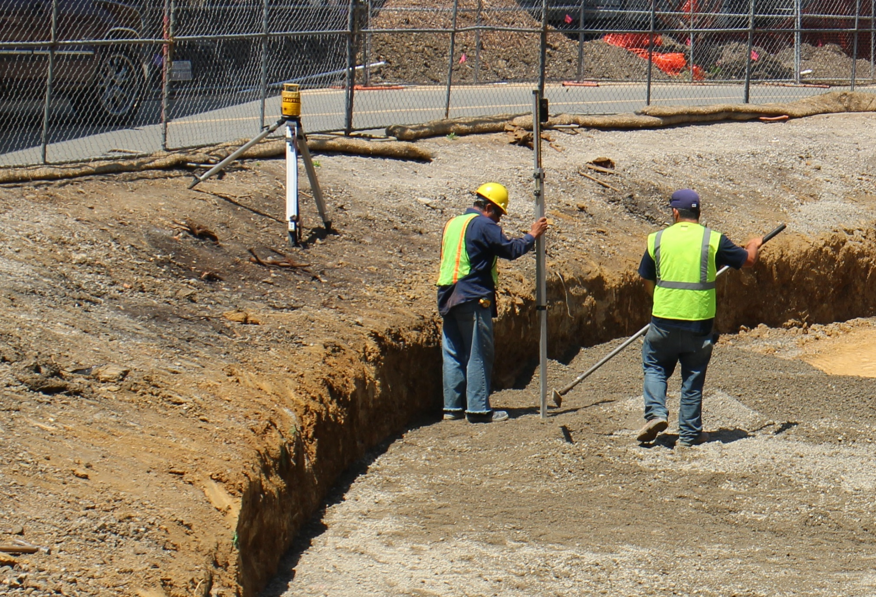
Flat, Flat, Flat

Slide 40
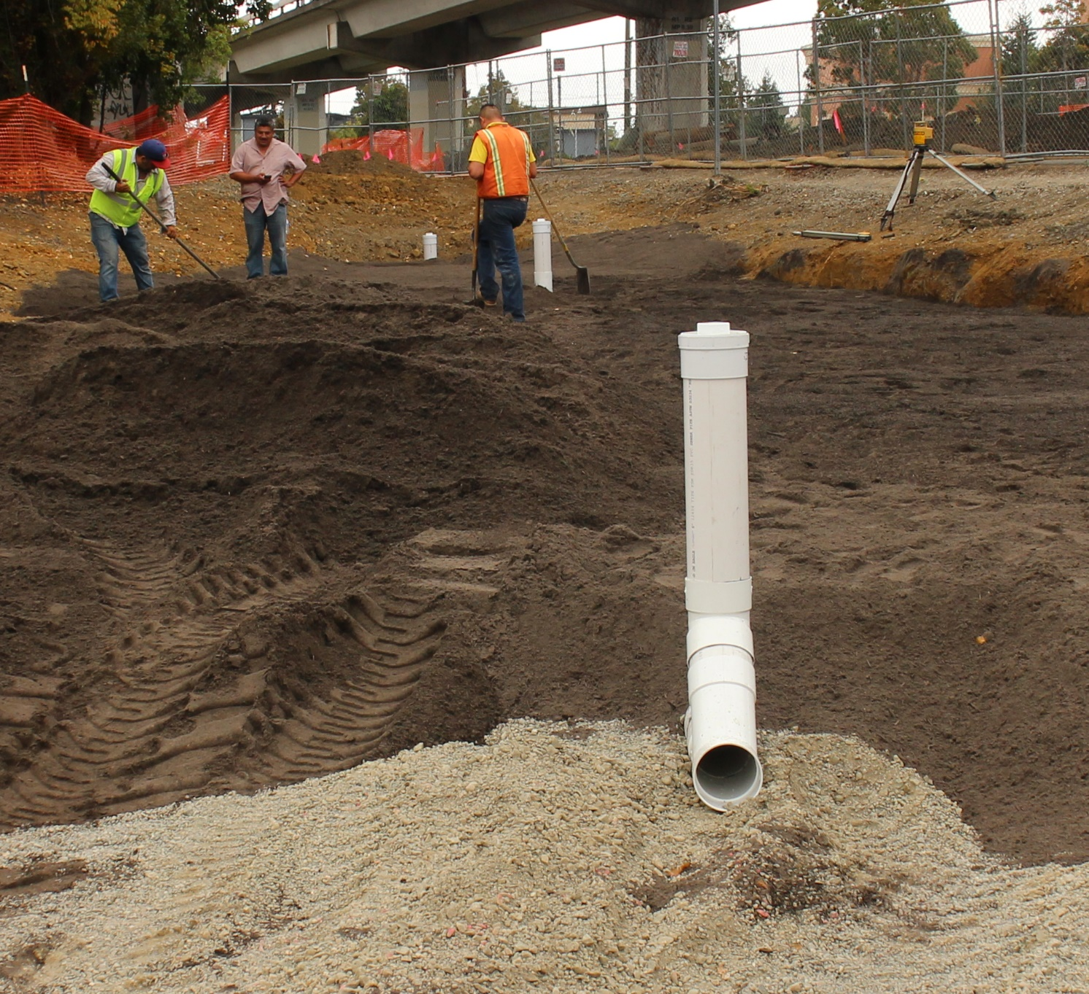
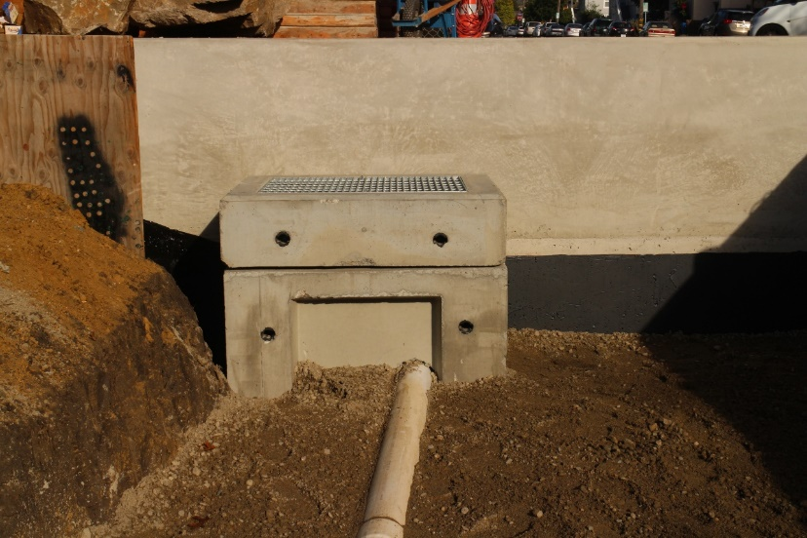
Gravel and Underdrain
    Class 2 permeable
  Caltrans spec 68-2.02(F)(3)
    No filter fabric
    Underdrain
  Discharge elevation at top
  of gravel layer
  PVC SDR 35 or equivalent;
  holes facing down
  Solid pipe for 2' closest
  to outlet structure
  Cleanout

Slide 41
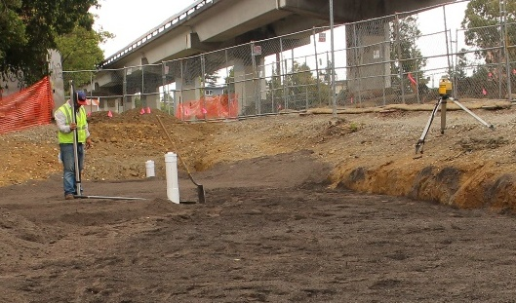
Flat, Flat, Flat

Slide 42
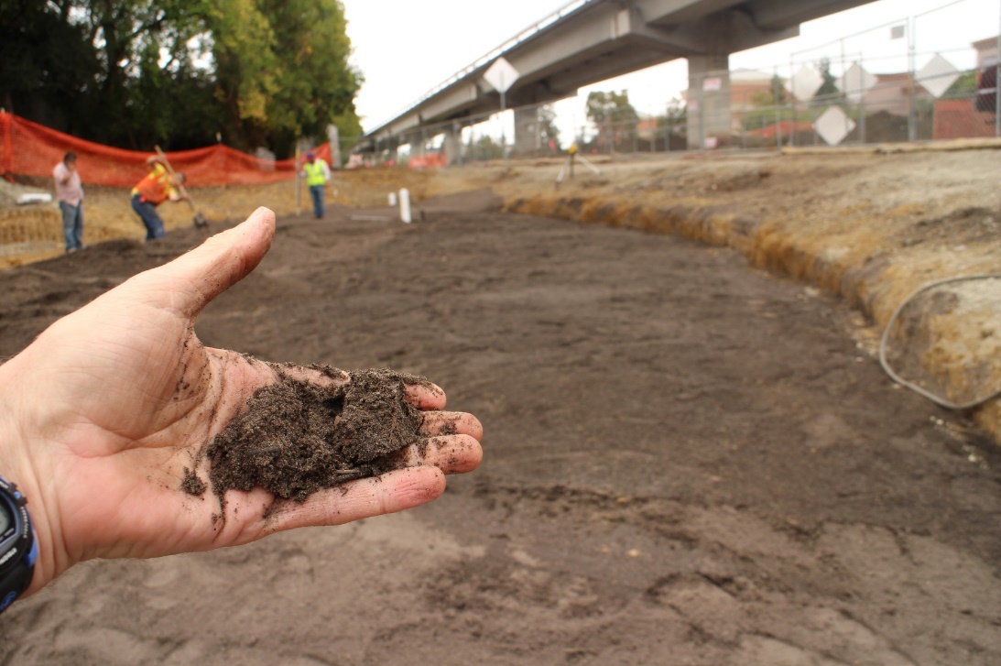
Planting Medium
    60-70% Washed Sand
  ASTM C33 for fine aggregate
    30-40% Compost
  Certified through US Composting Council
  Seal of Testing Assurance Program
    Install in 8"-12" lifts
    Do not compact
    Do not overfill
    Leave room for mulch

Slide 43
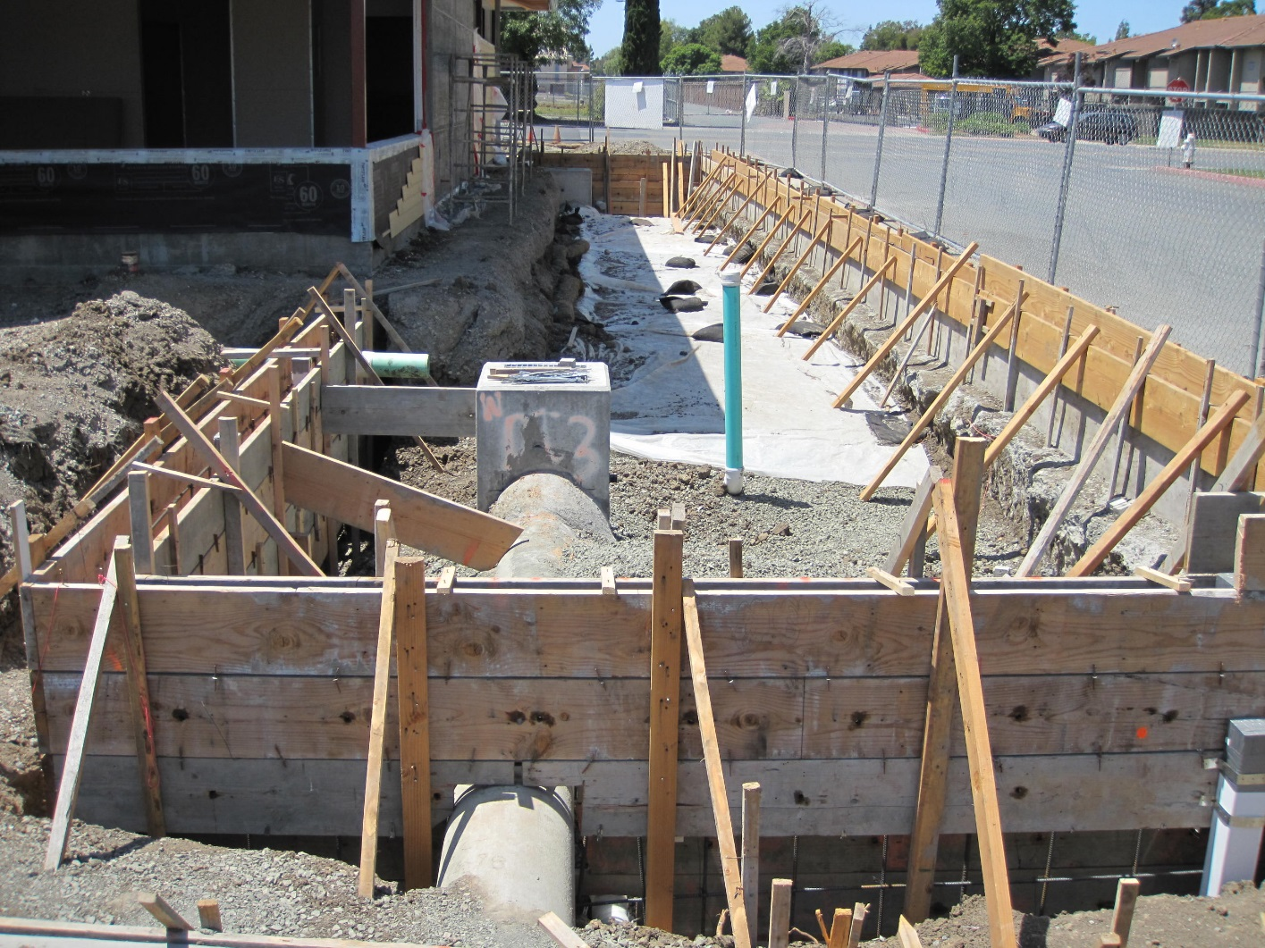
Foundations and Pavement

Slide 44
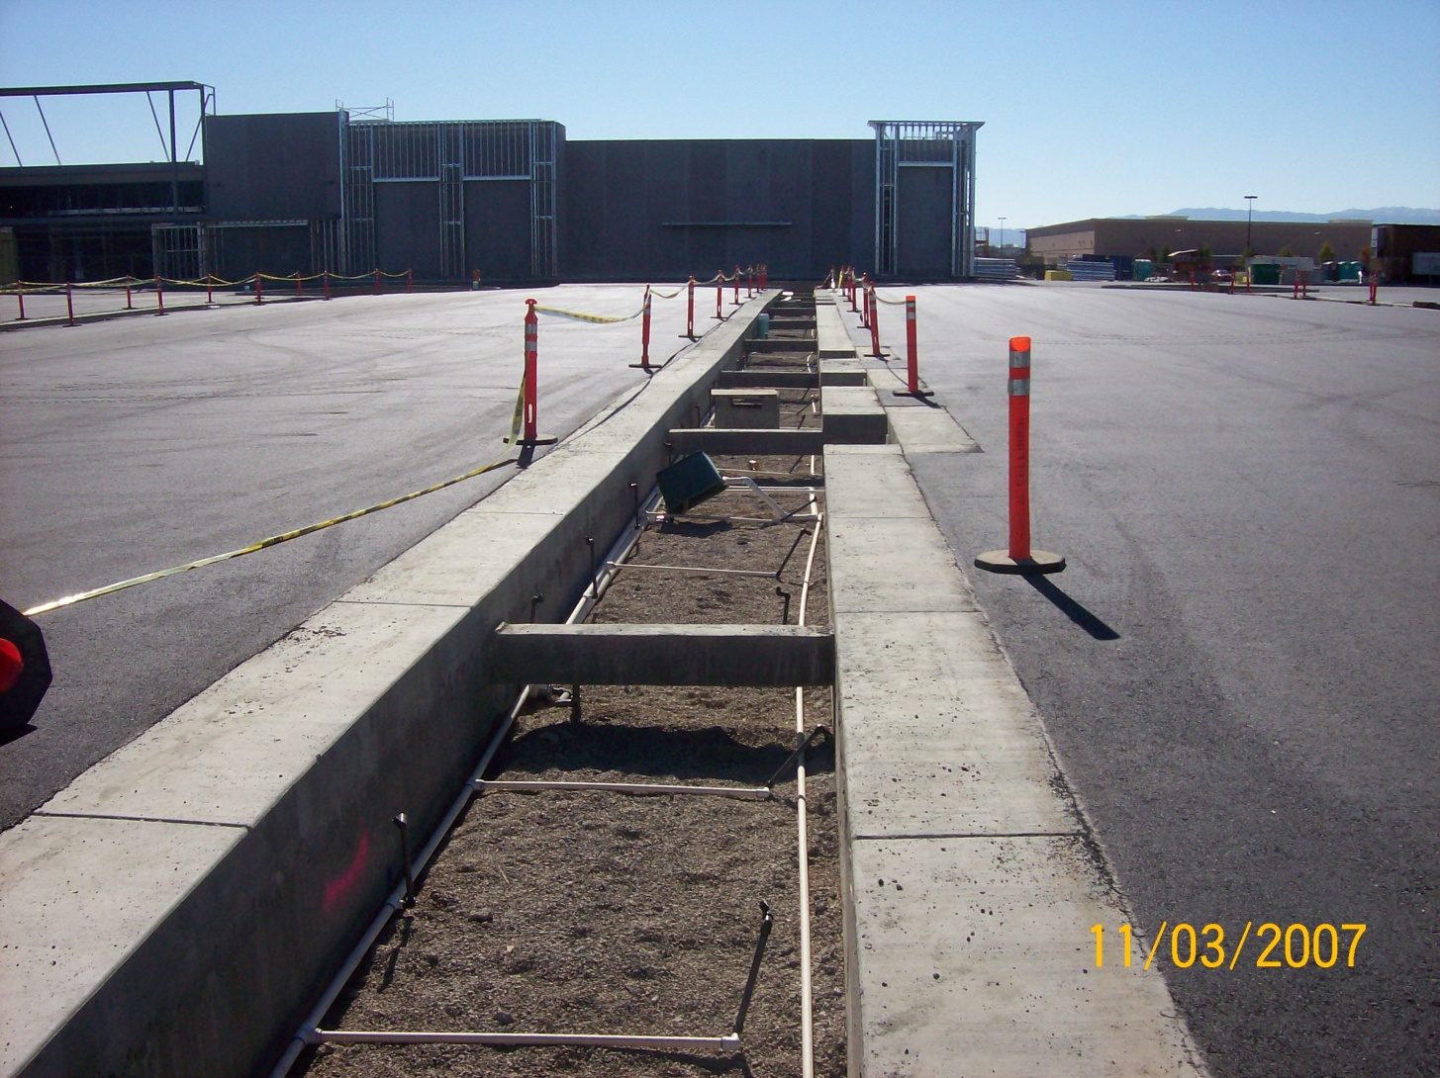
Foundations and Pavement

Slide 45
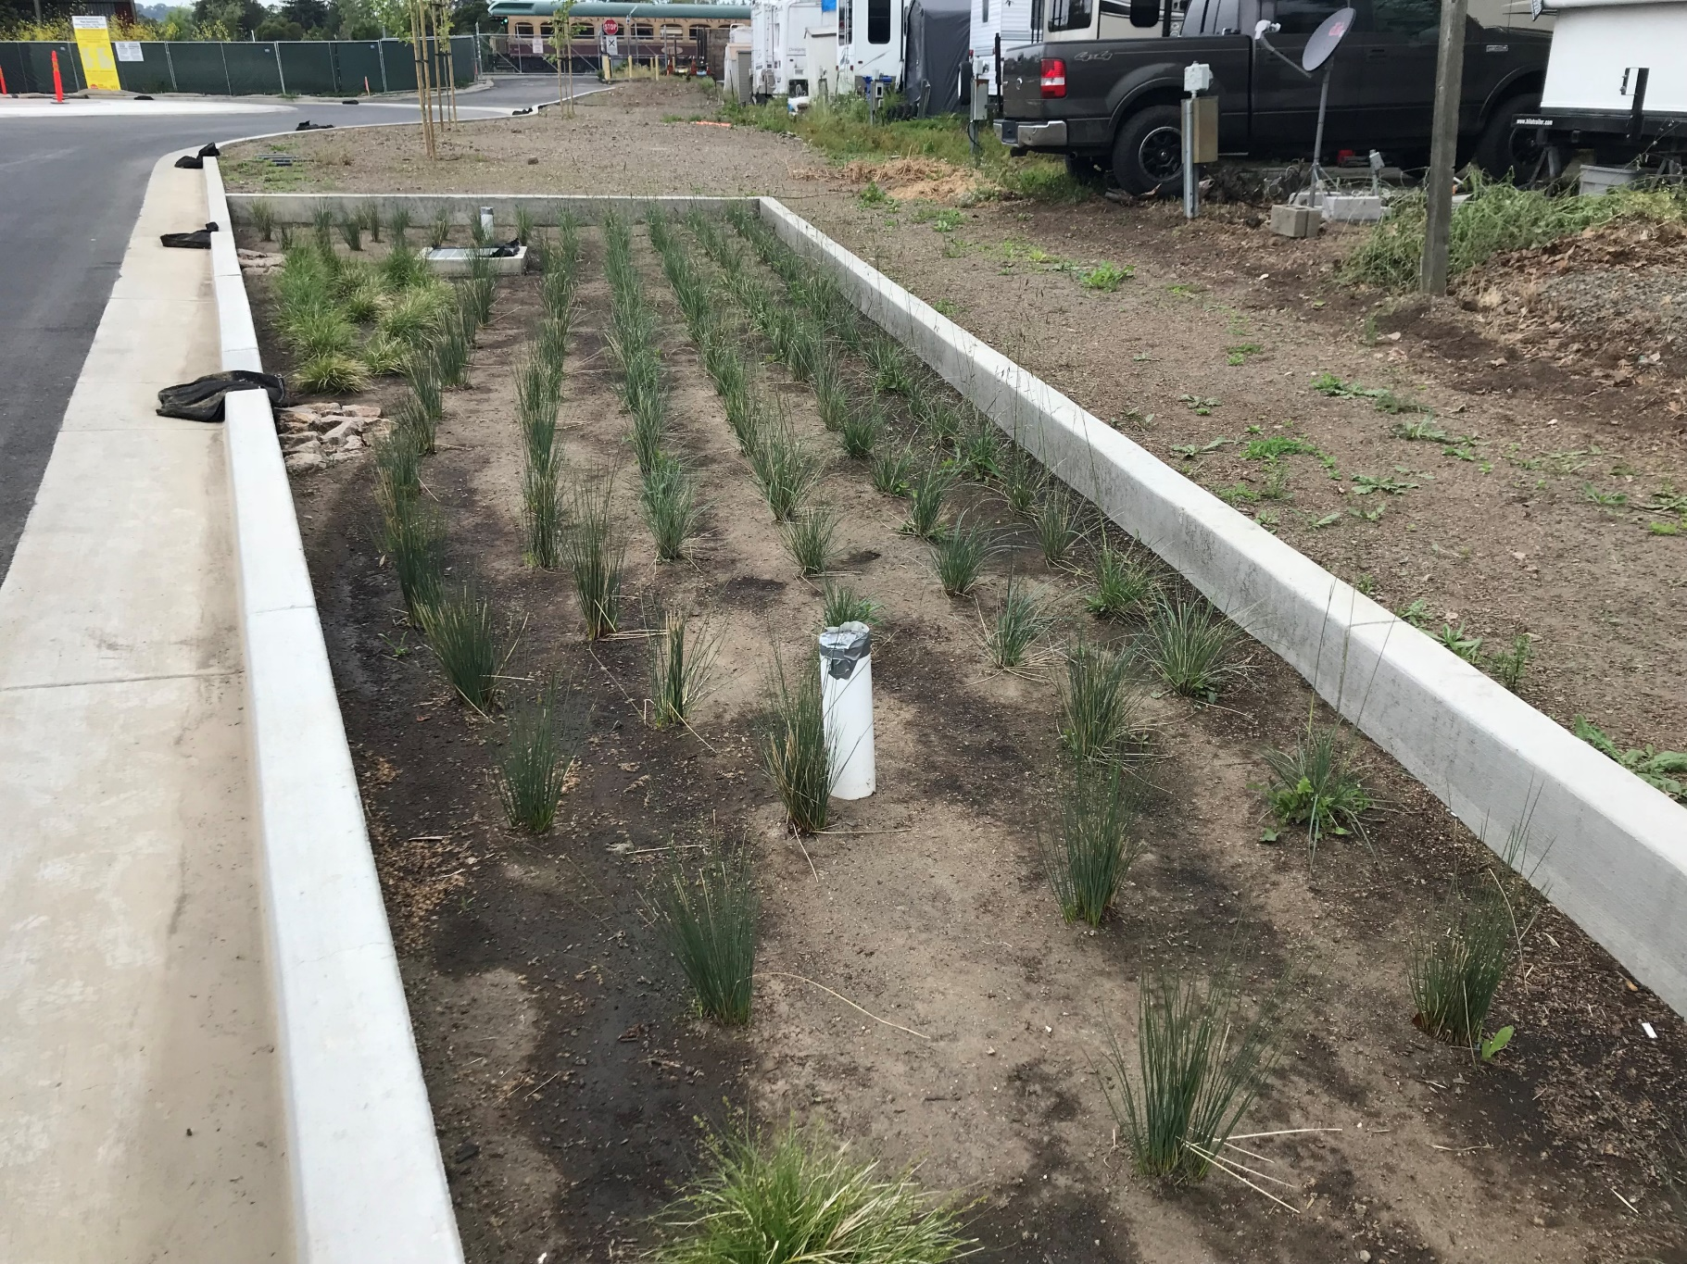
Like this

Slide 46
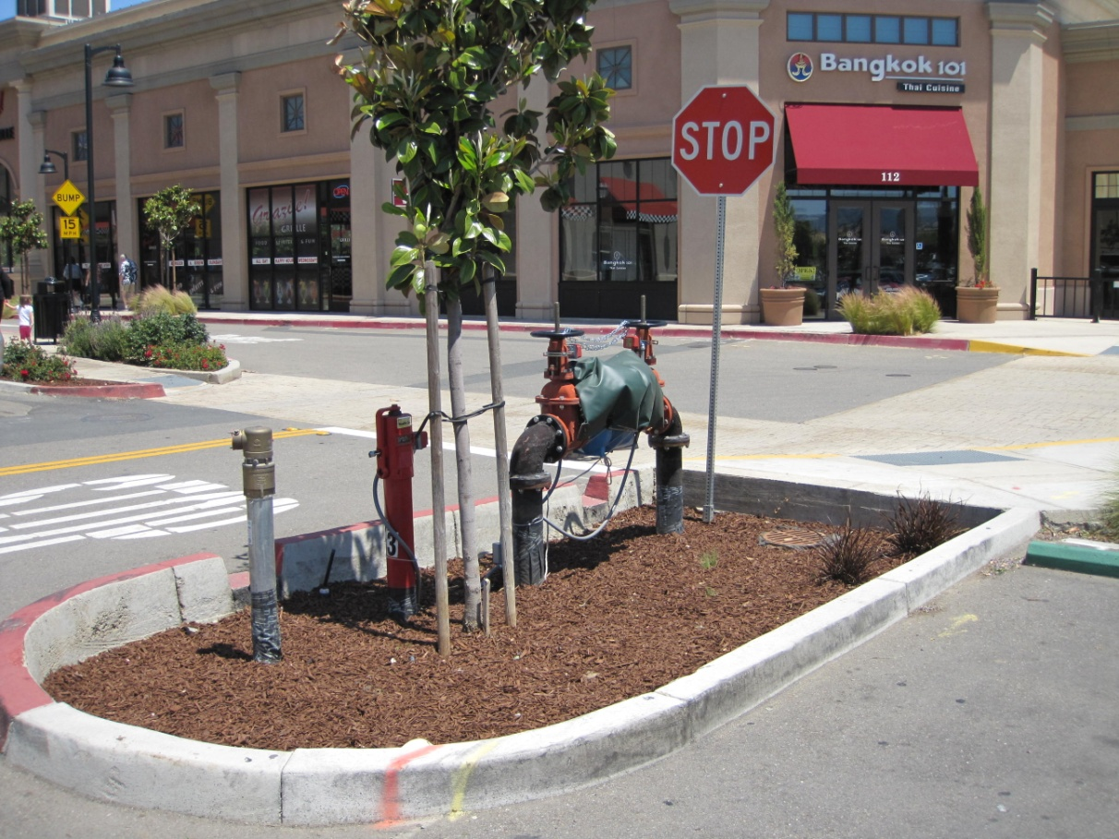
Utilities within bioretention facilities

